Slide 1
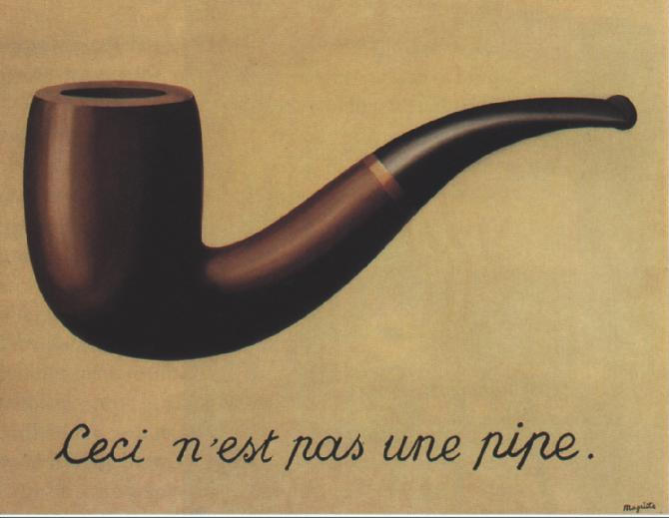

Slide 2
The first Surrealist manifesto was written by Andre Breton and released to the public in 1924. The document defines Surrealism as:
  "Psychic automatism in its pure state, by which one proposes to express -- verbally, by means of the written word, or in any other manner -- the actual functioning of thought. Dictated by the thought, in the absence of any control exercised by reason, exempt from any aesthetic or moral concern."

Slide 3
Quotes
"Although the dream is a very strange phenomenon and an inexplicable mystery, far more inexplicable is the mystery and aspect our minds confer on certain objects and aspects of life.“ de Chirico
"Contrary to prevalent misdefinitions, surrealism is not an aesthetic doctrine, nor a philosophical system, nor a mere literary or artistic school. It is an unrelenting revolt against a civilization that reduces all human aspirations to market values, religious impostures, universal boredom and misery." Franklin Rosemont
"Creativity is that marvelous capacity to grasp mutually distinct realities and draw a spark from their juxtaposition." Max Ernst

Slide 4
Definition
a 20th-century avant-garde movement in art and literature that sought to release the creative potential of the unconscious mind, for example by the irrational juxtaposition of images. [thank you wikipedia!]
Juxtaposition - the fact of two things being seen or placed close together with contrasting effect. "the juxtaposition of these two images"

Slide 5
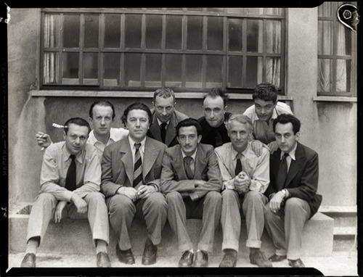

Slide 6
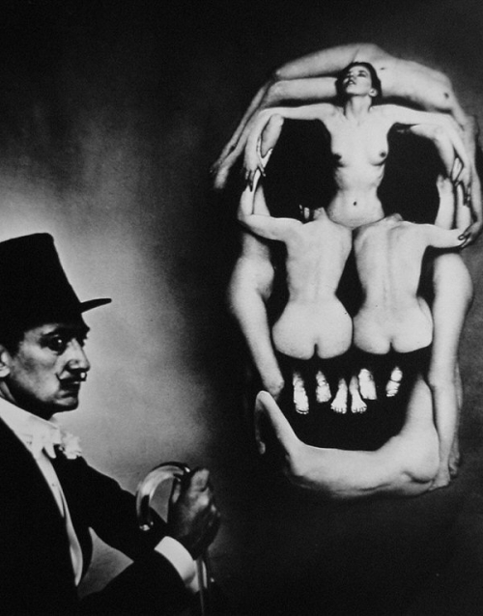

Slide 7
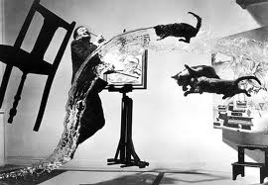

Slide 8
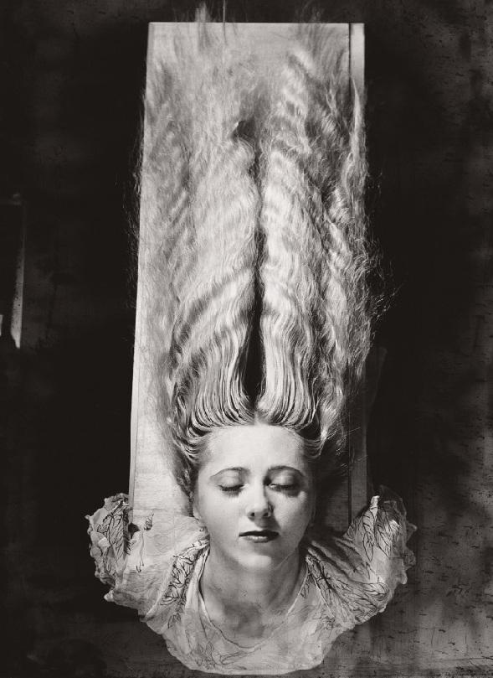

Slide 9
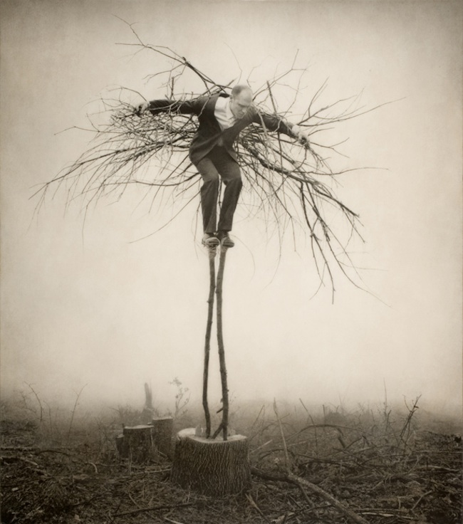

Slide 10
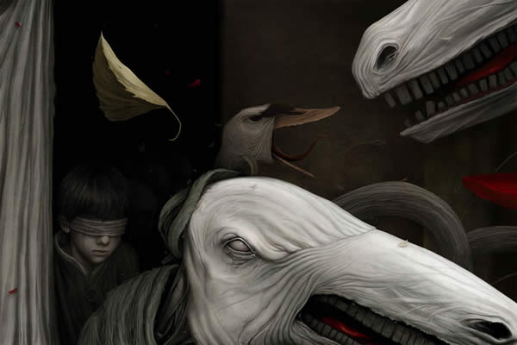

Slide 11
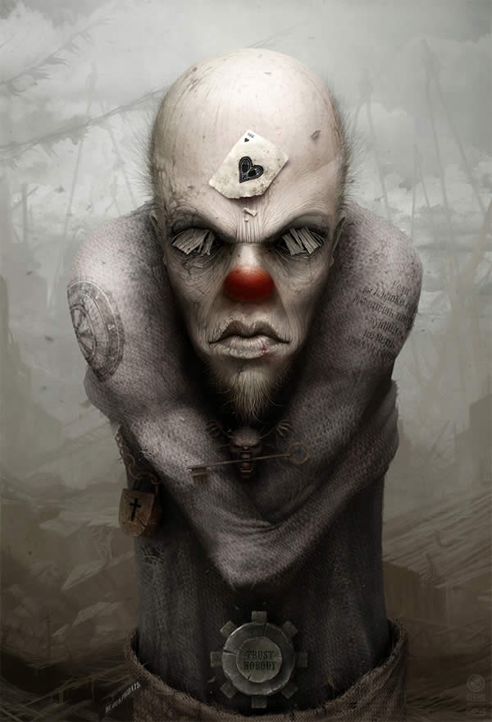

Slide 12
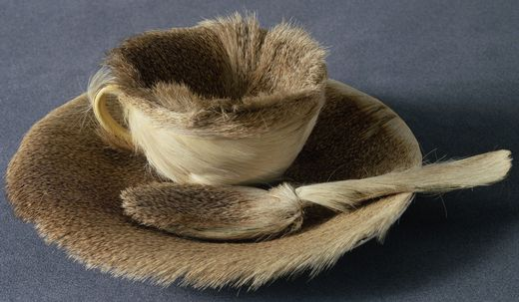

Slide 13
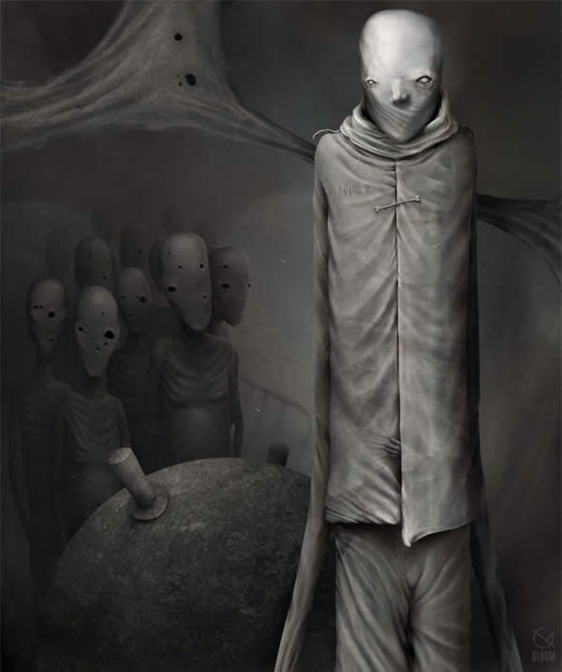

Slide 14
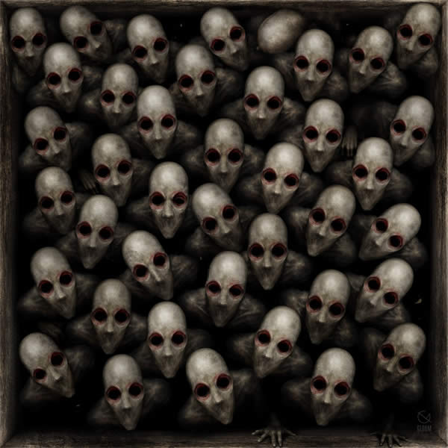

Slide 15
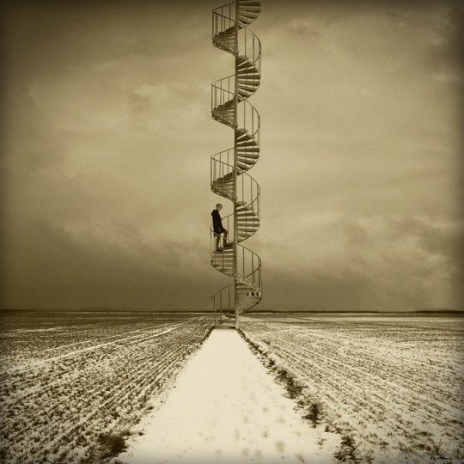

Slide 16
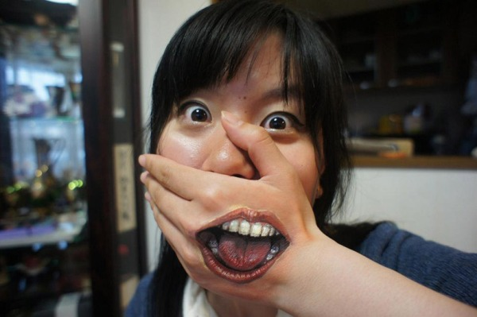

Slide 17
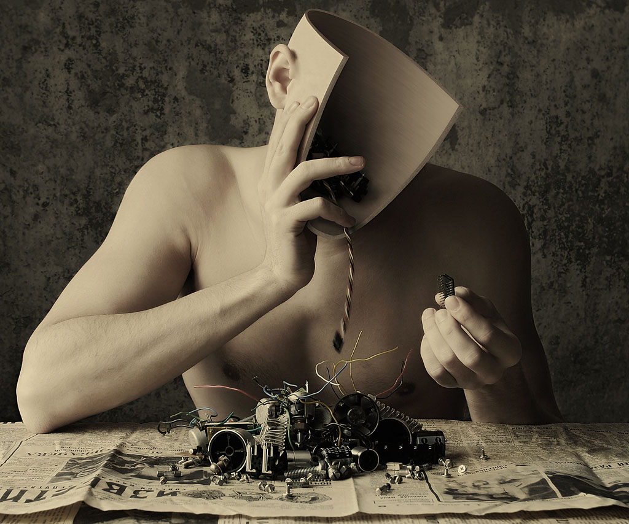

Slide 18
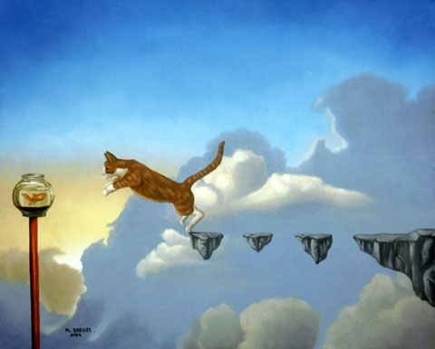

Slide 19
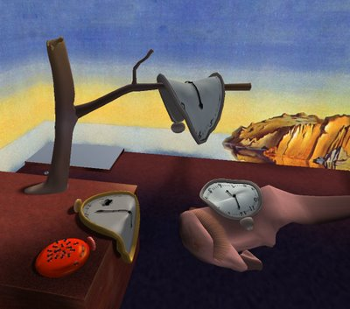

Slide 20
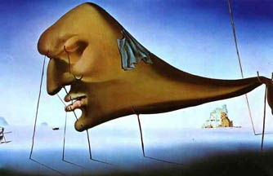

Slide 21
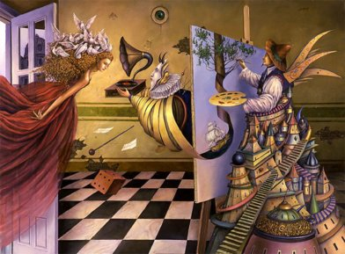

Slide 22
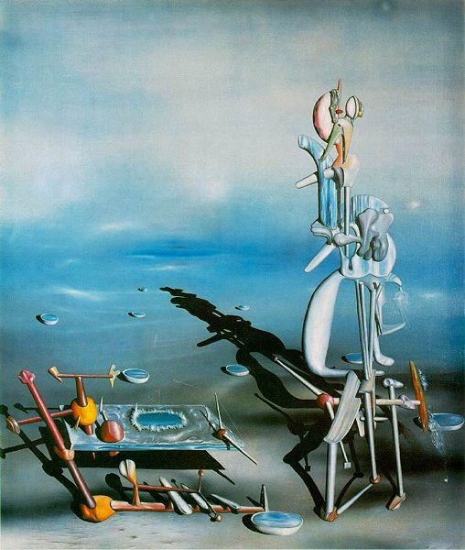

Slide 23
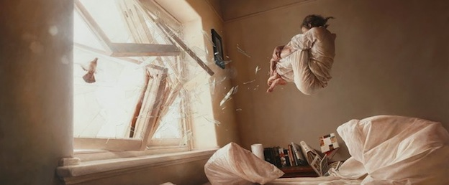

Slide 24
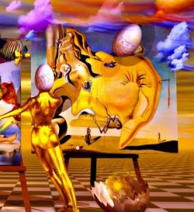

Slide 25
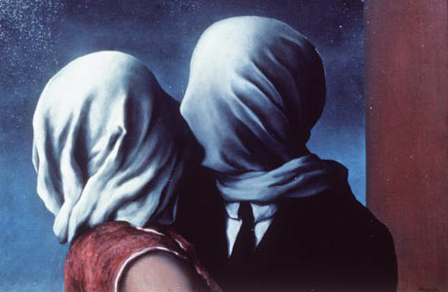

Slide 27
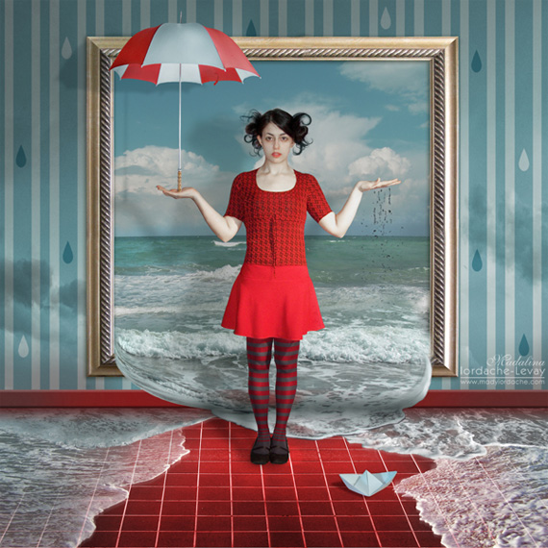

Slide 28
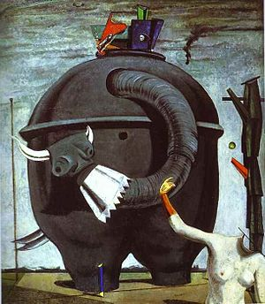

Slide 29
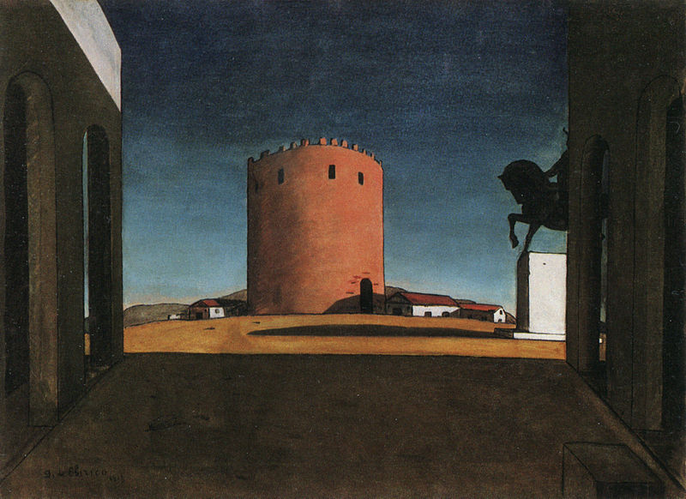

Slide 30
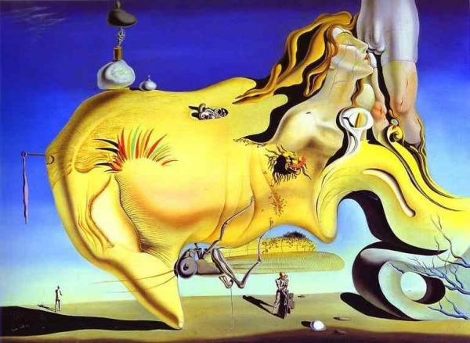

Slide 31
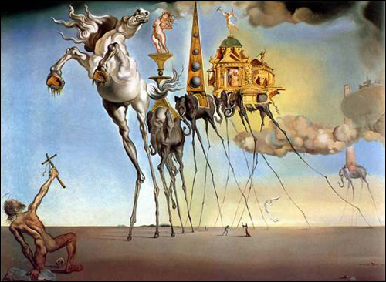

Slide 32
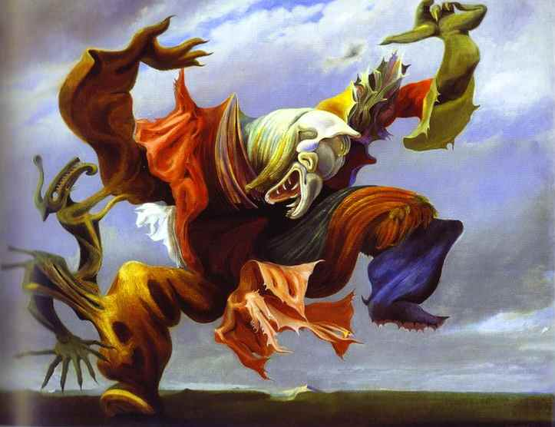

Slide 33
mag·ic re·al·ism
noun
1.
a literary or artistic genre in which realistic narrative and naturalistic technique are combined with surreal elements of dream or fantasy.

Slide 34
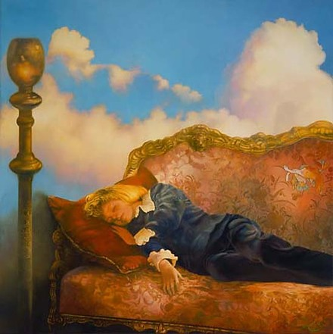

Slide 35
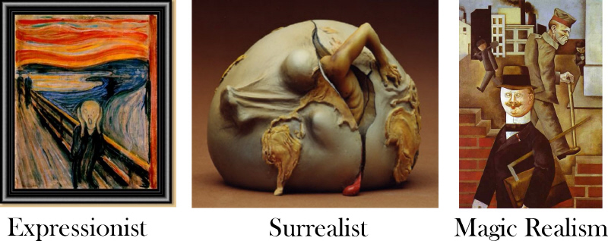

Slide 36
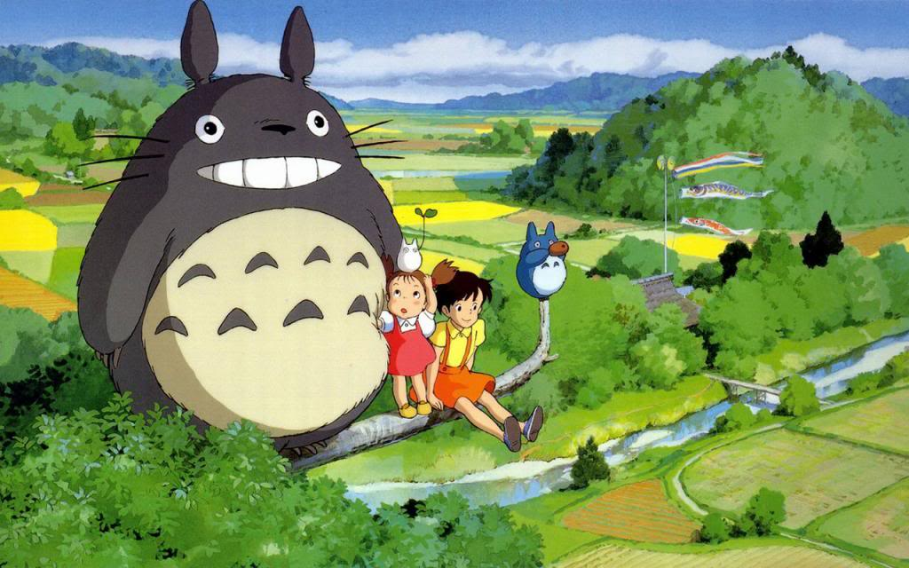

Slide 37
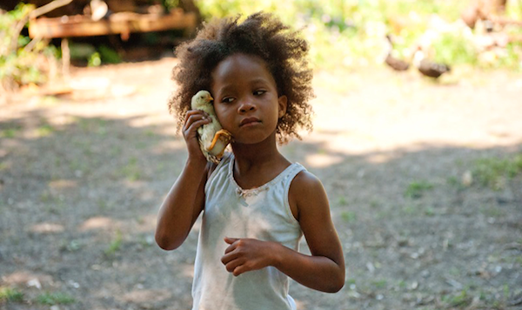

Slide 38
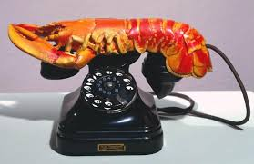

Slide 39
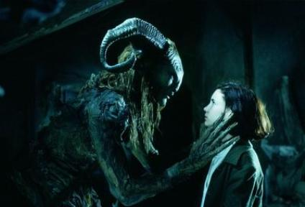

Slide 40
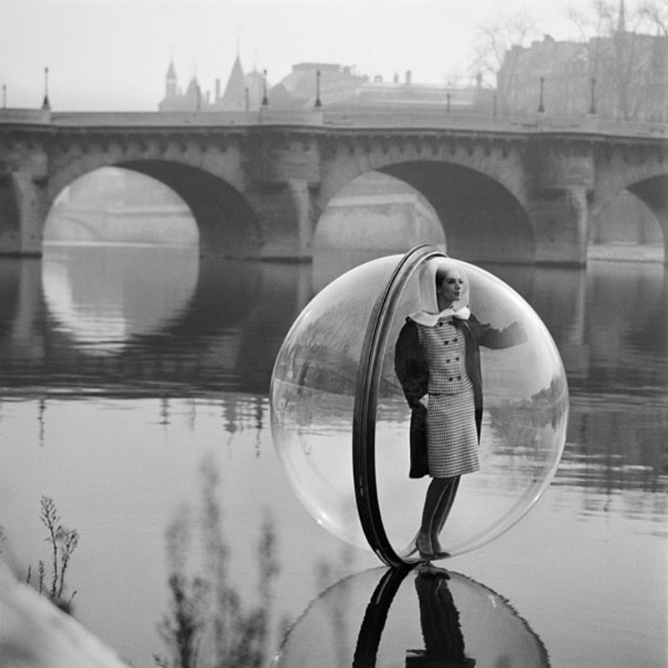

Slide 41
Please pull out a sheet of paper…

Slide 42
What are the qualities [a characteristic or feature that someone or something has] (images, colors, themes, etc) that make the images you just looked at Surreal or images of Magical Realism.
Write a paragraph describing these qualities.
You will have 5 minutes to write this paragraph.
Begin writing five minutes ago…

