Slide 1
Orientalism
Edward Said: “The Orient exists for the West, and is constructed by and in relation to the West. It is a mirror image of what is inferior and alien (‘Other’) to the West.”

Slide 2
Orientalism
Said: “Orientalism [is] the corporate institution for dealing with the Orient--dealing with it by making statements about it, authorizing views of it, describing it, by teaching it, settling it, ruling over it; in short, Orientalism as a Western style for dominating, restructuring, and having authority over the Orient.”

Slide 3
Orientalism
The Oriental man: depicted as feminine, weak, yet dangerous in his threat to white, Western women
The Oriental woman: depicted as eager to be dominated, strikingly exotic
These are sweeping generalizations that cross national and cultural boundaries

Slide 4
Orientalism
The Orient is considered:
Separate
Backwards
Eccentric
Sensual
Passive

Slide 5
Orientalism
[The Orient] displays feminine penetrability and supine malleability. Its progress and value are judged in terms of, and in comparison to, the West, so it is always the Other, the conquerable, and the inferior.

Slide 6
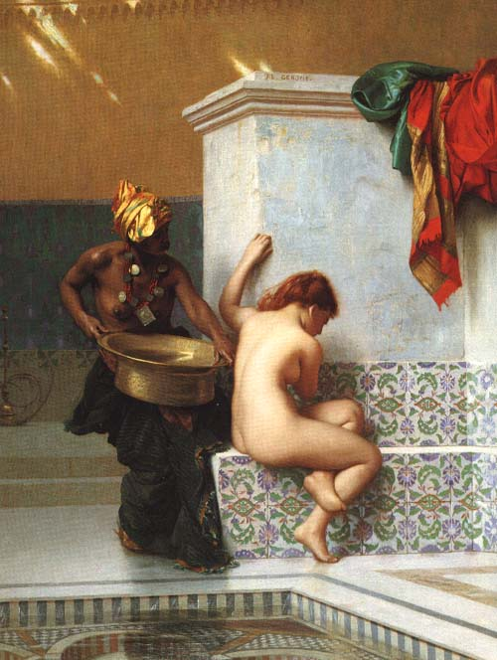
Jean-Léon Gérôme
Moorish Bath
1870

Slide 7
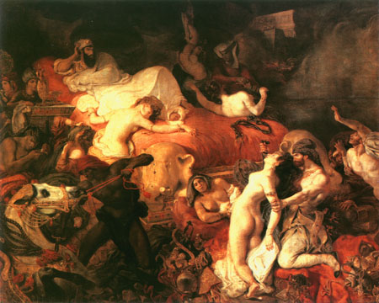
Delacroix
Death of Sardanapalus
1827

