Slide 1
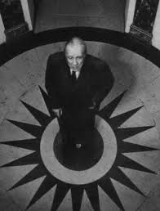
Jorge Francisco Isidoro Luis Borges, known as Jorge Luis Borges, was an Argentine short-story writer, essayist, poet and translator who was born in Buenos Aires. His work embraces the "character of unreality in all literature“ Born August 24, 1899. Died June 14, 1986

Slide 2
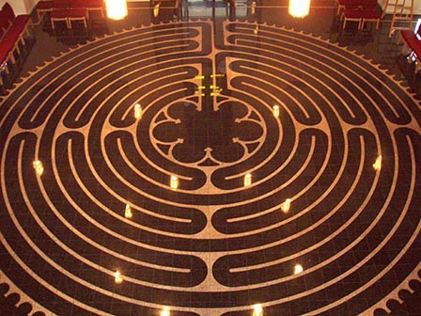
Labyrinth

Slide 3
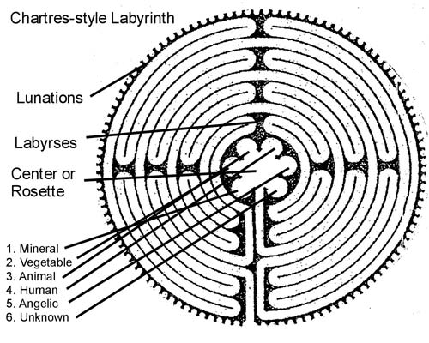

Slide 4

Maze

