Slide 1
Arguing FOR and AGAINST the Veil

Slide 2
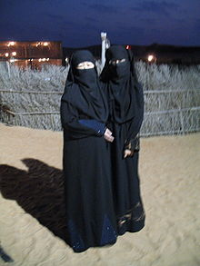
Abaya

Slide 3
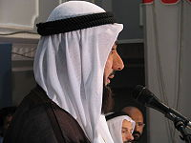
Agal - a thin black cord to keep the Ghutra in place

Slide 4
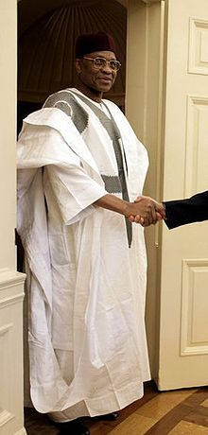
Boubou

Slide 5
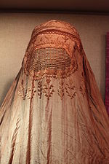
Burqa

Slide 6
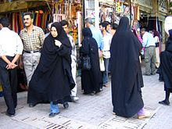
Chador

Slide 7
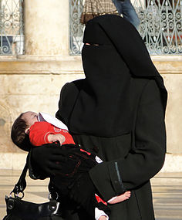
Niqab

Slide 8
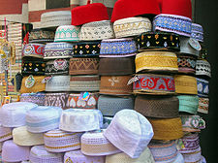
Taqiyah

Slide 9
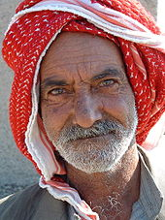
Keffiyeh

Slide 10

Thawb

Slide 11
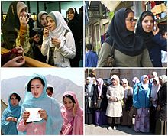
Hijab

Slide 12
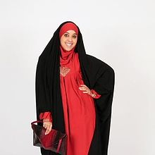
Jilbab

Slide 13
For or against???
Arguing FOR and Against the Veil
Your goal is to gain exposure to the practice of veiling women (either mandated or voluntary), both inside certain Muslim nations as well as in non-Muslim nations.

Slide 14
A Complex issue
There are many misperceptions about this practice.
Modesty is required.
Identify arguments for and against veiling.

Slide 15
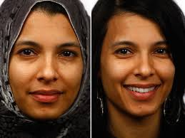
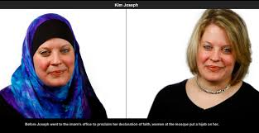
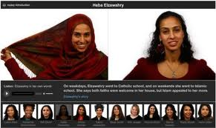


Slide 16
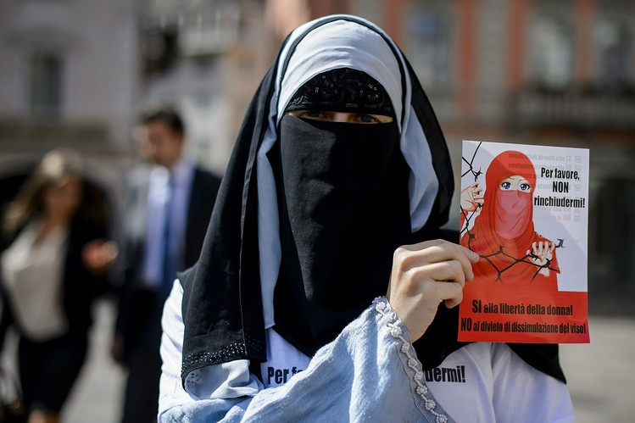
European Human Rights Court Upholds France's Burqa Ban

