Slide 1
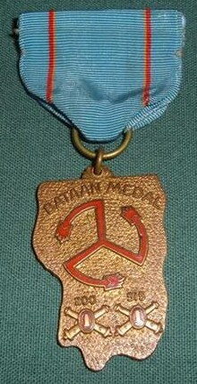
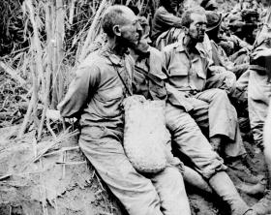
World War II From a New Mexican Perspective

Slide 2
Playing a critical role
New Mexico began playing a critical role in the emerging role between science and military in the 1940s.
This started with the testing of the variable-timed radio proximity-fused artillery shells.
Airplanes suspended over the desert mesa near Kirtland were used as targets.
“The proximity fuze helped blaze the trail to Japan.” James Forrestal, Secretary of the Navy.

Slide 3
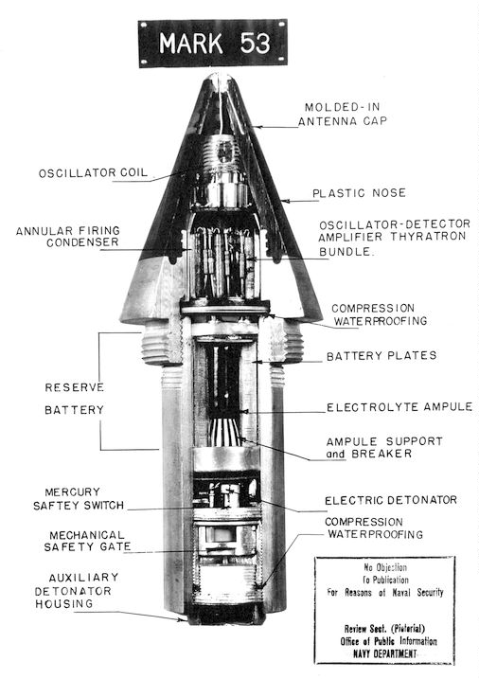

Slide 4
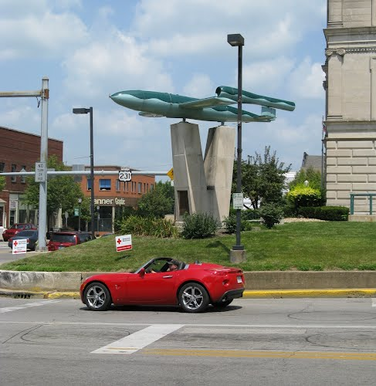
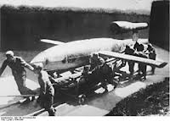
Winston Churchill said…
“These so called proximity fuzes, made in the United States proved potent against the small unmanned aircraft (V-1)with which we were assailed in 1944.”

Slide 5
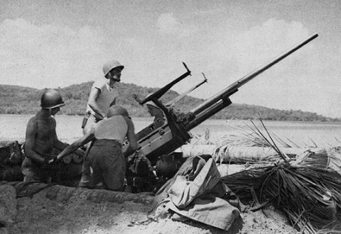
200th Coast Artillery and 515th Coast Artillery
This unit was selected for an overseas assignment and was shipped out to the Philippines in August 1941.
They were posted north of Manila.
They had never fired a live round from an anti-aircraft gun.

Slide 6
December 8, 1941
200th knew of Pearl Harbor through radio reports.
Japanese fighter planes arrived at 12:20 pm
7 out of the 300 Japanese planes that attacked the Philippines were shot down.
WWI style powder train fuses and obsolete ammunition were to blame for the poor shooting record.
3 inch guns were effective up to 20,000 feet.

Slide 7
What happened?
After the Japanese attack the Provisional 200th Coast Artillery (AA) of Manila was created.
Staffed with 1/3 officers and troops of the 200th.
Provided anti-aircraft protection for the city of Manila.
The 200th was sent to provide relief and cover for the retreat of Luzon Force into Baatan.

Slide 8
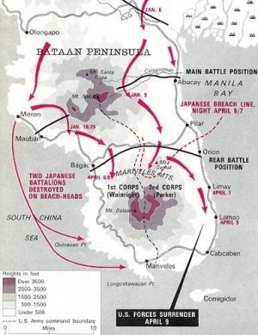
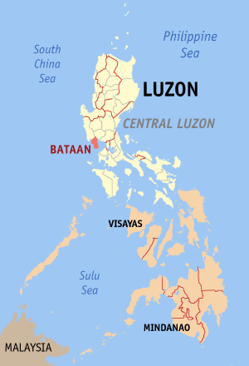

Slide 9
More shells are needed
The 200th needed to expend more anti-aircraft shells because the Japanese planes got ‘personal’ about it and began shooting the anti-aircraft batteries.
Daily expenditure rates went from 400 rounds to 1,000 rounds per day.
However, on April 9th, 1942 all that ended.
General King ordered allied forces to surrender leaving the 200th and 515th to resist the Japanese.

Slide 10
Bataan
The 200th was designed to provide air support and were not trained as ground troops.
They were the last line of defense along a ridge on the south side of Cabcaben Airfield at the tip of Bataan peninsula.
They faced better trained Japanese troops.
On April 9 1942, 47,000 were taken prisoner, denied food and water, robbed of personal possessions and were forced to march.

Slide 11
Death March
65 mile march to San Fernando
Claimed the lives of 16,950 Americans.
Many were beheaded, clubbed or beaten to death and left to die on the side of the road.
Marched to Camp O’Donnell which had been used as a training camp for Philippine Army recruits.
35,000 survivors had one working water faucet.

Slide 12
What General MacArthur said:
“History I am sure will record the defense of the Philippines as one of the decisive battles of the world. It’s protracted struggle enabled the United Nations to gather strength to resist in the Pacific. Had it not held out, Australia would have fallen with incalculable results.”
It was the largest surrender of U.S. troops in history.
It was a military disaster.
“I came out of Bataan and I shall return.” MacArthur would later say.

Slide 13
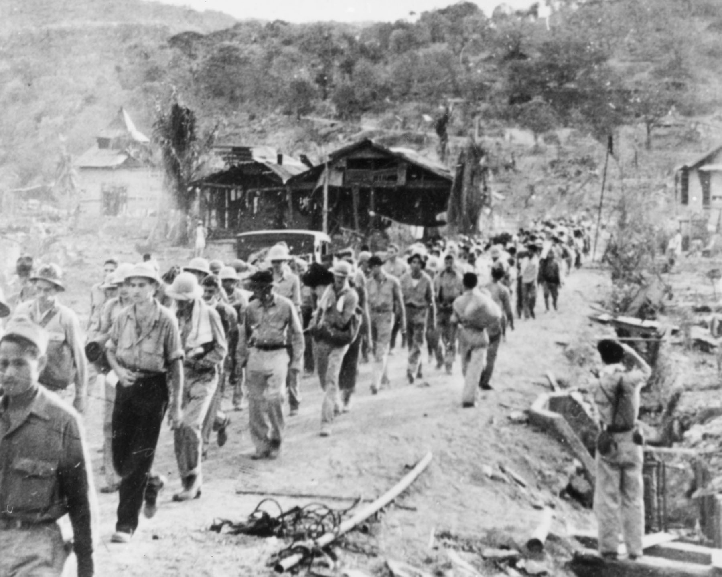

Slide 14
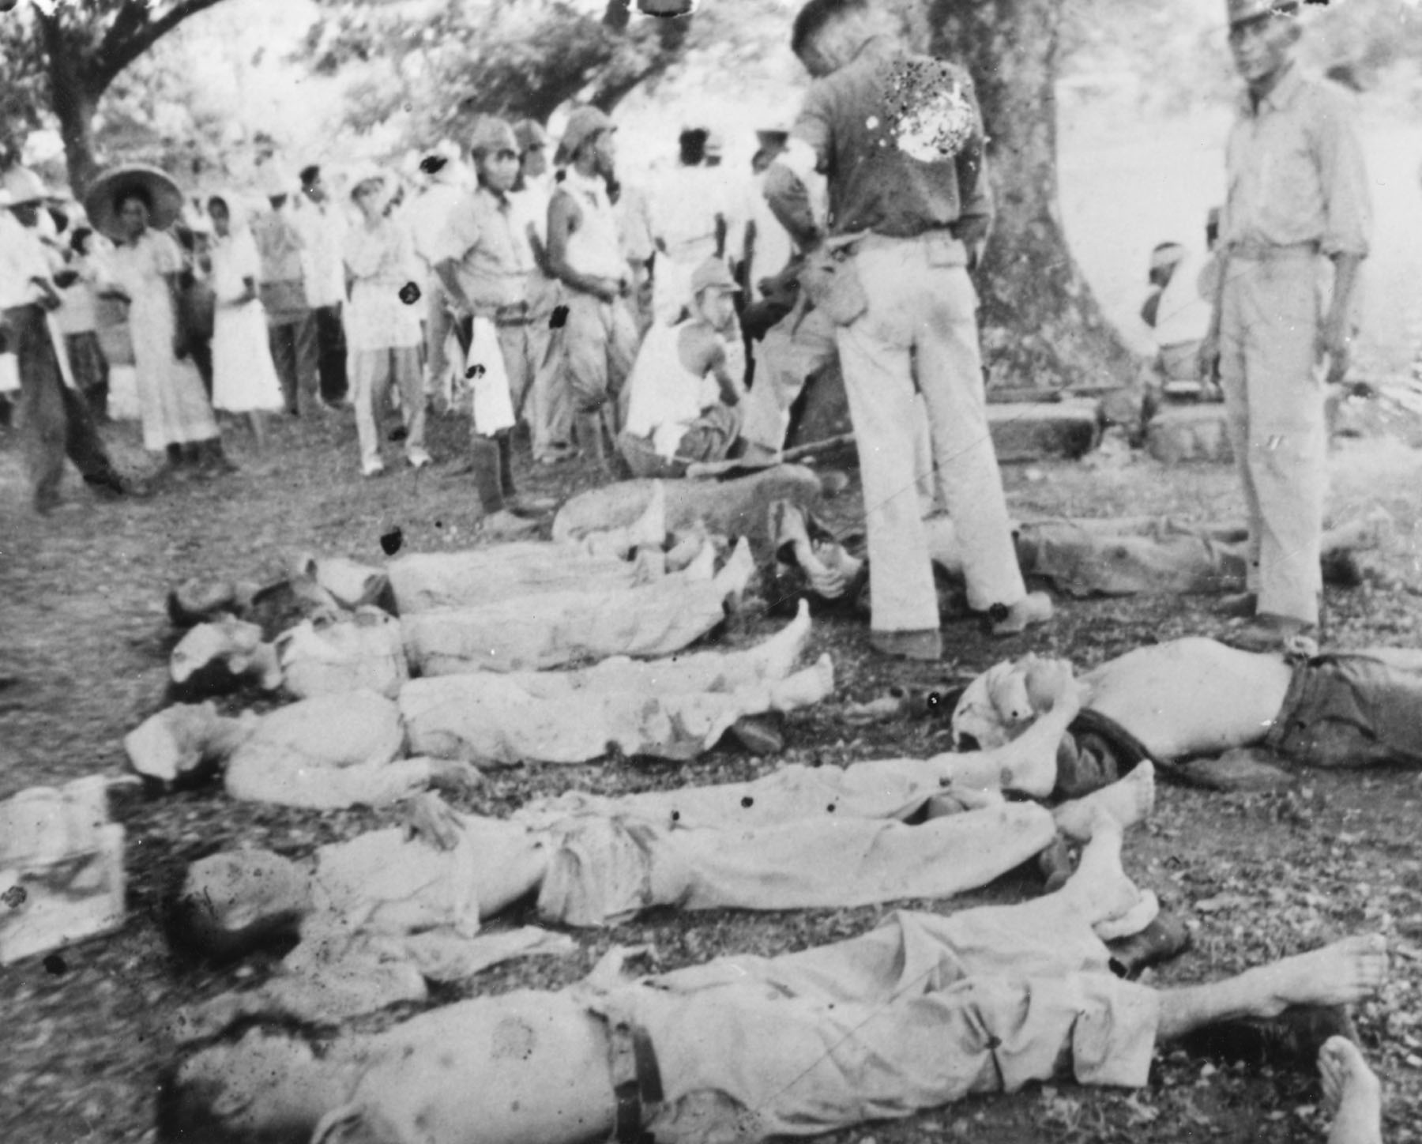

Slide 15
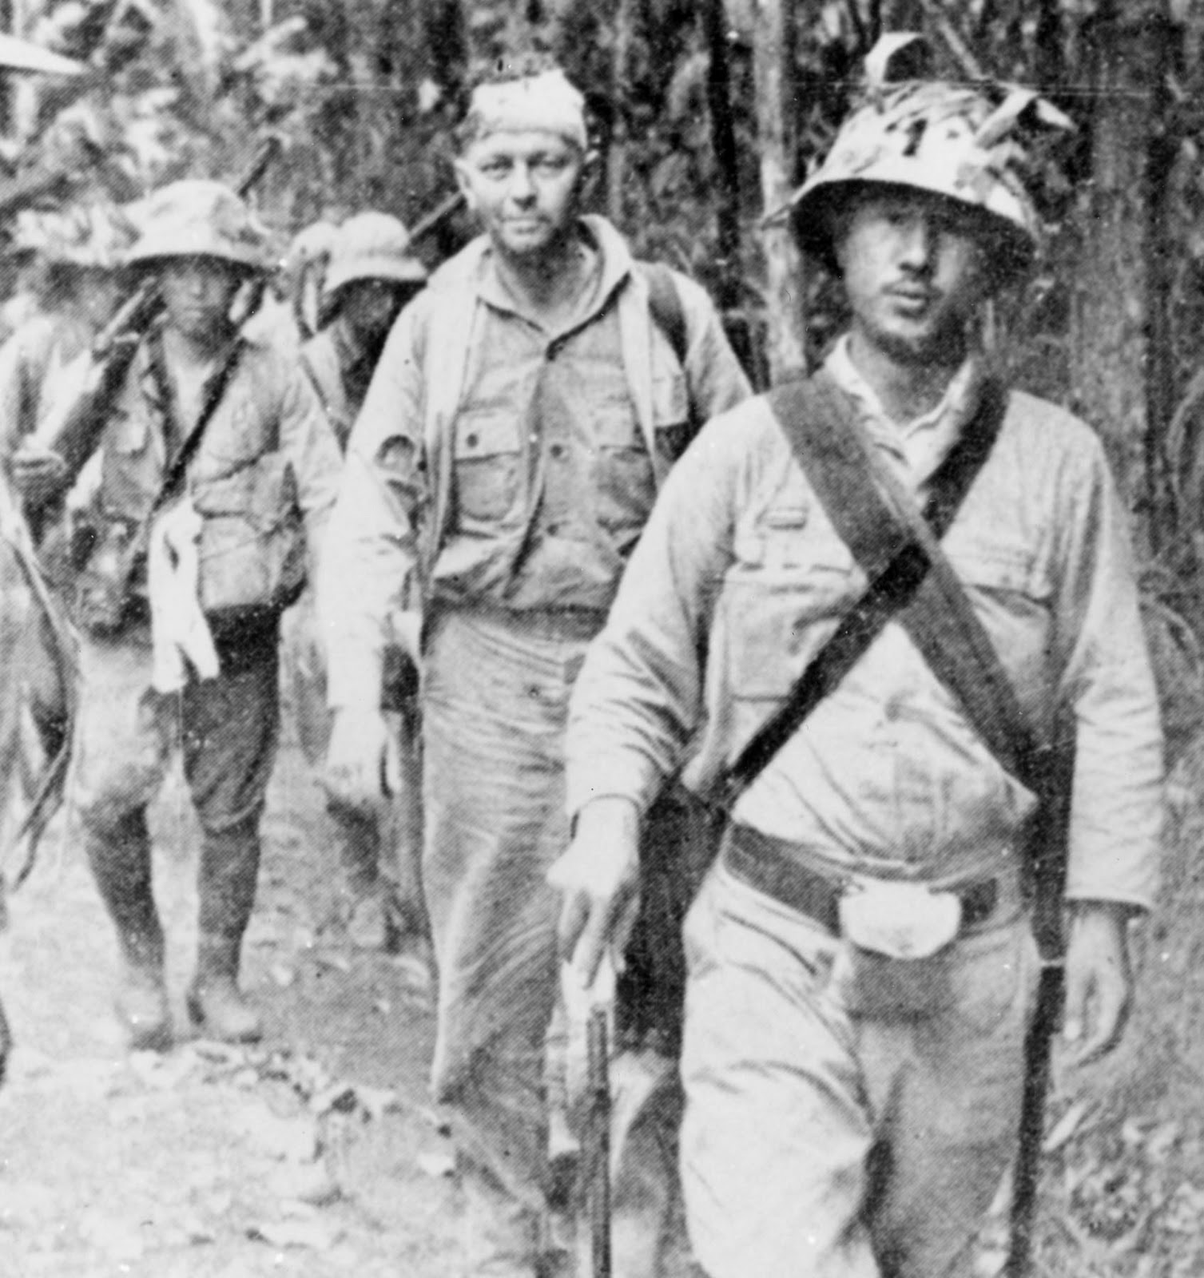

Slide 16
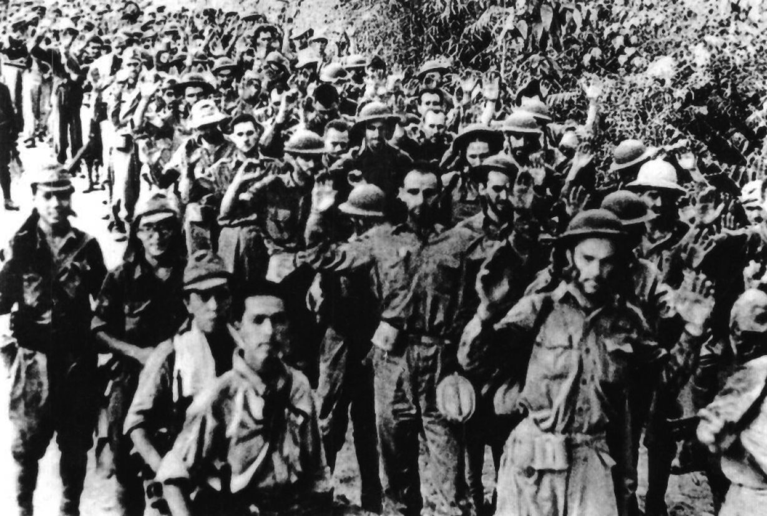

Slide 17
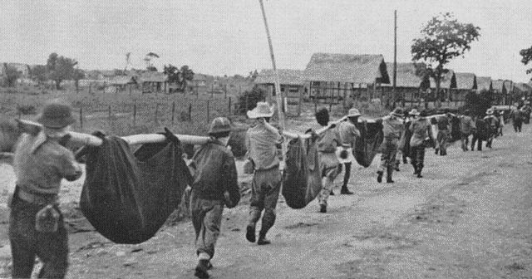

Slide 18
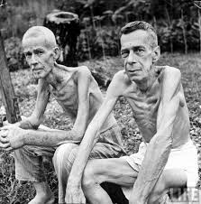
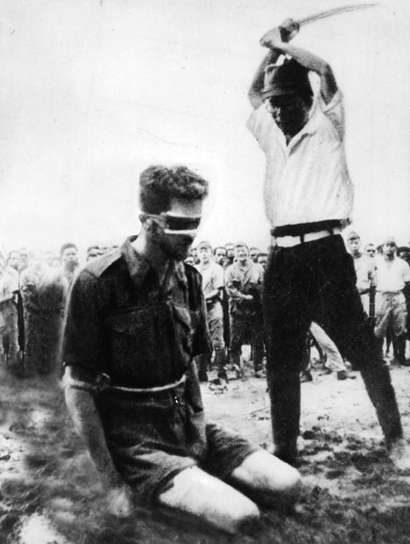

Slide 19
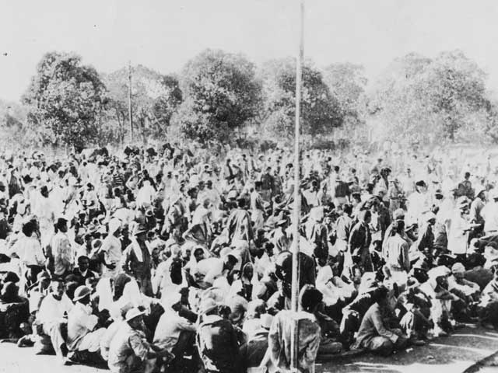
Camp O’Donnell

Slide 20
Survivors
At war’s end only about half of the 1,800 New Mexicans who originally shipped out to the Philippines returned home.
Only about half of those men survived another year.
After the war, the Purple Heart, Bronze Star, Prisoner of War and “Mac Arthur” medals were awarded to those who served in these units.
Some troops were awarded the Silver Star medals in recognition of their heroism in combat.

Slide 21
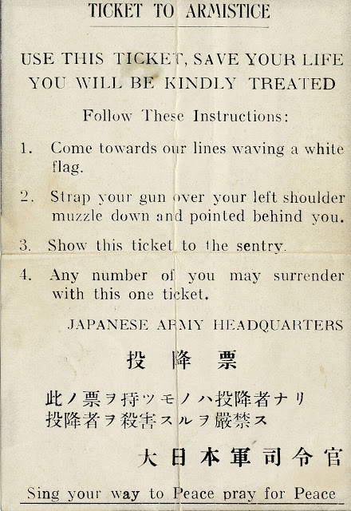

Slide 22
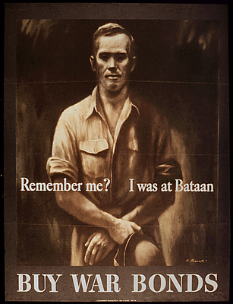
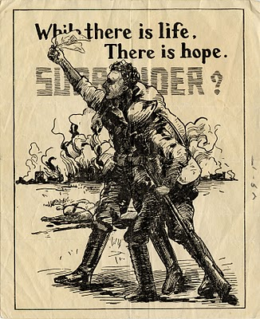

Slide 23
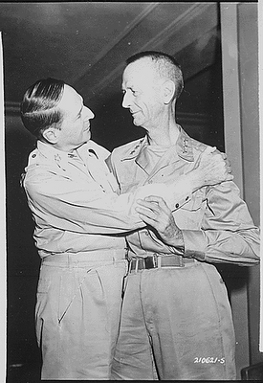
This National Archives Photo shows Douglas MacArthur and Lieutenant General Jonathan Wainwright greeting each other August 31, 1945 in Japan. It was their first meeting since parting on Corregidor more that three years before.

Slide 24
Discussion points:
What was the role and impact of New Mexico and New Mexicans in World War II?
2. How did the Bataan Death March help to define New Mexico as a state?

