Slide 1
Why is this an effective speech?

Slide 2
Lou Gehrig understood that rhetoric is always situational.
What is rhetoric?
Defined by the Greek philosopher Aristotle: “The faculty of observing in any given case the available means of persuasion.”

Slide 3
What is the meaning of ‘situational’?
The occasion or the time and place it was written or spoken.
What is the purpose of the speech?
Purpose: the goal that the speaker or writer wants to achieve.
What is Gehrig’s main idea?

Slide 4
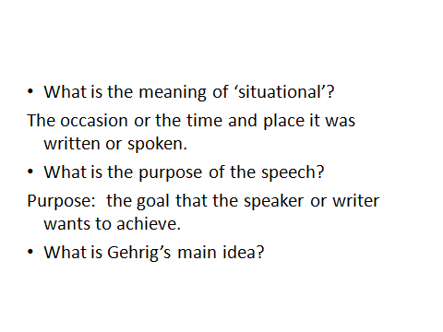

Slide 5
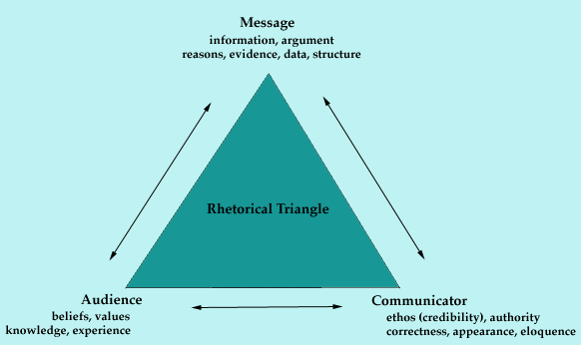

Slide 6
Ethos – An appeal to character to demonstrate credibility and trustworthiness
Logos – Offering of clear, rational ideas, thesis, details, facts.
Pathos – an appeal to emotion.

