Slide 1
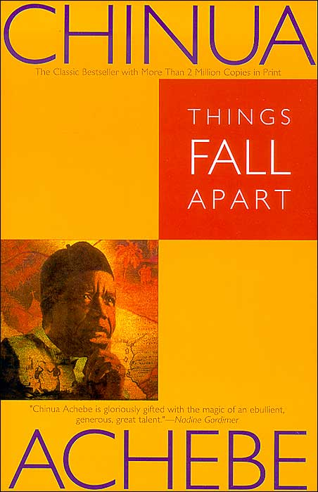
An Introduction to
Things Fall Apart

Slide 2
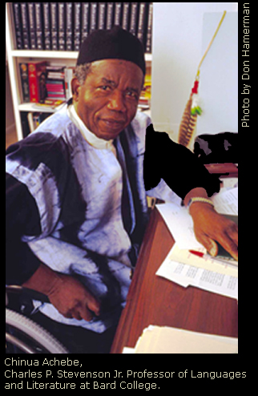
Chinua Achebe
(Shin’wa Ach-ab-ba)
Born 1930 in Nigeria
Writes about the breakdown of traditional African Culture in the face of European Colonization in the 1800s.
Sought to educate his fellow Nigerians about their culture and traditions.

Slide 3
Author’s Purpose
His first novel, Things Fall Apart, depicts the confrontation between the Igbo people of Southeast Nigeria and the British who came to colonize them.
“Achebe tells the story from an African point of view, showing that the Igbo were not "savages” needing to be civilized, as the European conquerors believed, but intelligent human beings with a stable, ordered society and rich tradition.”

Slide 4
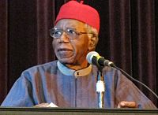
Author’s Background
Achebe was raised as a devout Christian.
His father was a teacher in a missionary school.
Achebe recalls that his family called themselves “the people of the church” and thought of non-Christians – including Achebe’s uncle, who still practiced traditional religion – as “heathen” or “the people of nothing.”
Achebe later rejected this thought, along with his European name “Albert.”

Slide 5
Author’s Work
Achebe left during the Nigerian Civil War of Independence (1967) to travel Europe and America to educate people about the cause.
In 1990, a car accident in Nigeria leaves Achebe paralyzed. He accepts a position to teach college in New York state.
He extends his stay in the U.S., due to the military coups in Nigeria in 1993 and recent corruption in the government.

Slide 6
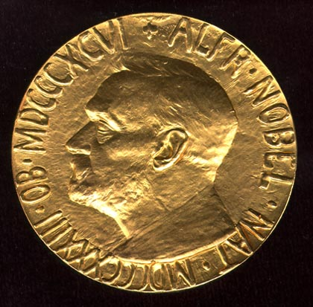

Achebe’s Style
Achebe blends a formal European style of writing (the novel) with African story-telling
He influenced other African writers and pioneered a new literary style using
Traditional idioms
Folk tales
Proverbs
Achebe is a “social novelist.” He believes in the power of literature to create social change.

Slide 7
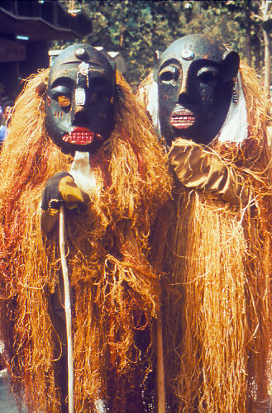
Background on Nigeria
History dates to Nok culture of 400 B.C.
The Niger River divides country into three major regions. The country is as large as Texas, Louisiana and Mississippi combined.

Slide 8
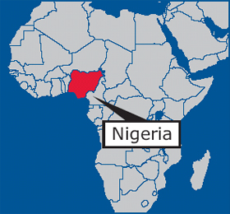
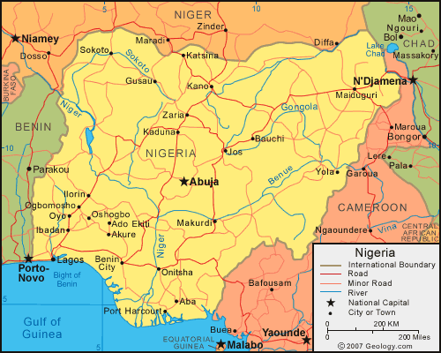
Nigeria Maps

Slide 9
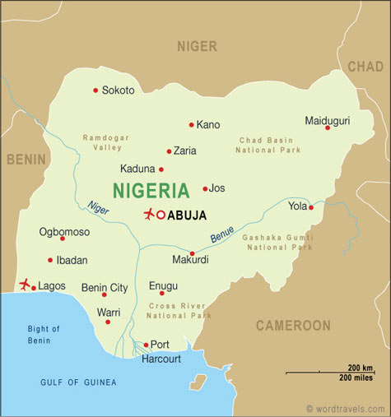
Background on Nigeria
There are over 100 million people in Nigeria today. The Igbo people are the third largest ethnic group.
The Igbo people live in the eastern region – where Things Fall Apart is set – near town of Onitsha.
The Yoruba live in the west and the Hausa-Fulani, an Islamic people, live in the north.

Slide 10
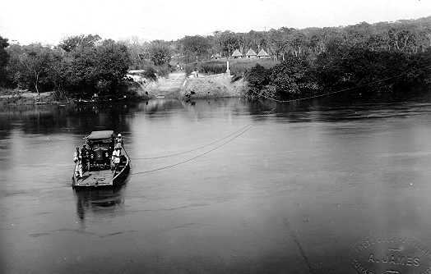
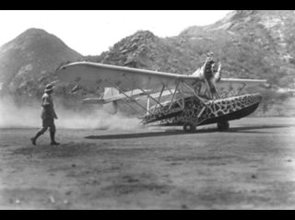
Background on Nigeria
Nigeria was a center of the European slave trade for many years – a dangerous and lucrative business.
It was colonized by Great Britain during the time of imperialism (18th and 19th centuries) and finally granted its independence by Great Britain in 1914.

Slide 11
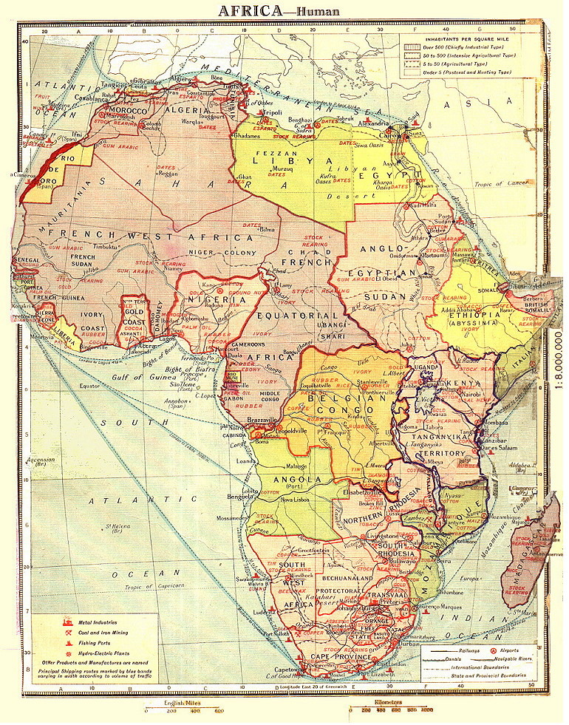
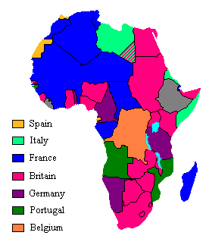
Europe Colonizes Africa

Slide 12
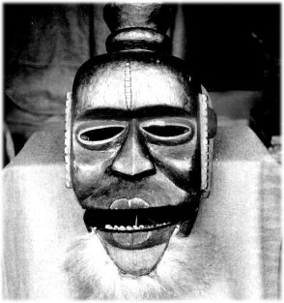
The Igbo
Third most populous ethnic group in Nigeria (16% of population)
Live in southeastern part of country in tropical rain forests (deal with rainy season and dry winds)
Subsistence farmers – raise their own crops:
  Yam, cassava, taro, corn, etc.
  Palm trees for oil and fiber
  Crafts and manual labor also
  provide income

Slide 13

Igbo Culture
It is a patriarchal society. Decision making involves males only
Men grow yams and women grow other crops
Live in villages based on male lineage – male heads of household all related on father’s side (approximately 5,000 people per clan)
Women go to live with husbands; prosperous men have 2 or 3 wives
  Each wife lives in her own hut in the family compound

Slide 14
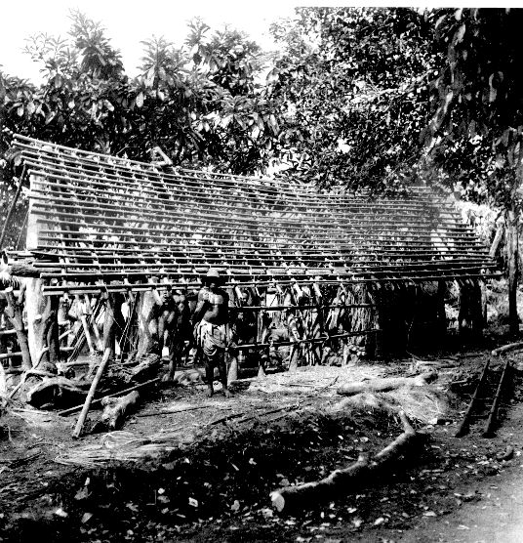
Igbo Images
Traditional
Obi – hut or
family compound
under construction

Slide 15
Igbo Society
No single leader, elders lead
Social mobility: Titles earned (not inherited). High value placed on individual acheivement.
Hospitality very important
Some Igbos owned slaves captured in war or as payment for debt.
Proximity to West African ports means many Igbo were taken in slave trade

Slide 16
Ibo Religion
Chukwu – supreme god, creator of world
  The will of gods was revealed through oracles.
  Each clan, village, and household had protective ancestral spirits
Chi – personal guardian spirit – affects one’s destiny, can be influenced through individual actions and rituals.
Egwugwu – masked, ancestral spirits of the clan who appear during certain rituals.

Slide 17
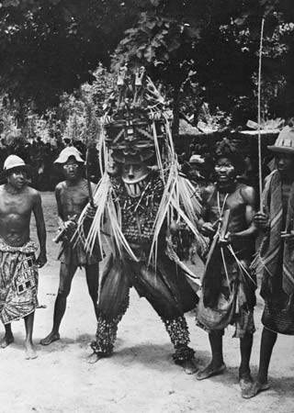
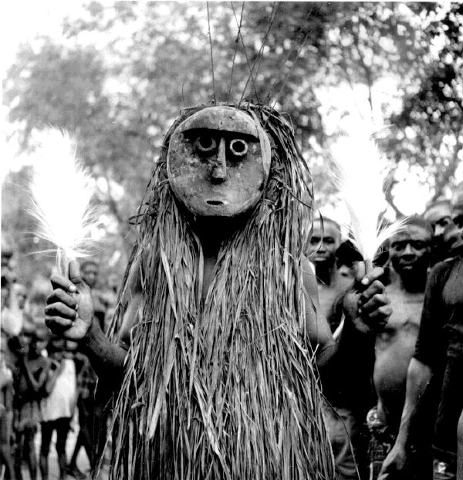
Igbo Images
Villager performing
role of egwugwu

Slide 18
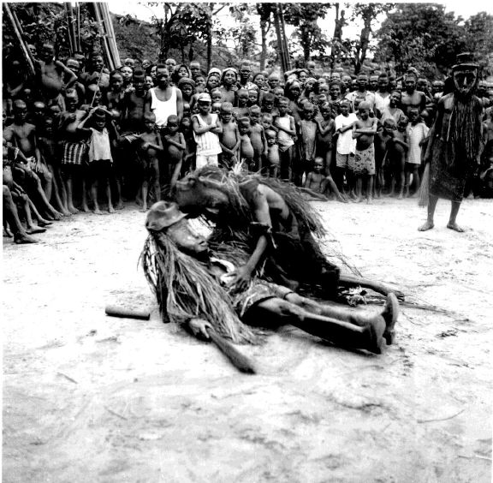
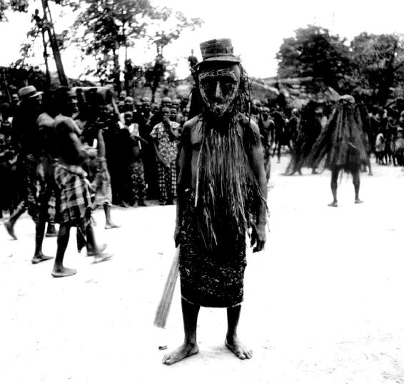
Igbo Images
Traditional dibia, a medicine man or healer.

