Slide 1


The Russian Revolution
→

Slide 2
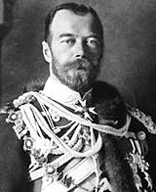
Pre-Revolutionary Russia
Only true autocracy left in Europe
No type of representative political institutions
Nicholas II became tsar in 1884
Believed he was the absolute ruler anointed by God
Russo-Japanese War (1904) – defeat led to pol. instability

Slide 3
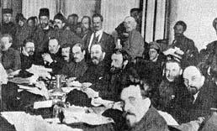
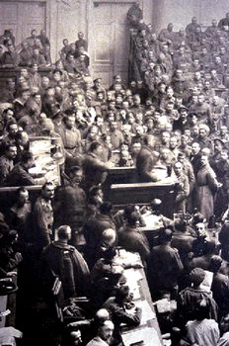
conditions deteriorated, rev. became possible, esp. w/ Lenin’s involvement
he had gravitated towards the Social Dem. Workers’ Party of George Plekhanov – they believed in dialectical materialism and thus favoured modernization/capitalism (which the czars also favoured as a measure to catch up w/ the w. Europe, esp. after the Crimean and Russo-Japanese Wars)

Slide 4
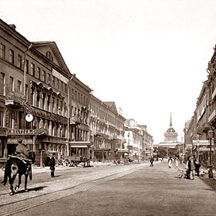
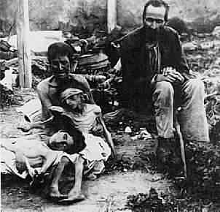
The Revolution of 1905
Rapid growth of (discontented) working class
Vast majority of workers concentrated in St. Petersburg and Moscow
Little help from the countryside: impoverished peasants – Populist Movements of the 1870s and later had done little to improve their lot
  No individual land ownership
  Rural Famine

Slide 5
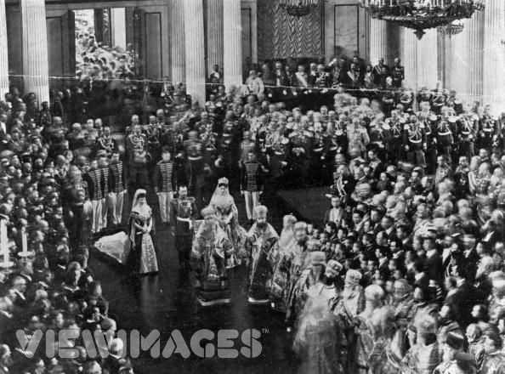
Conservatism Continues:
1905-1917
Tsar paid no attention to the Duma; it was harassed and political parties suppressed – only token land reform was passed
Nicholas was personally a very weak man; he became increasingly remote as a ruler
Numerous soviets thus began to appear

Slide 6
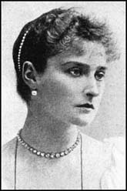
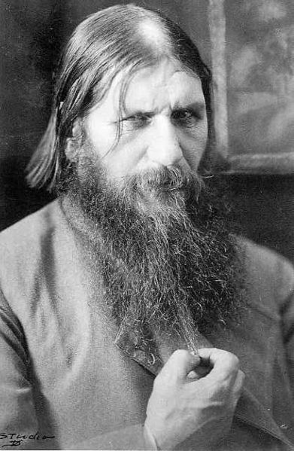
Alexandra: The Power Behind the Throne
Even more blindly committed to autocracy than her husband
She was under the influence of Rasputin
Origins of Rasputin’s power - ?
Scandals surrounding Rasputin served to discredit the monarchy

Slide 7
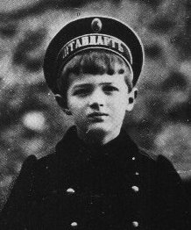
Alexis: Alexandra’s Son with Hemophilia

Slide 8
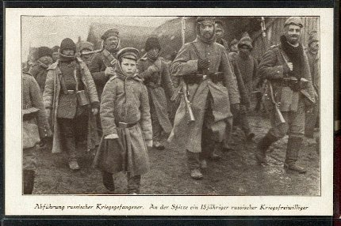
World War I: “The Last Straw”
War revealed the ineptitude and arrogance of the country’s aristocratic elite
Corrupt military leadership had contempt for ordinary Russian people
Average peasants had very little invested in the War

Slide 9
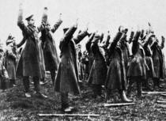
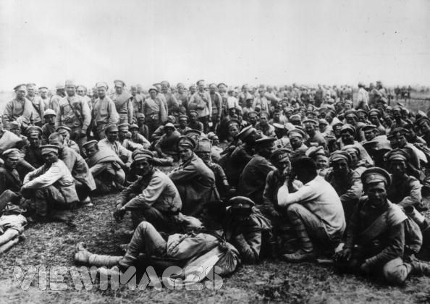
World War I (cont)
ill-trained, ineffective officers, poorly equipped (Russ. was not ready for ind. war) – the result was mass desertions and 2 million casualties by 1915
Result: Chaos and Disintegration of the Russian Army
Battle of Tannenberg (August, 1914) – massive defeat at hands of Hindenburg and Ger.

Slide 10
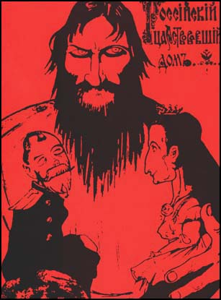
The Collapse of the Imperial Government
Nicholas left for the Front—September, 1915
Alexandra and Rasputin throw the government into chaos
Alexandra and other high government officials accused of treason

Slide 11
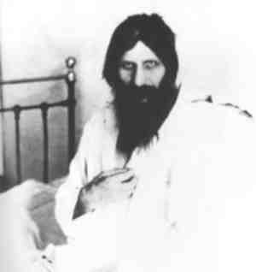
The Collapse of the Imperial Government (cont)
Rasputin assassinated in December of 1916
Complete mismanagement of the wartime economy
ind. production plummeted, inflation and starvation were rampant, and the cities were overflowing w/ refugees
they became a hotbed for pol. activism, and this was ignited by serious food shortages in March 1917, esp. in St. Petersburg

Slide 12
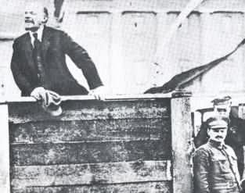
The Two Revolutions of 1917
The March Revolution (March 12)
The November Revolution (November 6)

Slide 13
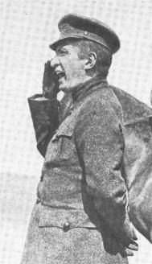
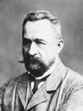
The March Revolution
Origins: Food riots/strikes
Duma declared itself a Provisional Government on March12
Tsar ordered soldiers to intervene; instead they joined the rebellion…the Tsar thus abdicated on March 17
the Menshevik Alexander Kerensky headed the Provisional Government, along w/ Prince Lvov
  Very Popular Revolution
  Kerensky favoured gradual socialist reform/ saw the war effort as #1 priority

Slide 14
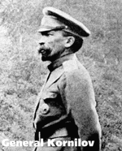
Kornilov Affair
General Kornilov attempted to overthrow Provisional Government with military takeover
To prevent this takeover, Kerensky freed many Bolshevik leaders from prison and supplied arms to many revolutionaries

Slide 15
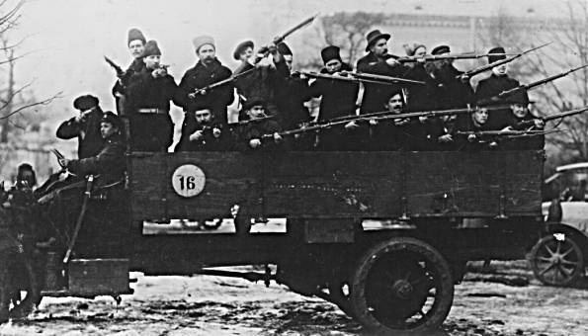
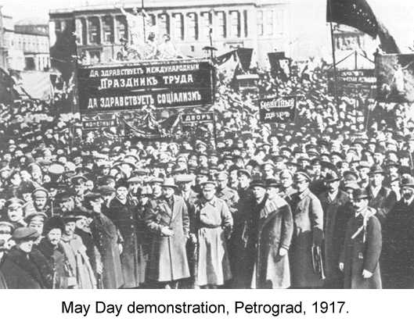
The Petrograd Soviet
    leftists in St. Petersburg formed the Petrograd Soviet, which they claimed to be the legit. gov’t
    Ger. was aware of the Russ. situation and began to concentrate on the W. Front
    Ger. even played a role in returning Lenin to Russia, so he could foment rev.
      Having been granted “safe passage”, Lenin returned in April 1917

Slide 16
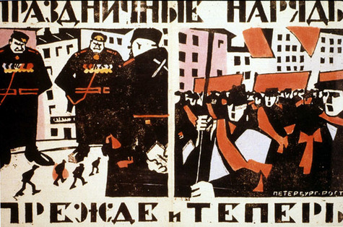
Soviet Political Ideology
More radical and revolutionary than the Provisional Government
Most influenced by Marxist socialism
Emulated western socialism
Two Factions
-- “Mensheviks”
-- “Bolsheviks”

Slide 17
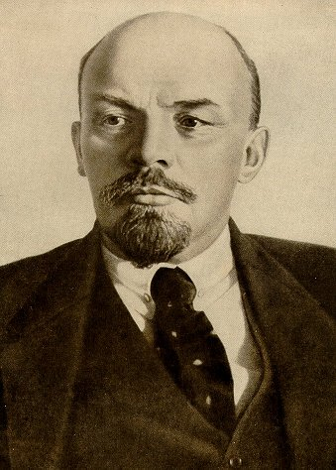
Founder of Bolshevism: Vladimir Lenin
His Early Years
--Exiled to Siberia in 1897
Committed to Class Struggle and Revolution
Moved to London in 1902 and befriended Leon Trotsky
What is to be Done?
  vanguard is required to lead the rev. (thus rev. from above) → this split the SDWP in 2

Slide 18
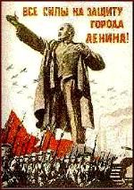
Lenin Steps into This Vacuum
Amnesty granted to all political prisoners in March of 1917
Lenin’s arrival in Petrograd
A tremendously charismatic personality
“Peace, Land, Bread”
“All Power to the Soviets”
He preached that the war was a capitalist/imperialist war that offered no rewards for the peasants/workers; he also felt the war was over w/ the czar’s abdication
Bolshevik party membership exploded; their power was consolidated

Slide 19
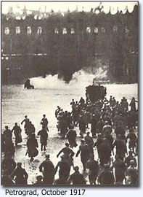
    Lenin formed the Military-Revolutionary Council and in May 1917 he urged the Pet. Soviet to pass Army Order # 1
      This gave control of the army to the common soldiers; discipline thus collapsed, and Kerensky was undermined

Slide 20
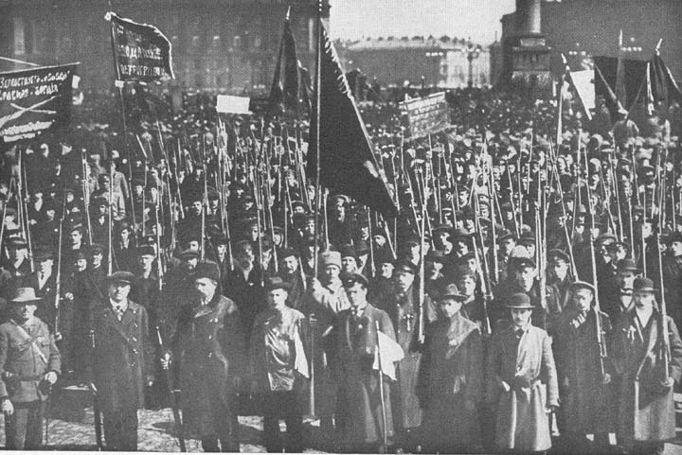
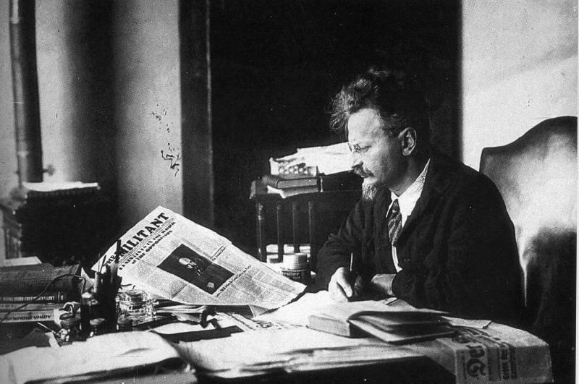
The November Revolution
Nov. 6, 1917…
this was the ideological aspect of the rev., w/ the coup itself planned by Leon Trotsky, who had gained the confidence of the army (= the “Red Miracle”)
Lenin went on to consolidate his power in Jan. 1918 when he disbanded the Constituent Assembly (had replaced the Duma) – the Bolsheviks had not gained a majority there in late Nov. elections - Russ. dem. thus terminated → a Council of People’s Commissars was created
All private property was abolished and divided among the peasantry
Largest industrial enterprises nationalized

Slide 21
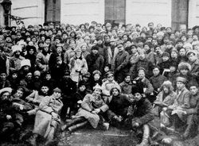
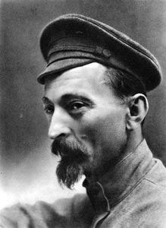
November Revolution (cont)
Political Police organized: CHEKA
Revolutionary army created with Trotsky in charge = “Red Army”
Bolshevik Party renamed Communist Party in March of 1918

Slide 22
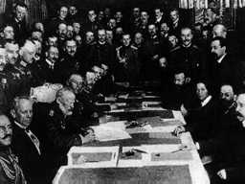
November Revolution (cont)
Lenin’s 1st task was to get Russia out of the war so he could concentrate on internal reform…
The Treaty of Brest-Litovsk negotiated with the Germans, giving them much Russian territory, population, and resources
Civil War followed, 1917-1920
→“Reds” versus “Whites”
Complete breakdown of Russian economy and society

Slide 23
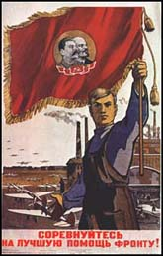
Interpreting the Russian Revolution
The official Marxist interpretation
→ The importance of a permanent international revolution
Function of Russian History and Culture
Imposed Revolution on an unwilling victim
A Social Revolution…

Slide 24
How can a political event, like a revolution, help inform literature?
In the case of the Russian Revolution, lets examine how one author and several stories show how the revolution, communism and the Russian Civil War is represented by Isaac Babel’s stories.

Slide 25
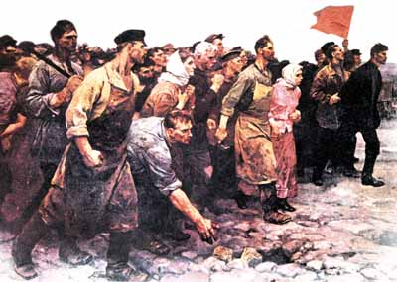

Slide 26
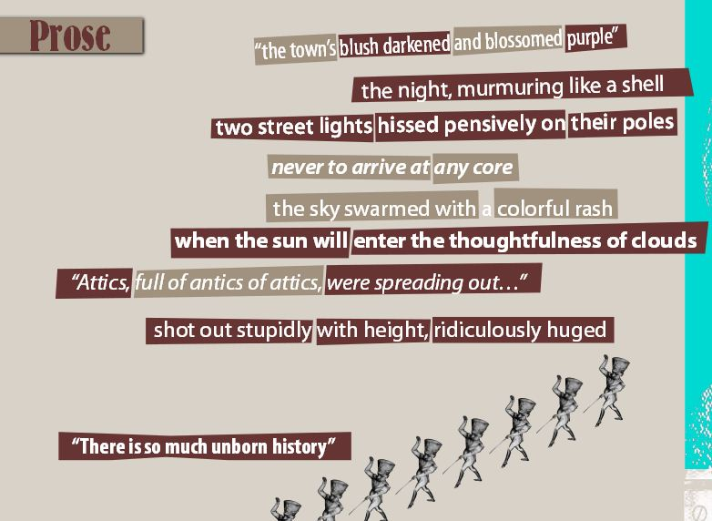

Slide 27
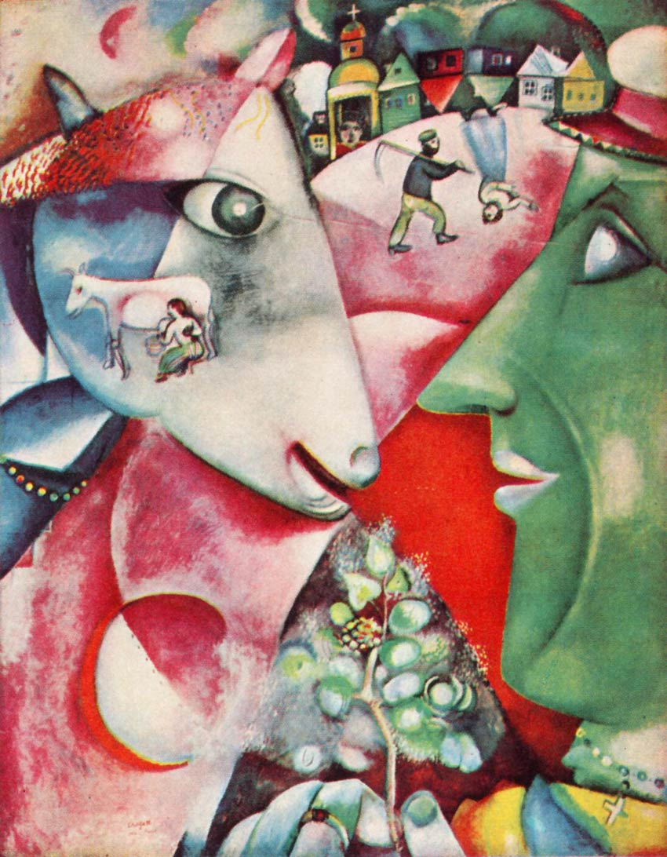
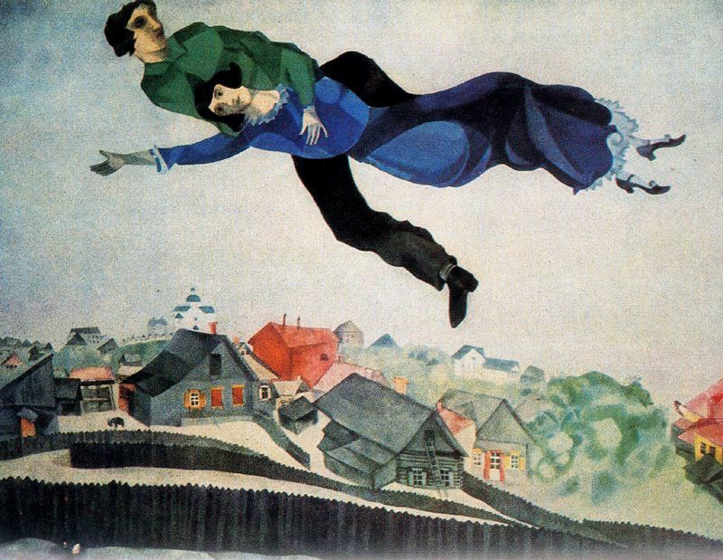
Mark Chagall – Russian painter

Slide 28
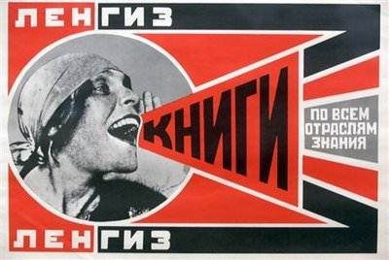

Slide 29
Read Isaac Babel
“Dolgushov’s Death” – a response to the Russian-Polish War.
Vocabulary – 10 words – defined.
Describe the Tone of the piece. Tone is the expression of the author’s attitude .
Describe the Mood of piece. Mood is the feeling the piece arouses in the reader.
Describe and write down any particular imagery that explains the story.
“Flying bullets whimper and yelp…

Slide 30
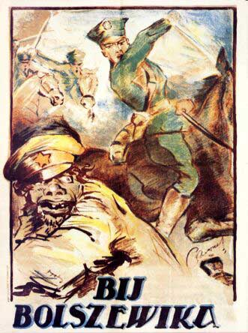
Polish Propaganda poster
Russian-Polish War

