Slide 1
The Manhattan Project

Slide 2
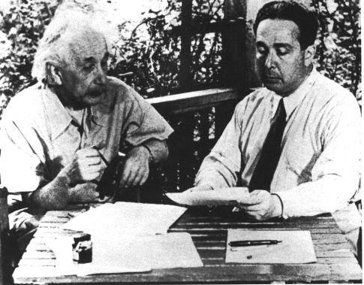
How it Began
Started by FDR in 1939 in response to Germany’s nuclear arms production (Einstein’s letter).
FDR’s Motive: Wanted beat Hitler to having the bomb
Einstein and Szilard

Slide 3
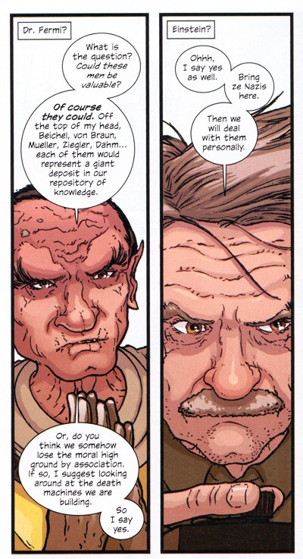

Slide 4
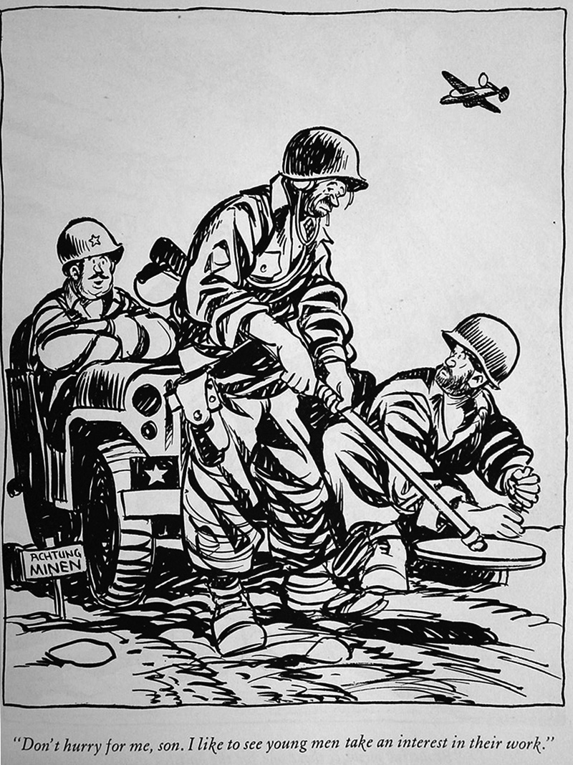
Bill Maudlin, Cartoonist
Grew up in southern New Mexico
His main cartoon characters were the scruffy an unshaven Willie and Joe.
Maudlin won a Pulitzer Prize but was mostly concerned with improving the moral of GI’s.

Slide 5
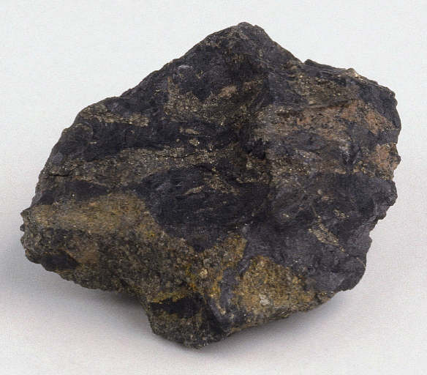
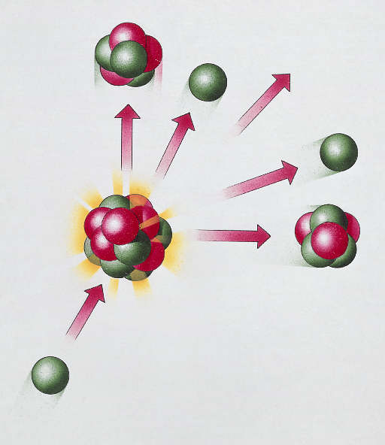
How it Works
Uranium was primary element in creating a nuclear chain reaction, which occurs when the atomic nuclei in radioactive matter are split (nuclear fission) by neutrons.
Each fission then creates new neutrons that produce fissions in additional atoms at an ever increasing and self-sustaining pace.

Slide 6
The Development
Work began in 1942 after success of creating a controlled nuclear reaction at University of Chicago
Would be the best kept secret of the war
  600,000 working on the project, but very few knew of its purpose → create an atomic bomb

Slide 7
The Developments
2 atomic reactors built in Oak Ridge, Tennessee and in Washington to create Uranium 235 and Plutonium (Very RARE!), which proved more practical in creating bomb than Uranium
Laboratory set up in Los Alamos, N.M. with purpose of creating the bomb

Slide 8
Manhattan Project
After Germany surrenders on May 8, 1945, many scientists working on the project see no reason to continue.
But continue on to test the bomb anyway

Slide 9
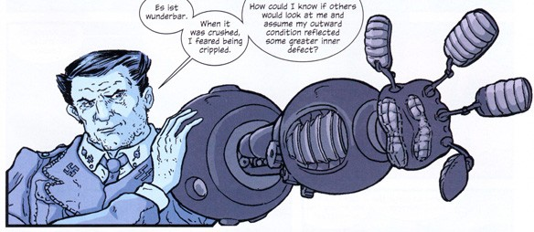

Slide 10
Trinity Test
Before the test of the bomb, people had different fears:
  Bomb wouldn’t work at all
  Set fire to the atmosphere → end of earth
Night, July 16, 1945 → 1st atomic bomb was detonated in an empty desert in NM
  Blinding flash, visible 180 miles away
  Deafening Roar as shock wave traveled across desert
  Created crater in desert
  Worked and more powerful than most dared to hope

Slide 11
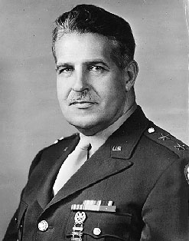
General Leslie Groves
Military Director of the Manhattan Project.
Famous for building the Pentagon
Wanted to be a field general

Slide 12
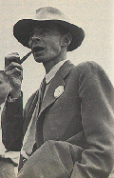
J. Robert Oppenheimer
Scientific Director of the Manhattan Project.
A physicist at UC Berkeley
Dated a woman who was a member of the communist party

Slide 13
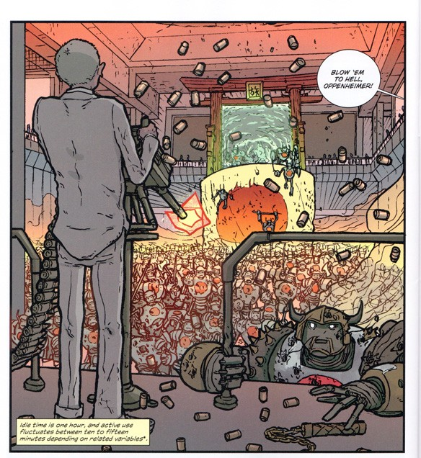

Slide 14
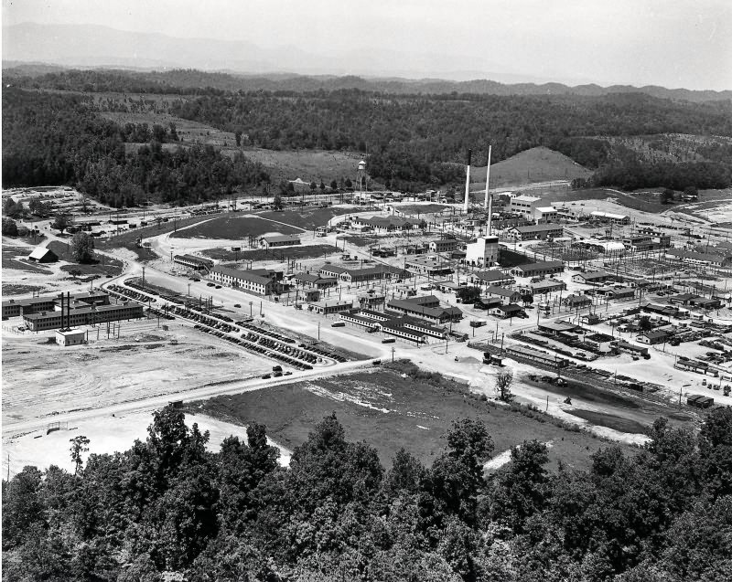
Oak Ridge
X-10
Secret City on the Clinch River near Knoxville, Tennessee.
Primary purpose was to enrich ²³⁵U.
Also built a graphite reactor at X-10 to study the production of plutonium.

Slide 15
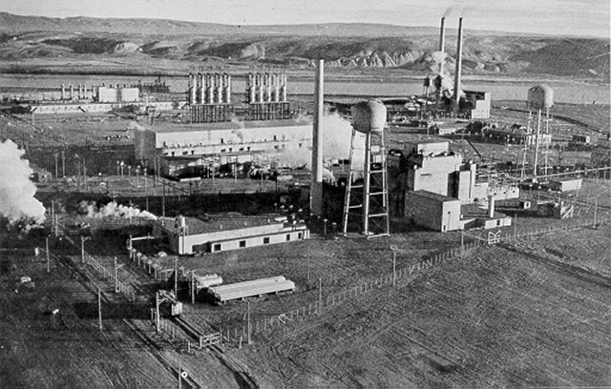
Hanford
Secret City on the Columbia River in Washington State.
A series of nuclear reactors designed to produce plutonium.
A chemical plant to purify plutonium.

Slide 16
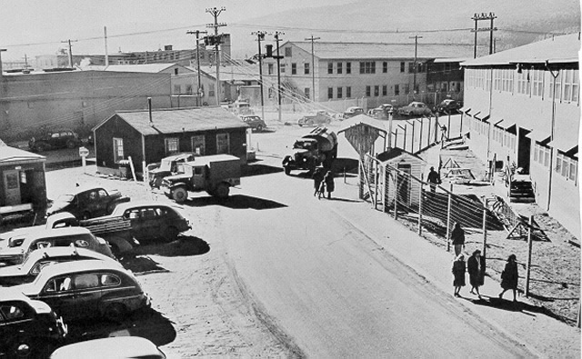
Los Alamos
Secret City in the Sangre de Christo Mountains in New Mexico.
The purpose was to design and build the bombs.

Slide 17
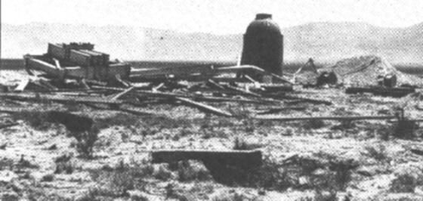
Site after the Trinity Test

Slide 18
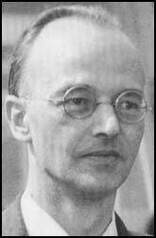
Klaus Fuchs
Born in Germany and came to Los Alamos as part of the British Mission
Worked on the explosive lens
An ardent communist who leaked information to the Russians

Slide 19
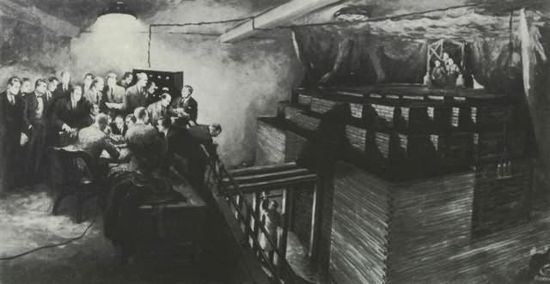
University of Chicago
Enrico Fermi built the first nuclear reactor, CP-1, in a squash court under the football stadium. The first sustained chain reaction occurred on Dec. 2, 1942.

Slide 20
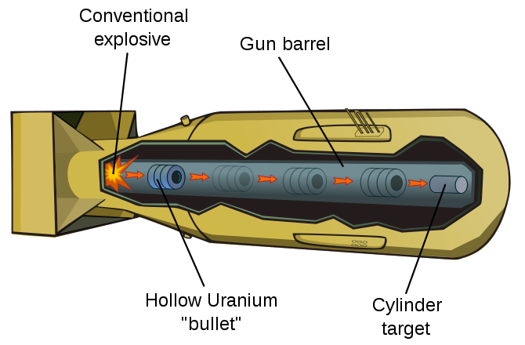
Gun Design
This design worked with uranium.
A 2000 lb TNT Blockbuster bomb was used as the “trigger”.

Slide 21
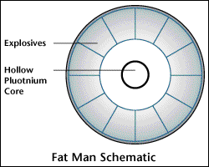
Implosion Design
This design was required for plutonium.
Impurities of ²⁴⁰Pu would release too many neutrons and cause premature detonation in the gun design. This would lower the yield.

Slide 22
Trinity Site
The gun design was simple and the scientists did not feel that testing was necessary.
The implosion device was much more complicated and needed to be tested.
The chosen site was in the Jornado del Muerto Valley near Alamogordo New Mexico and code named Trinity.

Slide 23
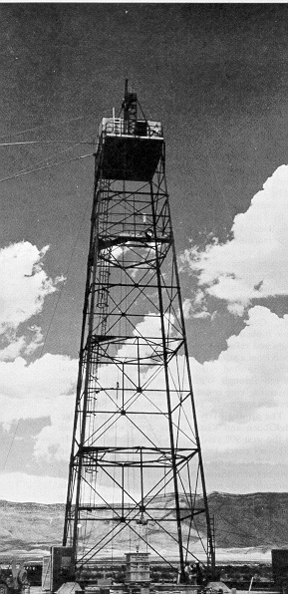
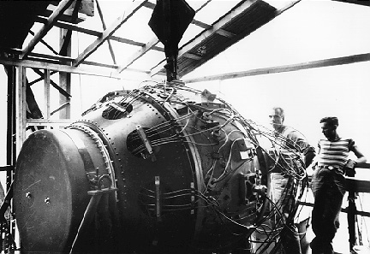
Gadget

Slide 24
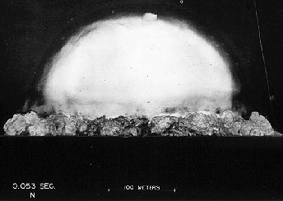
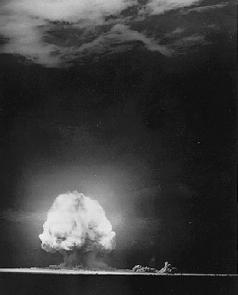
The Dawn of the Nuclear Age
The first nuclear explosion occurred at 5:29:45 am on July 16, 1945 at Trinity.

Slide 25
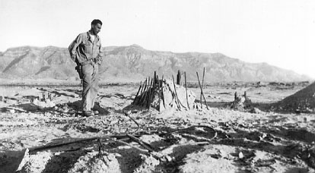
Edward Teller described wearing double welders glasses and was not impressed until he removed his hands from around the glasses.
Fermi was holding pieces of paper in his hand and waited for the shock wave to estimate the output. He later commented on missing both fission and the first nuclear explosion.

Slide 26
To Use or Not to Use
With the end of the war in Europe on May 8, 1945, discussion began on whether or not to use the bombs.
Japan had never been a threat to develop a bomb.
Groves definitely wanted to use the bombs.
Szilard started a petition, signed by many of the scientists involved in the project, to not drop the bombs. The petition was never delivered to Truman.

Slide 27
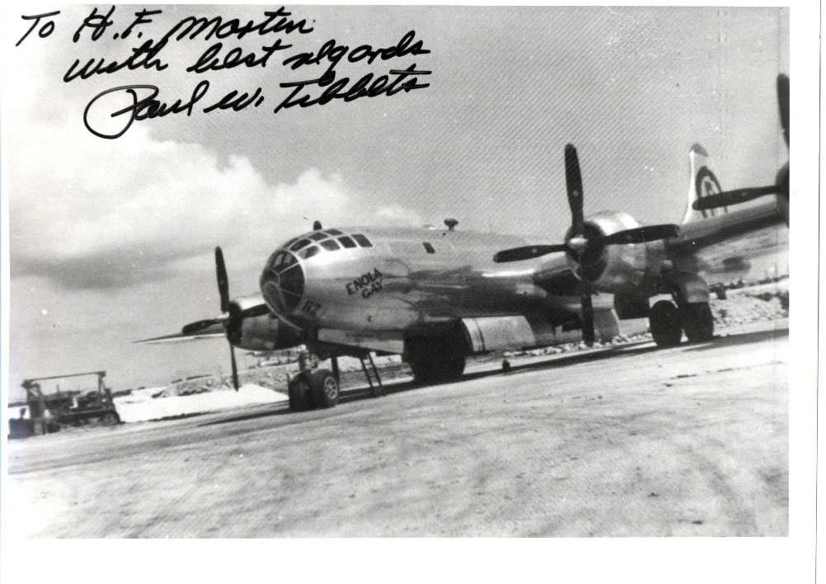
509th Composite Group
B-29 Bomber Group was constituted and refitted to carry the atomic bombs.
Special training took place stateside before transferring to Tinian Island.
The commander was Colonel Paul Tibbets

Slide 28
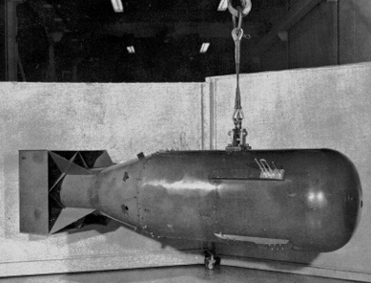
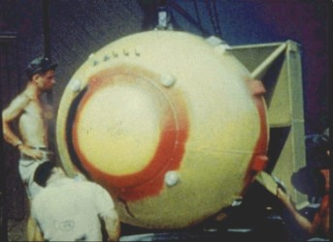
Little Boy and Fat Man

Slide 29
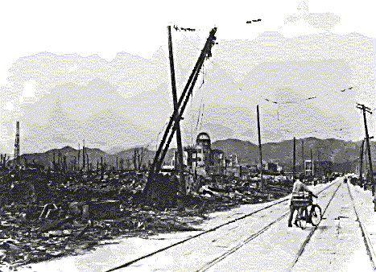
Hiroshima
Aug. 6, 1945, Little Boy was dropped by the Enola Gay piloted by Col. Paul Tibbets.
Equivalent to 12-15 kilotons of TNT.
70,000 immediate deaths, 140,000 by the end of the year.

Slide 30
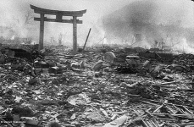
Nagasaki
August 9, 1945, Fat Man was droped by Bocks Car piloted by Maj. Charles Sweeney.
Equivalent to 21 kilotons of TNT.
40,000 immediate deaths, 70,000 by the end of the year.

Slide 31
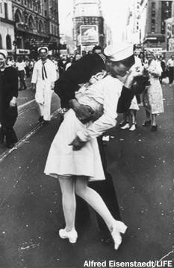
VJ-Day
Japan surrenders unconditionally on Aug. 14, 1945.
Surrender signed in Tokyo Harbor aboard the USS Missouri on Sept. 2.

Slide 32

After the War
Art work by Grant Powell
The US conducts tests on Bikini Atoll.
Able test recreated a Pearl Harbor style attack using a single plutonium bomb.
Today, you can dive on some of the sunken ships in the lagoon.
The Bikinians cannot yet return.

Slide 33
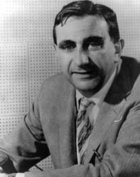
Edward Teller
Edward Teller pushed for further work on a fusion based bomb.
Known as the Father of the Hydrogen Bomb.

Slide 34
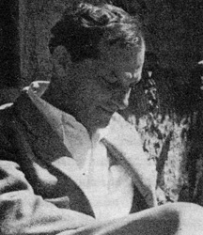
Stanislaw Ulam
Recognized that radiation could create the pressure that would cause fusion.
Led to the design of a staged thermonuclear device.

Slide 35
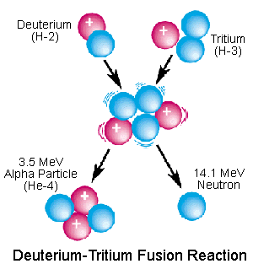
The Fusion Reaction
Requires a plutonium bomb as a trigger.

Slide 36
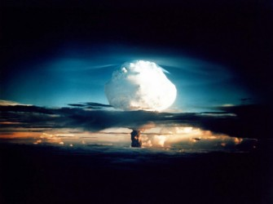
Mike
First staged fusion explosion occurred on Eniwetok Atoll on Nov. 1, 1952.
Mike used liquid deuterium as a fuel.
The output of 10.4 megatons of TNT exceeded all of the explosives used in WW II including both atomic bombs.

Slide 37
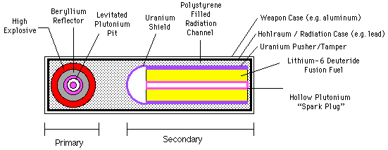
Modern Thermonuclear Warhead
Modern weapons use LiD as a fuel.
As many as 20 warheads may sit on a single ICBM.

Slide 38
The United States is the only country to have used a nuclear weapon in anger.

Slide 39
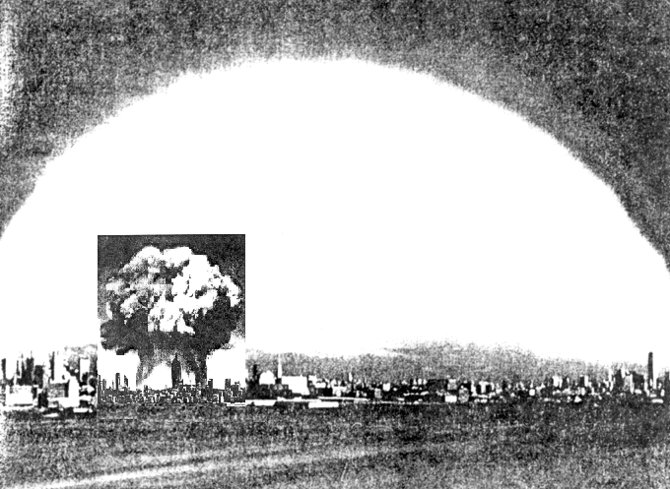
Fat Man and Mike superimposed over New York City

