Slide 1

Things Fall Apart
By: Chinua Achebe

Slide 2
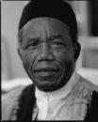
Chinua Achebe
Born on 16 November 1930, is a Nigerian novelist, poet, professor and critic. He is best known for his first novel, Things Fall Apart (1958), which is the most widely read book in modern African literature
www.wikipedia.com

Slide 3
Chinua Achebe’s Novels
Achebe's novels focus on the traditions of Igbo society,
the effect of Christian influences, and
the clash of values during and after the colonial era.
www.wikipedia.com

Slide 4
Chinua Achebe’s Life
Grew up in Ogidi, a village in Nigeria
His father taught at the missionary school
In 1958 Things Fall Apart was published
Currently teaches at Bard College
www.gradesaver.com

Slide 5
Things Fall Apart
Things Fall Apart is set in the 1890s, during the coming of the white man to Nigeria.
In part, the novel is a response and antidote to a large tradition of European literature in which Africans are depicted as primitive and mindless savages.

Slide 6
Taking Notes over the Novel
As you read the novel, you will take notes on a chart like this one on your own paper. You will need at least 5 entries per chapter.
Chapter #
Page #
line from text
summary of line
literary device

Slide 7
Literary Devices in Chapter
While reading, you must identify at least 5 literary devices used in the text per chapter.
Ex: “a long and thin strip of cloth round the waist like a belt”- simile page 73
“she was drenched in perspiration”- imagery page 76

Slide 8
Characters
As you read- you must write down information about each character
Okonkwo
Unoka
Ekwefi
Ezinma
Nwoye
Ikemefuna
Ogbuefi Ezeudu
Obierika
Mr. Brown
Reverend James Smith

Slide 9
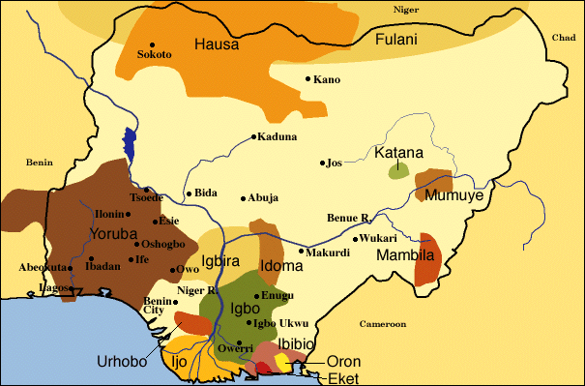
Igbo, Nigeria- location of story

Slide 10
Ibo Villages
Few miles from each other- spoke different languages
Customs:
3 day market week
The kola nut ritual
New Yam festival

Slide 11

Igbo People
Nigeria figure
The University of Iowa
Museum of Art

Slide 12
Ibo Economy
Economy based on “root crops”
Men grew yam
Women grew beans, cassava, and cocoyam

Slide 13
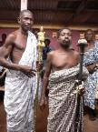
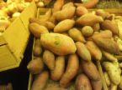
Yam Festival

Slide 14
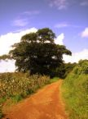
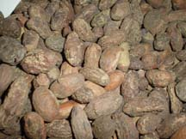
Kola Nut
Kola Nuts
Kola Nut Tree

Slide 15

Cassava

Slide 16





Igbo Masks

Slide 17
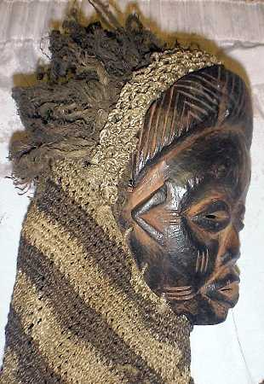
Igbo Masks Defined
Used during festivals
Used during ceremonies
Used to symbolize beauty

Slide 18
Chapter Vocabulary Words
You have a list of vocabulary words that are in each chapter. You are responsible for defining the words for each chapter BEFORE reading the chapter in class
You can use the list of words on http://www.vocabulary.com/lists/24253#view=list

Slide 19
Reading Schedule
Reading Schedule:Chapters 1-5 by Wednesday Jan 22
Chapters 6-9 by Friday, Jan 29
Chapters 10-19 by Wed, Feb 5
Chapters 20-End by Fri, Feb 12

Slide 20
Reading Schedule cont’d
You will continue to read the novel and take notes in class
If you are absent- it is YOUR responsibility to check out a book and get caught up on the reading.
We will have quizzes approximately every 5 chapters. These quizzes are worth 30 points.
Quizzes will be about the story and the vocabulary words for those chapters

Slide 21
Reading Schedule on my website
www.themastersprogram.net
There will be assessments on wikispaces throughout the month we are working on this novel. It will be your responsibility to check for new wikis. Be part of the discussion!
You can also check the calendar for additional information on the reading schedule.

