Slide 1
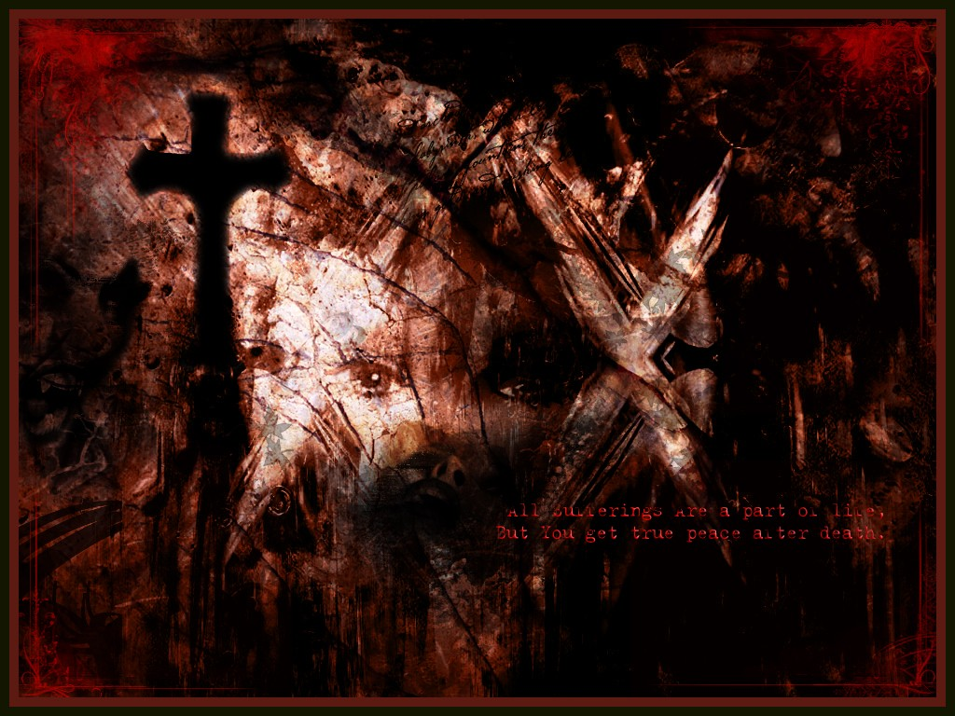
Romantic and Gothic Genres
In Frankenstein

Slide 2
Romanticism
Definition:
Romanticism is a complex artistic, literary, and intellectual movement that originated in the second half of the 18th century in Western Europe, and gained strength in reaction to the Industrial Revolution. In part, it was a revolt against aristocratic social and political norms of the Age of Enlightenment and a reaction against the scientific rationalization of nature (neoclassicism), and was embodied most strongly in the visual arts, music, and literature, but can be detected even in changed attitudes towards children and education.

Slide 3
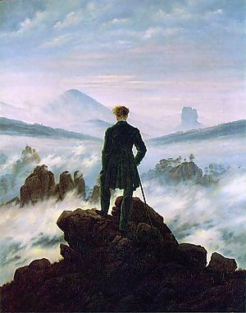
Romanticism
The movement validated strong emotion as an authentic source of aesthetic experience, placing new emphasis on such emotions as trepidation, horror, terror, and awe—especially that which is experienced in confronting the sublimity of untamed nature and its picturesque qualities, both new aesthetic categories.
Caspar David Friedrich,
Wanderer above the Sea of Fog, 1818

Slide 4
Romanticism
Victor Hugo called Romanticism “liberalism in literature.” It freed the artist and writer from restraints and rules.
Walter Pater thought the addition of strangeness to beauty defined the Romantic movement.
A current definition: a psychological desire to escape from unpleasant realities.

Slide 5
Romanticism
In the U.S., romantic Gothic literature made an early appearance with Washington Irving's The Legend of Sleepy Hollow (1820) and Rip Van Winkle (1819), followed by the Leatherstocking Tales of James Fenimore Cooper, with their emphasis on heroic simplicity and their fervent landscape descriptions of an already-exotic mythicized frontier peopled by "noble savages," similar to the philosophical theory of Rousseau.
Later, Transcendentalist writers such as Henry David Thoreau and Ralph Waldo Emerson still show elements of its influence and imagination, as does the romantic realism of Walt Whitman. But by the 1880s, psychological and social realism was competing with romanticism in the novel. The poetry of Emily Dickinson—nearly unread in her own time—and Herman Melville's novel Moby-Dick can be taken as epitomes of American Romantic literature.

Slide 6
Romanticism
Characteristics:
The predominance of imagination over reason and rules
Primitivism
Love of nature
An interest in the past
Mysticism
Individualism
Enthusiasm for the wild, irregular, or grotesque in nature
Enthusiasm for the uncivilized or “natural”

Slide 7
Romanticism
More Characteristics:
Interest in human rights
Sentimentality
Melancholy
Interest in the Gothic

Slide 8
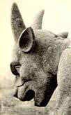
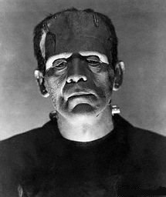
Supernatural And Gothic Literary Themes
Supernatural motifs appear throughout literature but are most prominent in the literary genre labeled "Gothic," which developed in the late eighteenth-century and is devoted primarily to stories of horror, the fantastic, and the "darker" supernatural forces.

Slide 9
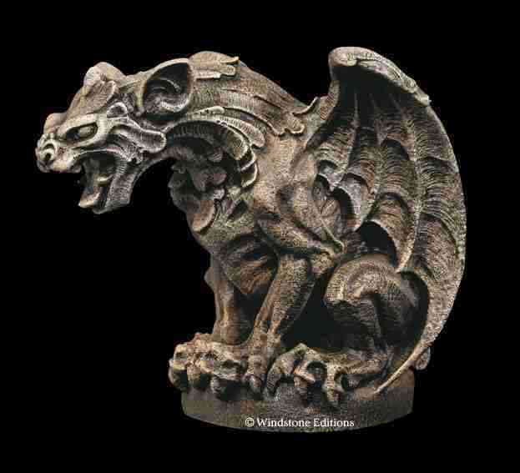
Gothic literature derives its name from its similarities to the Gothic medieval cathedrals, which feature a majestic, unrestrained architectural style with often savage or grotesque ornamentation (the word "Gothic" derives from "Goth," the name of one of the barbaric Germanic tribes that invaded the Roman Empire).
The vaulting arches and spires of Gothic cathedrals reach wildly to the sky as if the builders were trying to grasp the heavens; and the cathedrals are covered with a profusion of wild carvings depicting humanity in conflict with supernatural forces—demons, angels, gargoyles, and monsters.

Slide 10
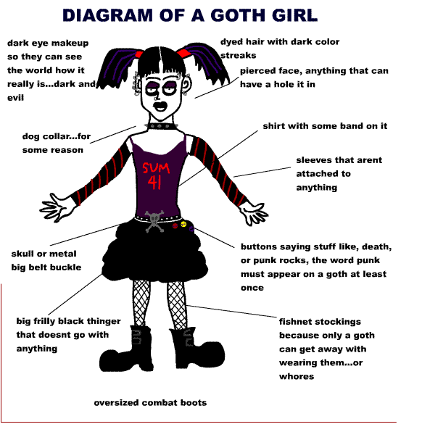

Slide 11
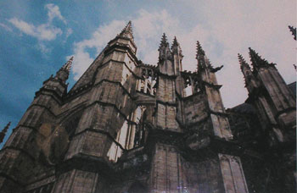
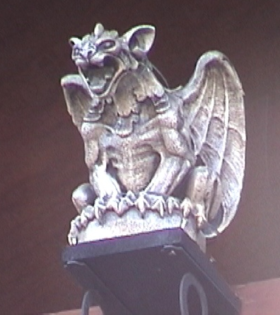
The architecture evokes the sense of humanity’s division between a finite, physical identity and the often terrifying and bizarre forces of the infinite. The Gothic aesthetic also embodies an ambition to transcend earthly human limitations and reach the divine.

Slide 12
Like Gothic architecture, Gothic literature focuses on humanity’s fascination with the grotesque, the unknown, and the frightening, inexplicable aspects of the universe and the human soul. The Gothic "relates the individual to the infinite universe" (Varma, 16) and creates horror by portraying human individuals in confrontation with the overwhelming, mysterious, terrifying forces found in the cosmos and within themselves. Gothic literature pictures the human condition as an ambiguous mixture of good and evil powers that cannot be understood completely by human reason.
Thus, the Gothic perspective conceives of the human condition as a paradox, a dilemma of duality—humans are divided in the conflict between opposing forces in the world and in themselves.

Slide 13
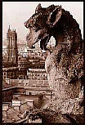
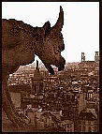
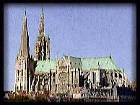
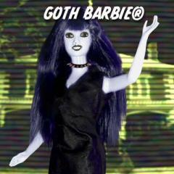
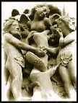
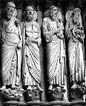
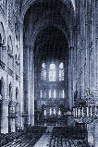
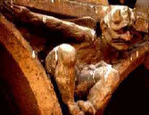

Slide 14
Gothic
Prominent features of Gothic fiction include terror (both psychological and physical), mystery, the supernatural, ghosts, haunted houses and Gothic architecture, castles, darkness, death, decay, doubles, madness, secrets, and hereditary curses.
The stock characters of Gothic fiction include tyrants, villains, bandits, maniacs, Byronic heroes, persecuted maidens, femmes fatales, monks, nuns, madwomen, magicians, vampires, werewolves, monsters, demons, angels, fallen angels, revenants, ghosts, perambulating skeletons, the Wandering Jew (!?) and the Devil himself.

Slide 15

Supernatural / Gothic Literary Motifs
A motif is a repeated theme, image, or literary device. Look for these common supernatural/Gothic motifs in Frankenstein.

Slide 16
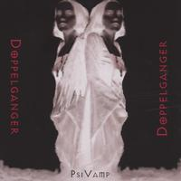
The Double or Doppelganger (German for "double-goer"):
Defined by Frederick S. Frank as "a second self or alternate identity, sometimes a physical twin. The Doppelganger in demonic form can be a reciprocal or lower bestial self or a Mr. Hyde. Gothic doppelgangers often haunt and threaten the rational psyche of the victim to whom they become attached."

Slide 17
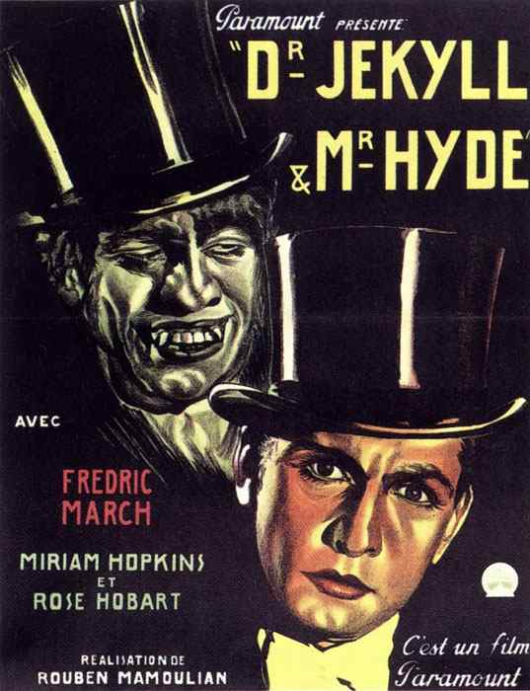
The double motif involves a comparison or contrast between two characters or sets of characters within a work to represent opposing forces in human nature. For example, Dr. Jekyll and his evil double Mr. Hyde are contrasted to represent the battle between the rational, intellectual self (Jekyll) and the irrational, bestial self (Hyde). The double motif suggests that humans are burdened with a dual nature, a soul forever divided.
Double characters are often paired in common relationships, such as twins, siblings, husband/wife, parent/child, hero/villain, creator/creature, etc.

Slide 18
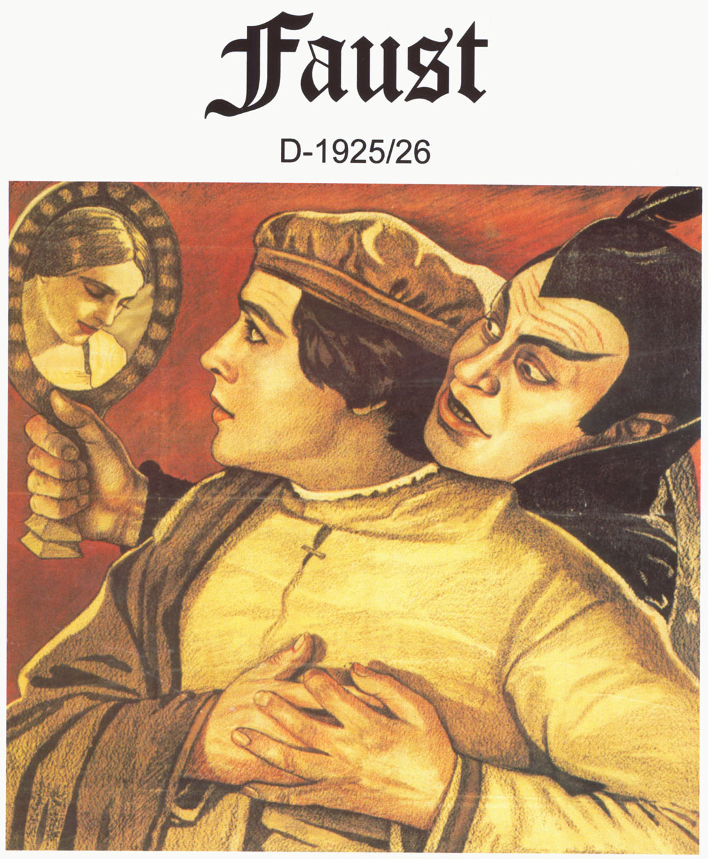
Forbidden Knowledge or Power/ Faust Motif:

Slide 19
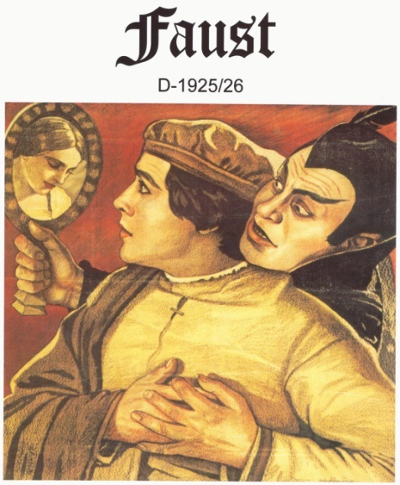
Forbidden Knowledge or Power/ Faust Motif:
Forbidden knowledge/power is often the Gothic protagonist’s goal. The Gothic "hero" questions the universe’s ambiguous nature and tries to comprehend and control those supernatural powers that mortals cannot understand. He tries to overcome human limitations and make himself into a "god." This ambition usually leads to the hero’s "fall" or destruction; however, Gothic tales of ambition sometimes paradoxically evoke our admiration because they picture individuals with the courage to defy fate and cosmic forces in an attempt to transcend the mundane to the eternal and sublime.

Slide 20
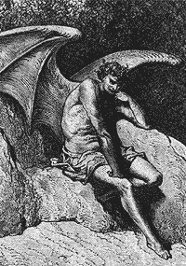
Monster/Satanic Hero/Fallen Man:
The courageous search for forbidden knowledge or power always leads the hero to a fall, a corruption, or destruc- tion, such as Satan’s or Adam’s fall. Consequently, the hero in Gothic literature is often a "villain." The hero is isolated from others by his fall and either becomes a monster or confronts a monster who is his double. He becomes a "Satanic hero" if, like Satan, he has courageously defied the rules of God’s universe and has tried to transform himself into a god. Note: the mad scientist, who tries to transcend human limitations through science, is a type of Satanic hero that is popular in Gothic literature (examples include Dr. Jekyll and Frankenstein).

Slide 21
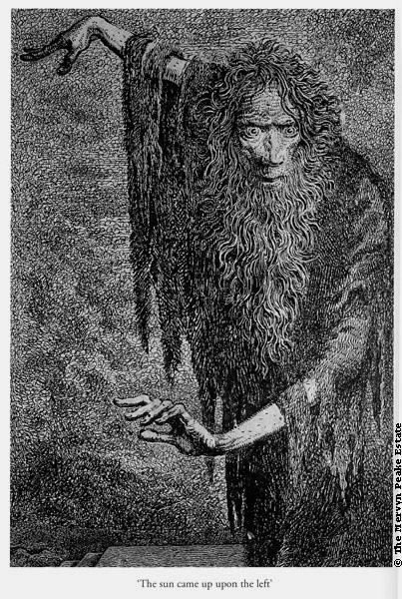
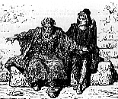
Multiple Narrative / Spiral Narrative / Frame Narrative Method:
The story is frequently told through a series of secret manuscripts or multiple tales, each revealing a deeper secret, so the narrative gradually spirals inward toward the hidden truth. The narrator is often a first-person narrator compelled to tell the story to a fascinated or captive listener (representing the captivating power of forbidden knowledge). By revealing to us their own souls’ secrets, these narrators reveal the secrets of humankind’s soul.

Slide 22
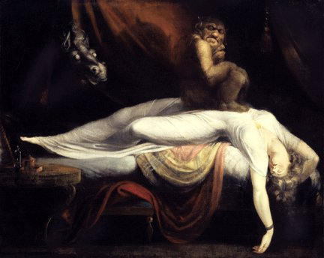
Dreams/Visions:
Terrible truths are often revealed to characters through dreams or visions. The hidden knowledge of the universe and of human nature emerges through dreams because, when the person sleeps, reason sleeps, and the supernatural, unreasonable world can break through. Dreams in Gothic literature express the dark, unconscious depths of the psyche that are repressed by reason— truths that are too terrible to be comprehended by the conscious mind.

Slide 23
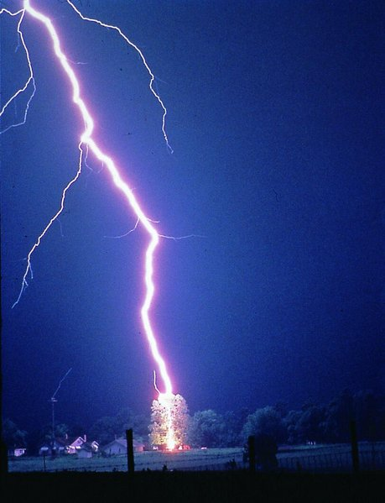
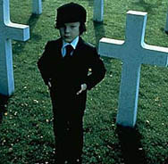
Signs/Omens:
Reveal the intervention of cosmic forces and often represent psychological or spiritual conflict (e.g., flashes of lightning and violent storms might parallel some turmoil within a character’s mind).

Slide 24
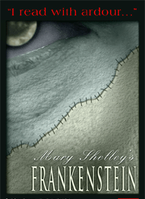

Slide 25
