Slide 1

Pop Culture Responds to War
Creative Responses to Conflict

Slide 2
“Cry havoc!
And let slip the dogs of war!”
– Julius Caesar, Act III: Scene 1
How do we understand war?
What are some of the ways in which war is communicated to us?
Today we’re going to examine different responses to war – how do we come to understand and be able to speak about war – in art, music, and popular media.

Slide 3
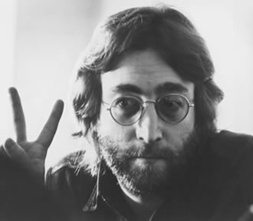
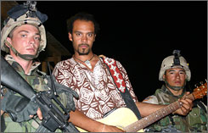
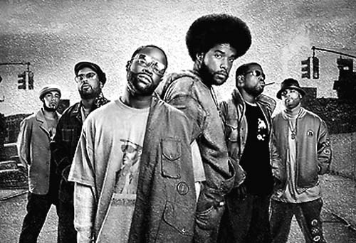
The Protest Song
One of most common
Strong tradition going back hundreds of years
Most common examples from 1960’s in response to Vietnam War
http://www.youtube.com/watch?v=iSeuLsNV4CA

Slide 4
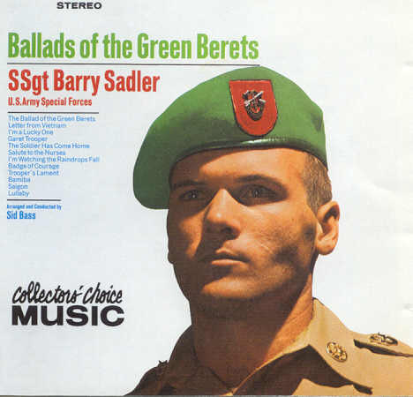
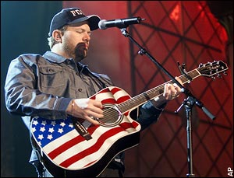
Patriotic Songs
In support of the country’s leadership
Often base arguments on threats to national security, moral obligation to end oppression, established superiority or hegemony, or necessity to survival of democratic world
Emphasize personal sacrifice and fortitude
Many examples from throughout history
Used to elicit support for war effort
http://www.youtube.com/watch?v=7GYXm7n62nU

Slide 5
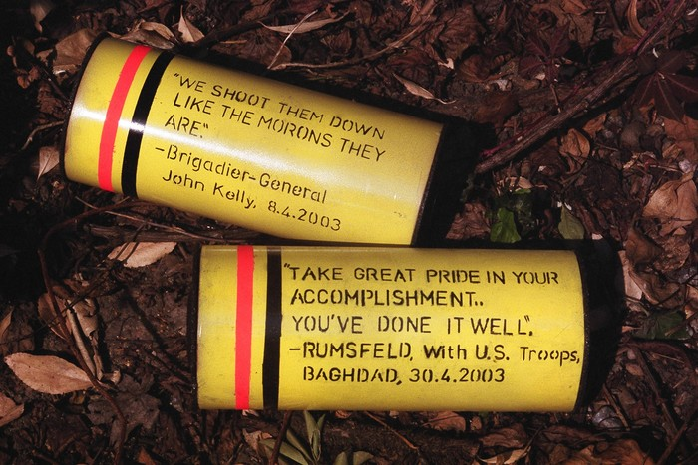
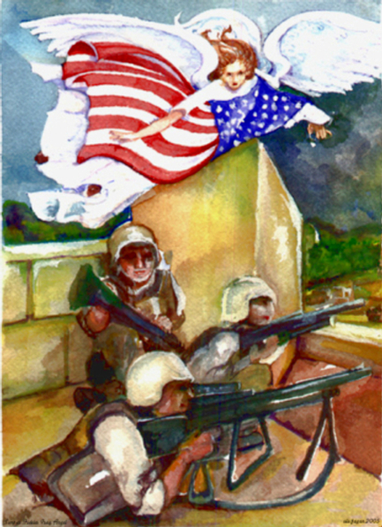
Visual Art
“CLUSTER BOMBLETS,IRAQ” (2003) by Chris Holden
Pro- and Anti-War art created
  Propaganda?
  Critical response?
“Semper Fidelis Iraq” (200x) by Elle Fagan

Slide 6
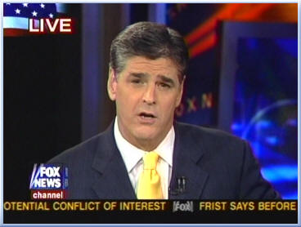
Media: News and Observers
Mainstream media often sought for news of war and for insight into wartime politics and situations
Bias?
Is balanced or unbiased reporting even possible?
Who can you trust?

Slide 7
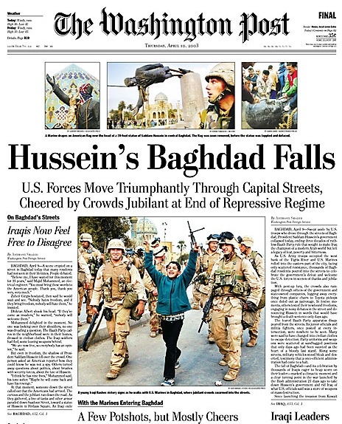
Looking for Bias
Who is being interviewed and who is allowed to talk over all the others?
Sources?
Bias words – words that could convey a particular opinion or pass judgment on the event
Every outlet has a bias – what could it be?

Slide 8
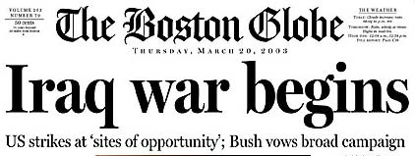
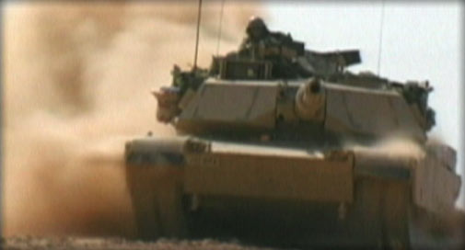
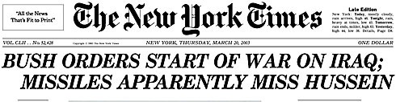

Slide 9
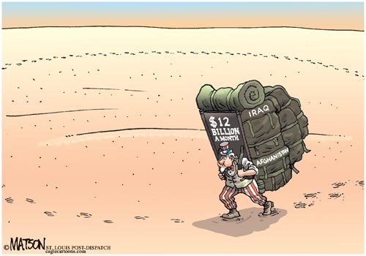
Responding to War Through Humor
How might humor be an appropriate response to war?
How might it help us understand?
How might it critique or support the war?

Slide 10
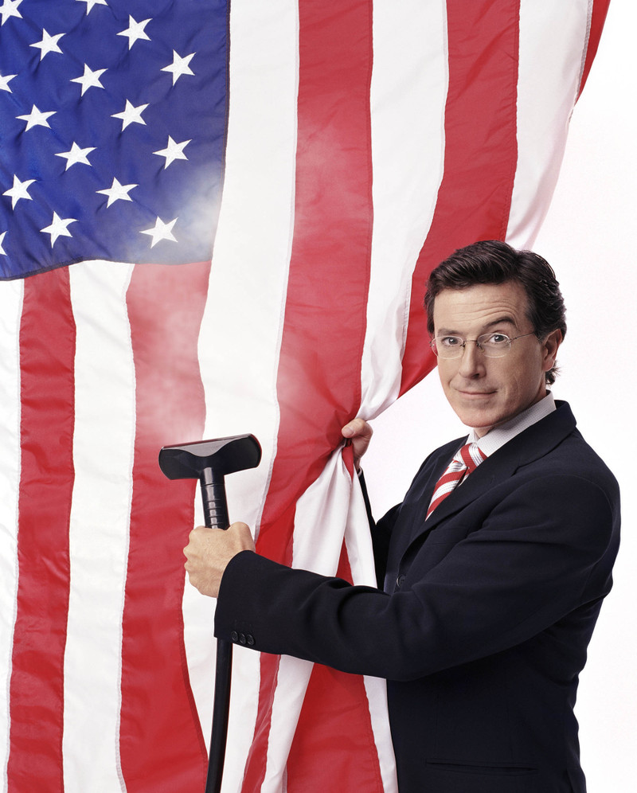
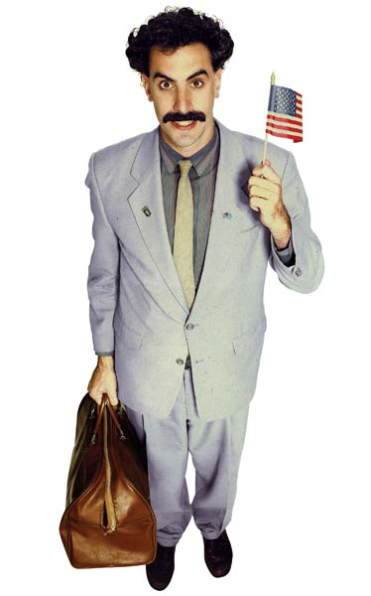
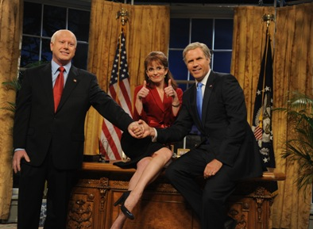
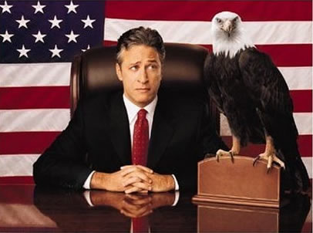
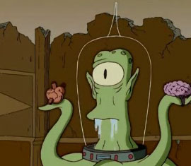
Satire
An attack on or criticism of any stupidity or vice in the form of scathing humor
a critique of what the author sees as dangerous religious, political, moral, or social standards
A way of examining a thought, concept, theory, or representation to unpack the different meanings and consider incongruities or hypocrisy

Slide 11
Compare/Contrast
“Straight Ahead”
Humor or Satire
Take a look at the following videos.
One is a satire, one is from a reputable international news source, and one is a video made by an independent person who is responding to media coverage of the war.
Pay attention to authorship, sources, bias words, and other clues.
Which do you trust? Why?

