Slide 1
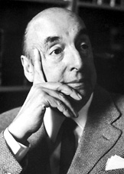
Pablo Neruda
(Neftalí Ricardo Reyes Basoalto)
7/12/1904—9/23/1973
Origin: Chile
Language: Spanish
George Davis, Keaun Beacom

Slide 2
Biography
Pablo Neruda was born on July 12th, 1904 in Parral Chile and died on September 23, 1973 in Santiago, Chile. Pablo received a motivation prize “for a poetry that with the action of an elemental force brings alive a continents destiny and dreams” and also was awarded the Nobel Prize for Literature in 1971. His father worked for the railroad, and his mother was a teacher which motivated him to become an author. He started his career at the age of 13 by publishing articles and poems for the daily La Manana local news.

Slide 3
Key Ideas in Pablo Neruda’s Nobel Writings
“We come from far away, from that which is behind us and within us, from different languages, from countries that love one another.”-Pablo Neruda Banquet Speech
“Each of us made his way forward filled with this limitless solitude, with the green and white silence of trees and huge trailing plants and layers of soil laid down over centuries, among half-fallen tree trunks which suddenly appeared as fresh obstacles to bar our progress.”-Pablo Neruda Nobel Lecture

Slide 4
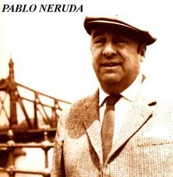
A Survey of Pablo Nerudas Famous Poems
Tonight I Write (The Saddest Lines)
Love
Sonnet XVII
Clenched Soul
Your Laughter
Oda al Tomate
Your Hands
I Explain A Few Things
Pablo Neruda wrote many different poems that all express different things. Pablo Neruda wrote poetry about everything; politics, love, day-to-day life, sorrow, you name it.

Slide 5
Pablo Neruda’s Poetry
Death lies in our beds : in the lazy mattresses, the black blankets, lives a full stretch and then suddenly blows, blows sound unknown filling out the sheets and there are beds sailing into a harbour where death is waiting, dressed as an admiral.—Death Alone, by Pablo Neruda; verse 7
Pablo Neruda work has such surreal way of describing thoughts. His work paints images that many never thought about before such as “unknown filling out the sheets and there are beds sailing into a harbour where death is waiting” paints an image of death that is surreal as can be.

Slide 6
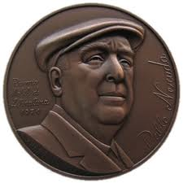
Pablo Neruda
Pablo Neruda has brought such a contribution to the twentieth-century’s literature. He’s introduced and pushed a new surreal way of writing. Pablo Neruda was heavy influenced by his parents to become a writer. Pablo received many awards for his work such as; the Nobel Prize for literature and the Motivation Prize for poetry. Pablo Neruda work is still on going and will continue to create a surreal way of thinking for future generations.

