Slide 1
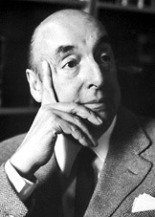
Pablo Neruda
Won Nobel Prize in literature in 1971.
Born July 12,1904
Died September 23,1973

Slide 2
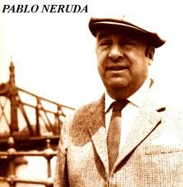
Biographic Info
Born in Parral, Chile; died in Santiago, Chile.
Real name was Neftli Ricardo Reyes Basoalta.
Worked as a diplomat during his life.
Poetry was a hobby.

Slide 3
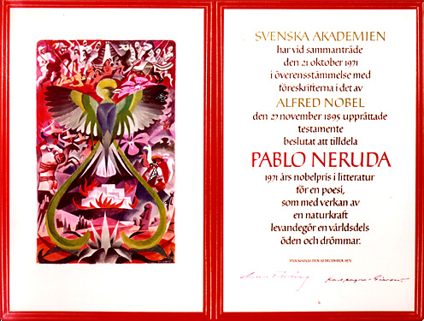

Slide 4
1927 Neruda was put in charge of a number of honorary consulship by the government.
Was awarded the nobel, "for a poetry that with the action of an elemental force brings alive a continent's destiny and dreams".

Slide 5
Speech Key ideas
In his speech, Neruda explains his ideas on poetry and poets.
  “The poet is not a "little god". No, he is not a "little god". He is not picked out by a mystical destiny in preference to those who follow other crafts and professions.”
  “I believe that poetry is an action, ephemeral or solemn, in which there enter as equal partners solitude and solidarity, emotion and action, the nearness to oneself, the nearness to mankind and to the secret manifestations of nature. And no less strongly I think that all this is sustained - man and his shadow, man and his conduct, man and his poetry - by an ever-wider sense of community, by an effort which will for ever bring together the reality and the dreams in us because it is precisely in this way that poetry unites and mingles them.”

Slide 6
Nobel Speech
I did not learn from books any recipe for writing a poem, and I, in my turn, will avoid giving any advice on mode or style which might give the new poets even a drop of supposed insight. When I am recounting in this speech something about past events, when reliving on this occasion a never-forgotten occurrence, in this place which is so different from what that was, it is because in the course of my life I have always found somewhere the necessary support, the formula which had been waiting for me not in order to be petrified in my words but in order to explain me to myself.

Slide 7
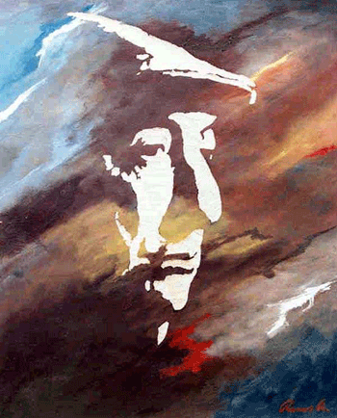
Contribution to Literature
Pablo Neruda was a gifted writer who was dedicated to literature and his profession.
His writings were a part of him and his thoughts. He wrote about the things around him and what was important to him.

