Slide 1
Octavio Paz
(March 31,1914-April 19,1998)

Slide 2
Biographical information
Published his first poems as a teenager in 1931.
At age 19, he published his first collection of poetry, called “Luna Silvestre”(wild moon)
In 1990- he was awarded the Nobel prize in Literature

Slide 3
Contributions to Mexico
Served as Mexican ambassador to India
He founded a magazine called “Taller”, which encouraged young poets to start publishing their work.

Slide 4
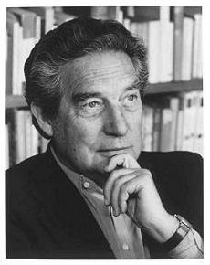

Slide 5
Key ides from Nobel prize speech
Reflected on Latin American identity “I should briefly mention what distinguishes Spain from other European countries, giving it a particularly original historical identity-” Octavio Paz mentioned in his speech of acceptance for literature.
Paz also went on about giving the Spanish describing them as having a peninsular eccentricity that embodies the centuries of influence from Jewish, Roman, Arabs thought, and the Reconquest.
Octavio frequently commented on his native Mexican identity from the topics within his speech.

Slide 6
List of Author’s work
The Labyrinth of Satitude (1950)
“Piedre de Sol” (“Sunstone”) (1957)
“La Hija de Reppaccini” (1956)

