Slide 1
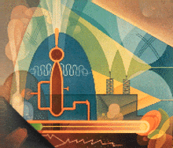
New Deal Art in New Mexico
A look at art and artists during the Great Depression

Slide 2
New Deal Art
When President Franklin Roosevelt’s New Deal planners offered American artists jobs, the New Mexico artists picked up their brushes and chisels, and for about 10 years, from 1933 to 1943, signed onto federal programs to make art for their communities.

Slide 3
New Deal Art
Out-of-work artists in New Mexico picked up their brushes and chisels, and for about 10 years, from 1933 to 1943, signed onto federal programs—most notably the New Deal's Works Progress Administration Art Project--to create artwork for public buildings, allowing the artists to remain independent, support their families, and contribute work of long value to their New Mexico communities.

Slide 4
New Deal Art
By 1935, more than half of New Mexico's population was involved in one or another of the WPA projects . . . including the inspired Public Works of Art Project. More than 65 murals with varied subject material were created in New Mexico during the Depression.

Slide 5
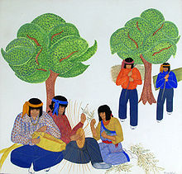
Pablita Velarde
Velarde was born on Santa Clara Pueblo near Española, New Mexico. After the death of her mother when Pablita was about five years old, she and two of her sisters were sent to St Catherine's Indian School in Santa Fe.

Slide 6
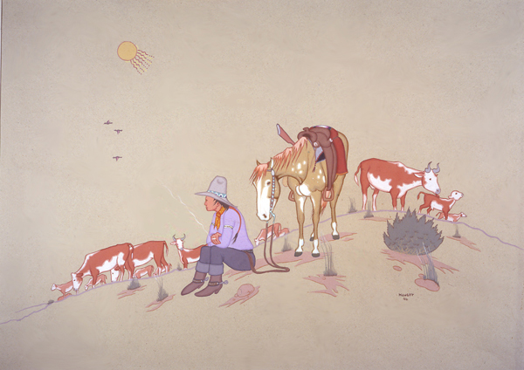
Allan Houser
Allan Capron Houser or Haozous (June 30, 1914—August 22, 1994) a Chiricahua Apache sculptor, painter and book illustrator born in Oklahoma. He was one of the most renowned Native American painters and Modernist sculptors of the 20th century.

Slide 7
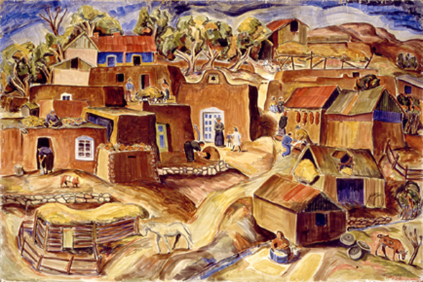
William Lumpkins
William Lumpkins was born on the Rabbit Ears Ranch in Clayton, New Mexico. His early education came from a tutor who instilled a lasting interest in Zen Buddhism in the young artist.

Slide 8
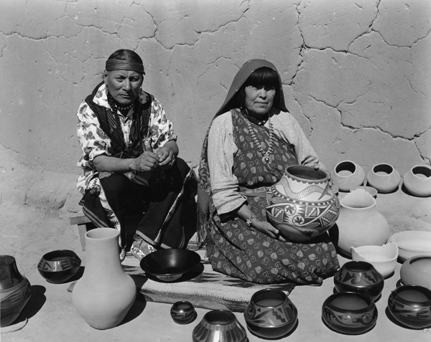
Maria Martinez
Maria Montoya Martinez (1887, San Ildefonso Pueblo, New Mexico – July 20, 1980, San Ildefonso Pueblo) was a Native American artist who created internationally known pottery

Slide 9
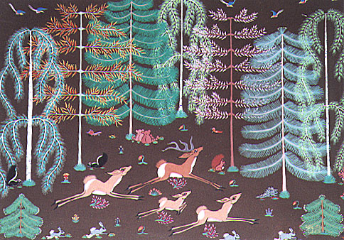
Pop Chalee
Pop Chalee was born Merina Lujan on March 20, 1906 in Castle Gate, Utah. Her father, Joseph Cruz Lujan was from Taos and her mother Merea Margherete Luenberger, was predominately Swiss

Slide 10
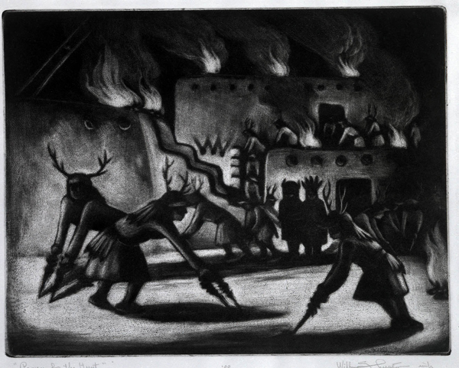
Will Shuster
Will Shuster was born in Philadelphia and studied to be an electrical engineer while at the same time pursuing his interest in art. During his military service in WWI he was gassed, became ill, and developed tuberculosis.

Slide 11
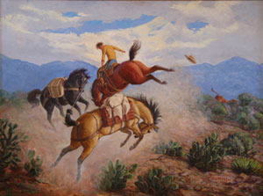
Ila McAfee
Ila McAfee was born in a Colorado ranching community, ten miles from the nearest schoolhouse. Her artistic interest began early and centered upon horses, which she would draw as a child.

Slide 12
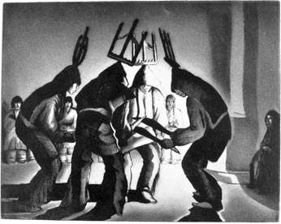
Gene Kloss
Gene Kloss (born Alice Geneva Glasier) had already established the beginnings of a distinguished art career in her native California when she first visited Taos on her honeymoon in 1925. She reportedly said she considered herself a New Mexican from that day forth.

Slide 13
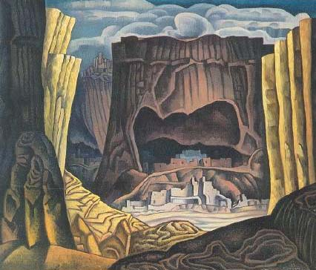
Raymond Jonson
In 1922, Jonson's life was changed when he visited New Mexico for the first time. The experiences and sights of this short visit to Santa Fe, convinced Jonson to move to New Mexico in 1924 to focus on painting among the southwestern landscapes

Slide 14
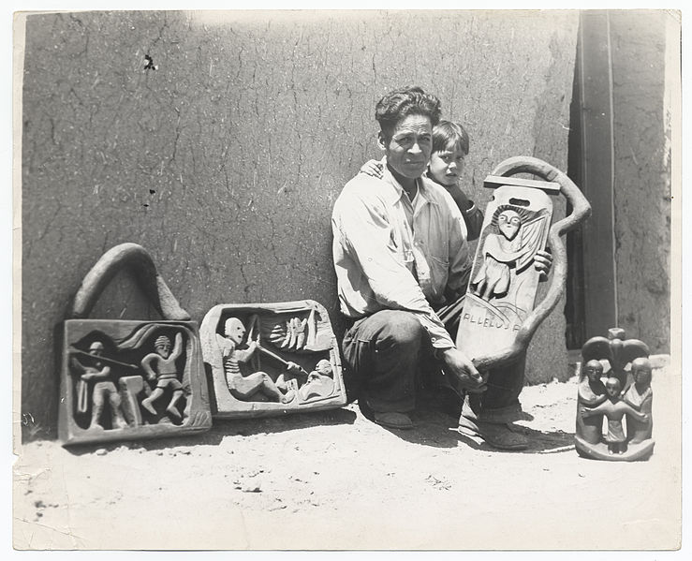
Patrocino Barela
Patrocino Barela, with four wood carvings and his little son. This humble day laborer of New Mexico, is the most dramatic discovery made in American Art for the past several years

Slide 15
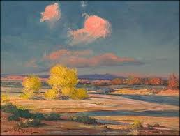
Gerald Cassidy
Gerald R. Cassidy was an early 20th century artist, muralist and designer who lived in Santa Fe, New Mexico.

Slide 16
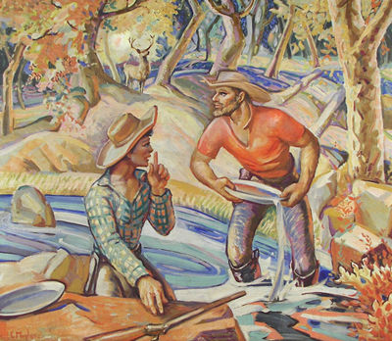
Lloyd Moylan
Moylan moved to Santa Fe around 1931. By 1933 and in the depth of the Great Depression, Moylan was sharing his Alcalde, NM studio with D. Paul Jones, an artist friend from Broadmoor Art Academy who would also eventually be employed as a New Deal artist in the Federal Arts Projects.

Slide 17
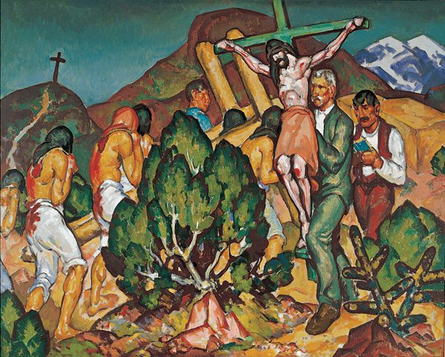
William Penhallow Henderson
William Penhallow Henderson (born in 1877 in Medford, Massachusetts - died in 1943 in Tesuque, New Mexico) was an American painter, architect, and furniture designer.

Slide 18
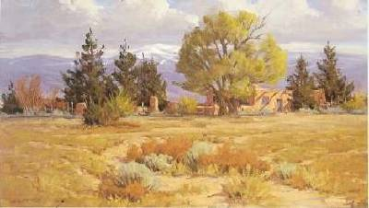
Bill Warder
His first notable work was a mural in a public library for the WPA Arts Project in 1937. His murals grace the walls of many, many schools and public buildings in Albuquerque and throughout New Mexico.

Slide 19
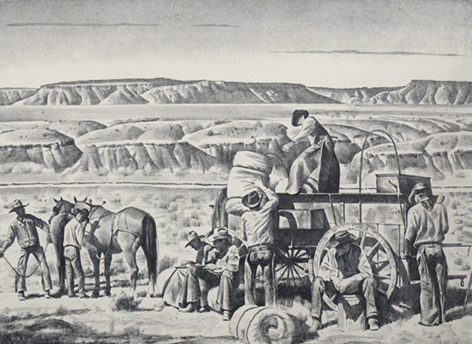
Theodore Van Soelen
In 1938 Van Soelen won a mural commission for the Post Office in Portales
.

Slide 20
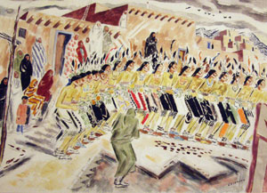
J. Ward Lockwood
Though Lockwood's career is primarily defined by the work he did while in Taos, he painted and taught for a variety of corporations and universities. He did work for the WPA and the Federal Arts Project

Slide 21
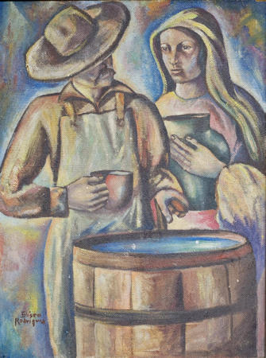
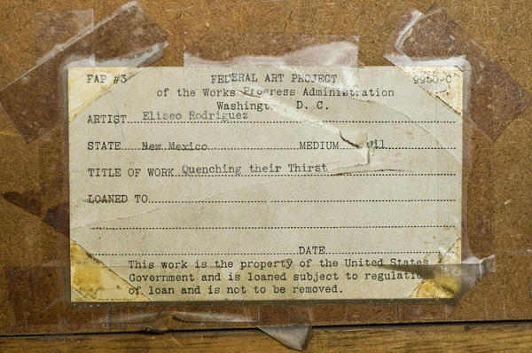
Eliseo Rodriquez
The original oil work was done in a variety of colors. On the back of it is written the words, "Federal Art Project of the Works Progress Administration," a reference to the 1935 New Deal cultural development program instituted by then-President Franklin Delano Roosevelt

Slide 22
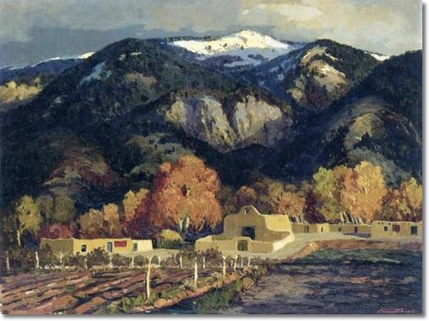
Fremont Ellis
Fremont F. Ellis (1897-1985)

Slide 23
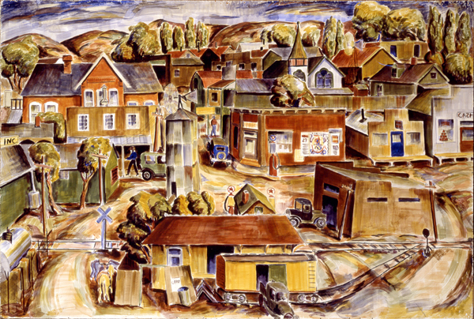

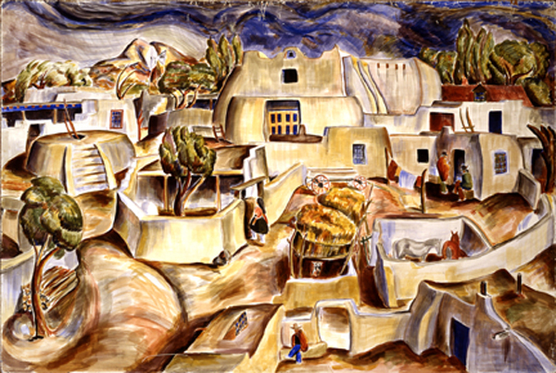
Compare William Lumpkins paintings
Anglo Village
Spanish Village
Indian Village
Similar Traits
Contrasting Traits
Compare and contrast the three. How are they similar, how are they different?

Slide 24
Credits
The Collectors Guide
Wikipedia
New Mexico Museum of Art

