Slide 1
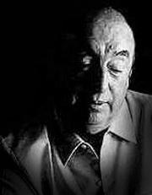
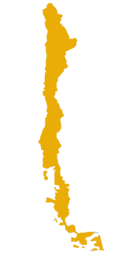
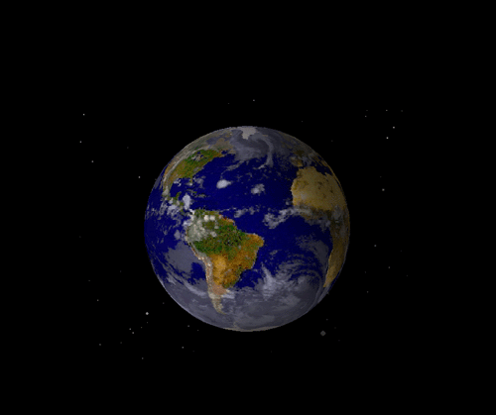


C h i l e
Pablo Neruda
poet and statesman
1904 - 1973
Nobel Prize for Literature, 1971

Slide 2
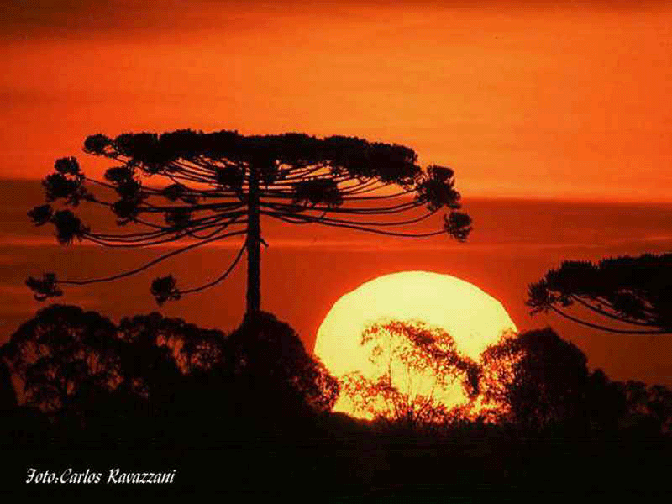

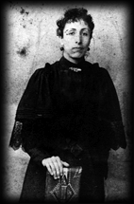
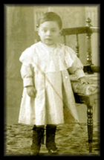
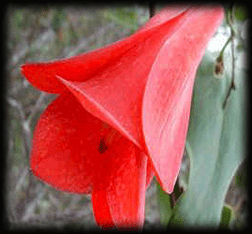

1904
Parral
The son of
Rosa Naftalí Basoalto
and José del Carmen
Reyes Morales,
Neftalí Ricardo Reyes Basoalto (Pablo Neruda)
is born the 12th
of July in Parral, Chile.

Slide 3
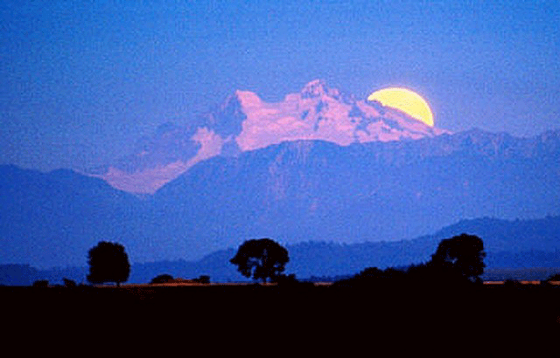

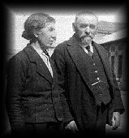
1920
He attends the Boys School in Temuco where he studies humanities.
Temuco

Slide 4
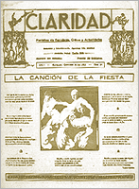
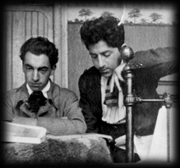

1922
He contributes to the Student Federation magazine ‘‘Claridad’’.
1923
In August, the first edition
of ‘Crepusculario’’ is published.

Slide 5
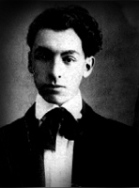

1917
1919
He publishes an article entitled ‘‘Entusiasmo y perseverancia’’
using his real name,
Neftalí Reyes.
He collaborates with others on ‘‘Selva oscura’’ in Temuco.
His poem ‘‘Nocturno ideal’’ wins third prize in a poetry contest.
1918
He publishes the poem
‘‘Mi ojos’’ in the magazine ‘‘Corre-vuela’’ in Santiago.
1920
In October he begins to use the pseudonym “Pablo Neruda” and in November he wins First Prize in Temuco’s spring festival. He writes two books that will later be part of Crepusculario.

Slide 6
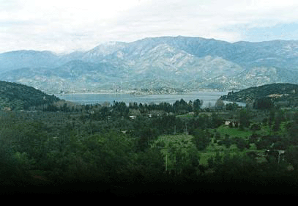

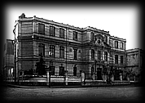
Santiago
1921
He moves to Santiago to study in the Teachers’ Institute to become a French teacher, and wins First Prize in the contest sponsored by the National Student Association.

Slide 7
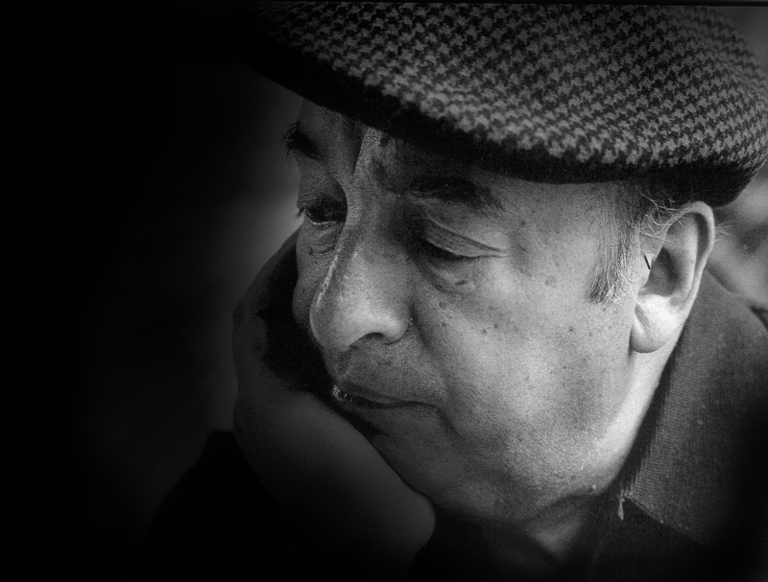

Poem 20
Tonight I can write the saddest lines.
Write, for example, 'The night is starry
and the stars are blue and shiver in the distance.’
Through nights like this one I held her in my arms.
She loved me, sometimes I loved her too.
Tonight I can write the saddest lines.
To think that I do not have her.
To feel that I have lost her.
translated by W. S. Merwin

Slide 8
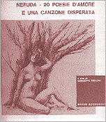
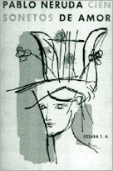
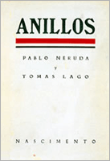
1924
1925
1926
Twenty poems of love and one desperate song
Páginas escogidas
de Anatole France, with prologue and translation by Pablo
Neruda
He edits the magazine
Caballo de Bastos and writes for various literary publications and the newspaper La Nación.
El habitante y su esperanza
Anillos
Second edition of Crepusculario

Slide 9
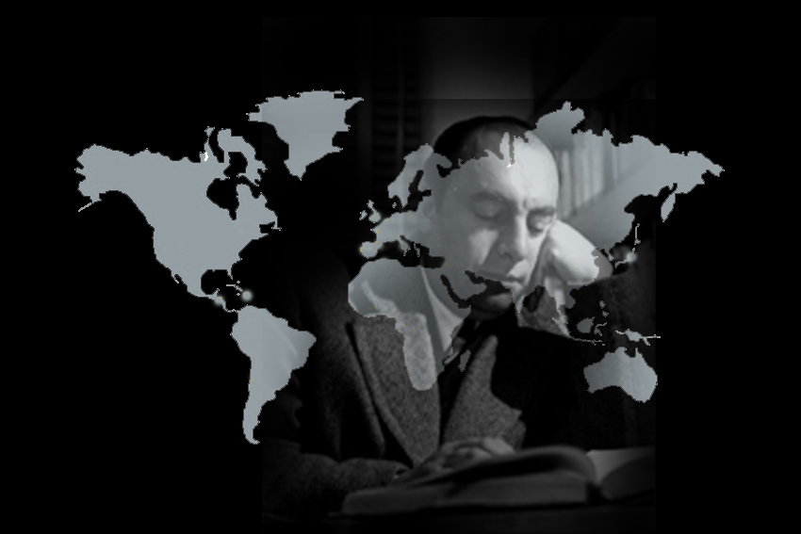

1927-1932
Burma
Singapore
Ceylon
Java
Neruda serves as honorary Consul for Chile in Asia. During this period of great loneliness, he wrote Residencia en la tierra.

Slide 10
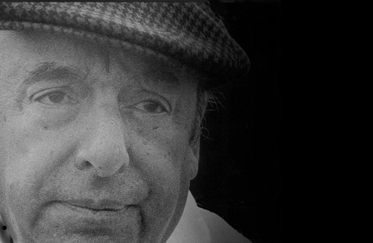
WALKING AROUND
I happen to be tired of being a man.
I happen to be tired of my feet and my nails
and my hair and my shadow.
I don’t want so much misery.
I don't want to go on as a root and a tomb,
alone under the ground, a warehouse with corpses, half frozen, dying of grief.
I happen to be tired of being a man.

Slide 11
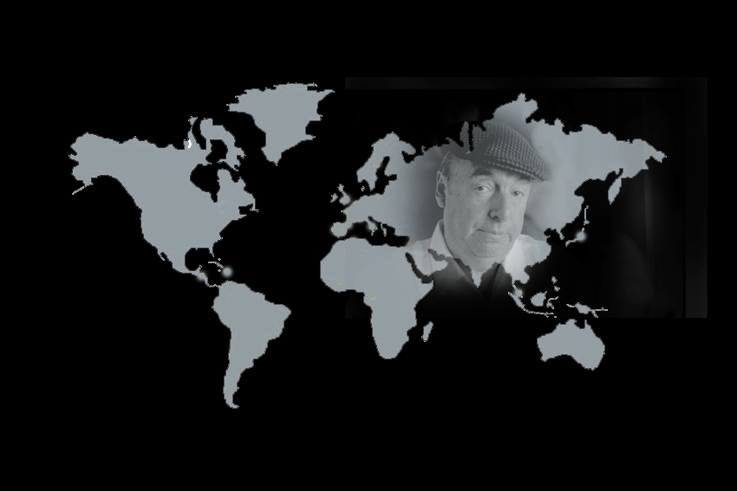

1934-1937
París
Barcelona
Madrid
Neruda is named Consul in Spain, where he meets the great
poets García Lorca, Cesar Vallejo, and Miguel Hernandez.

Slide 12
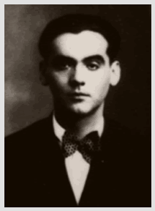
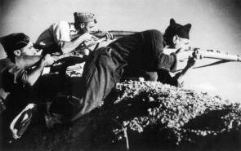
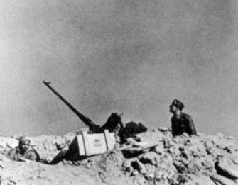
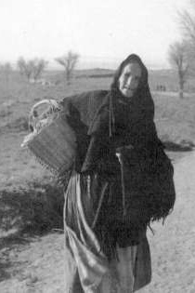
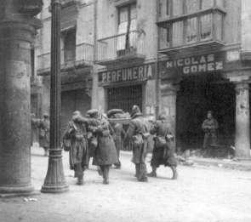
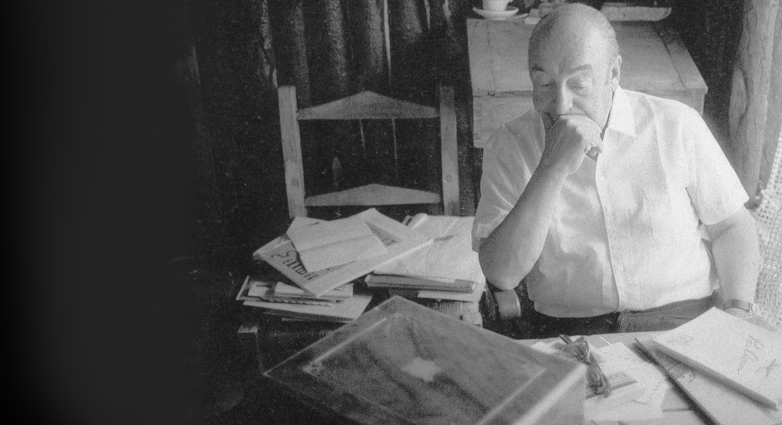
1937
The Spanish Civil War and the murder
of his good friend poet García Lorca, deeply affect him and motivate him to
join the Republican movement,
first in Spain, and later in France,
where he starts working on his
collection of poems
España en el Corazón.

Slide 13
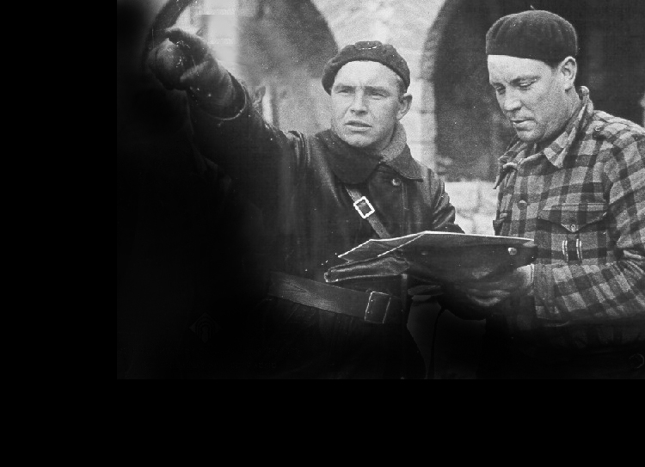
I’m Explaining a Few Things
I lived in a suburb of Madrid, with bells,
and clocks, and trees.
Remember, Raul?
Eh, Rafael?
Federico, do you remember
from under the ground my balconies on which the light of June drowned flowers in your mouth?
Brother, my brother!

Slide 14
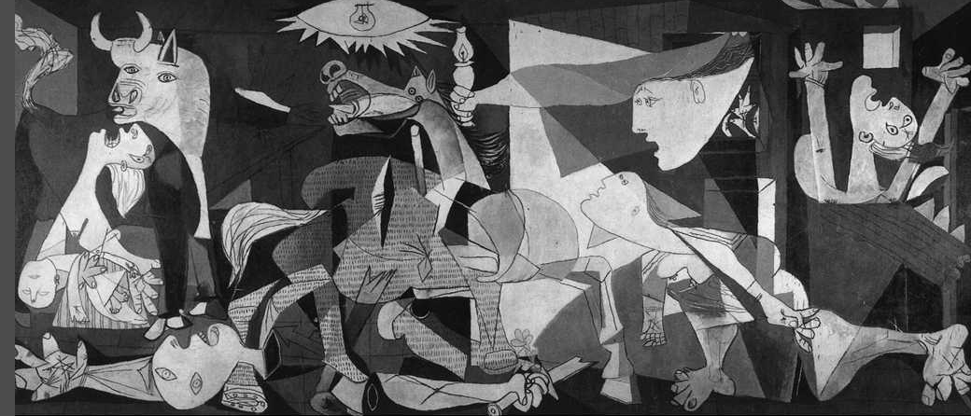
And who made war?
It’s been pounding since the day before yesterday.
I’m afraid.
It pounds like a stone against the wall,
like thunder with blood, like a dying mountain.
This is a world I didn’t make.
You didn’t make it.
THEY made it.

Slide 15
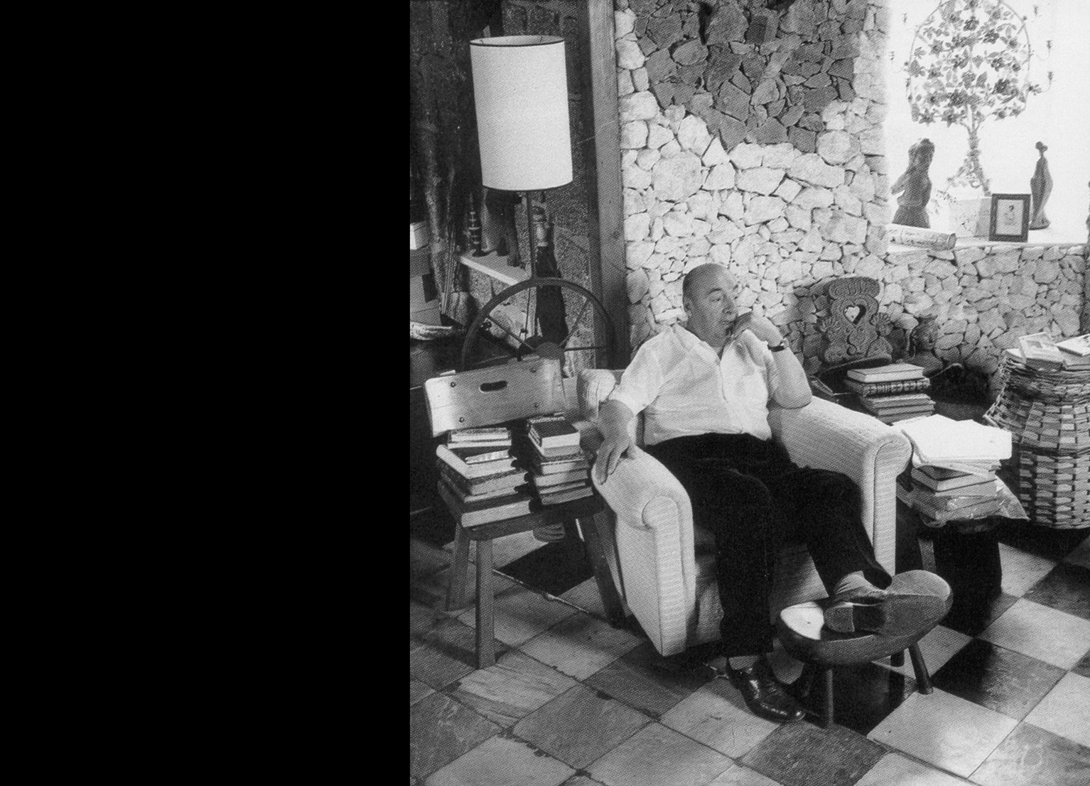
1939 - 1940
Neruda is appointed Chilean consul in Paris, and is responsible for saving the lives of thousands of Spaniards, who he transports in a ship from Franco’s prison camps to new lives in Chile.
While Consul General in Mexico, he rewrites his
Canto General de Chile, transforming it into an epic poem about the whole South American continent, its nature, its people and its historical destiny.

Slide 16
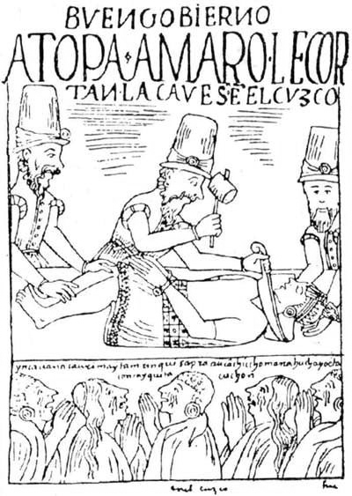
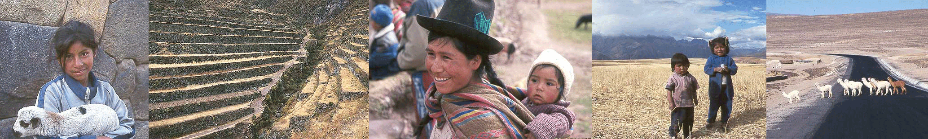
TUPAC AMARU (1781)
Tupac Amaru, vanquished sun,
a vanished light rises
from your sundered glory
like the sun over the sea.
The deep tribes of clay,
the sacrificed looms,
the wet sand houses
say in silence: “Tupac,”
and Tupac is a seed,
they say in silence “Tupac,”and Tupac germinates in the ground.
translated by Jack Schmitt

Slide 17
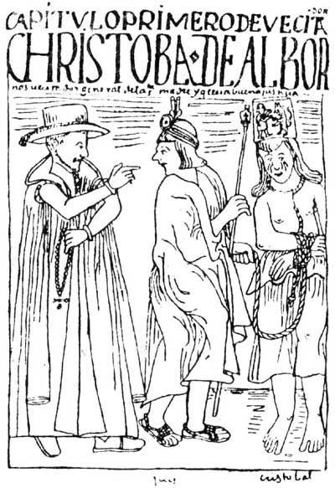
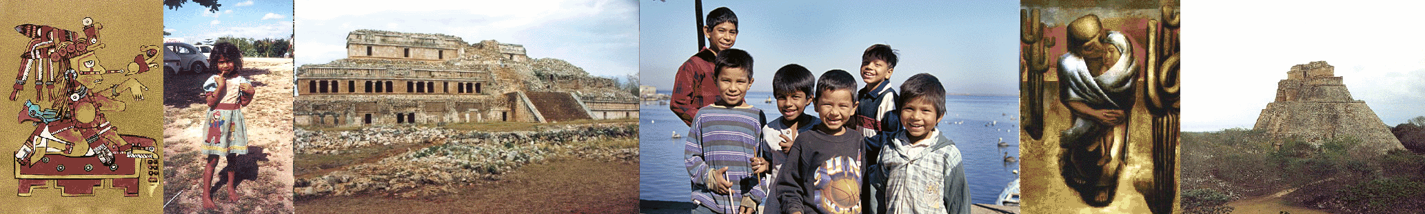
THEY ARRIVE TO MEXICO’S SEA
(1519)
The murderous wind takes wing to Veracruz.
In Veracruz the horses are put ashore.
The ships are packed with claws
And red beards from Castile.
Arias, Reyes, Rojas, Maldonados,
The foundlings of Castilian abandonment
Veterans of hunger in winter
And of lice in the roadside inns.
Translated by Jack Smith

Slide 18
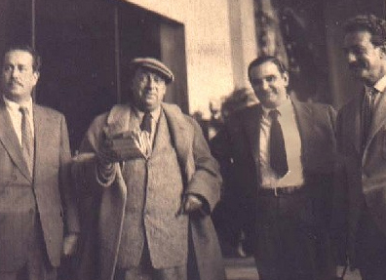
1943
Neruda returns to Chile, and in 1945 he is elected senator of the Republic, also joining the Communist Party of Chile.
When President González Videla's violently suppresses a strike of miners in 1947, Senator Pablo Neruda protests.

Slide 19
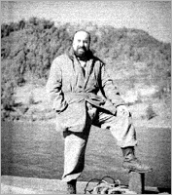
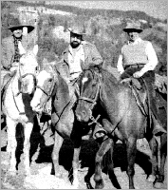
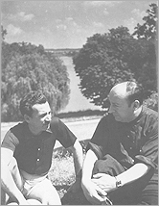
1948
In the Chilean Senate, he gives a speech later published with the title “I Accuse”. As a result, the president orders his arrest. In hiding inside Chile, he begins to write Canto General.
1949
After more than a year living in secret, he manages to flee Chile, crossing the southern Andes through thick forest on horseback, to Argentina.
He begins to live in exile in various countries.
1950
Along with Picasso and other artists, he receives the International Peace Prize.

Slide 20
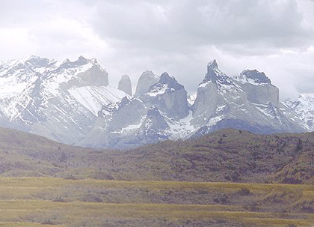
When from Chile
Oh patria, patria,
oh native land, when
and when and when,
When will I be home again?
When, oh my country, will I go
from door to door during the elections
collecting the fearful liberty
that it may shout in the middle of the street?
When, oh my country, will you marry me
with your seagreen eyes and your dress of snow
and we will have millions of new children
that will return the land to the poor?

Slide 21
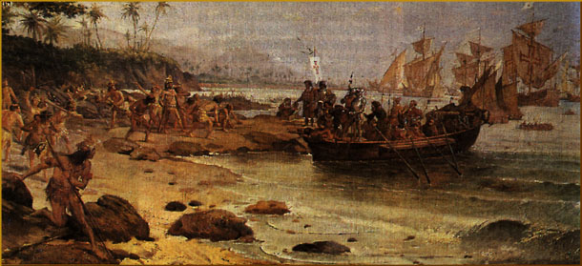
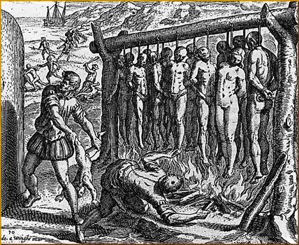
La United Fruit Company
…the dictatorship of flies:
Trujillo flies, Tachos flies
Carias flies, Martinez flies, …
Meanwhile the Indians fall
into the sugared depths
of the harbors
and are buried in the
morning mists;
a corpse rolls, a thing without
name, a discarded number,
a bunch of rotten fruit.
With the bloodthirsty flies
came the Fruit Company,
amassed coffee and fruit
in ships which put to sea like
overloaded trays with the treasures
from our sunken lands.

Slide 22
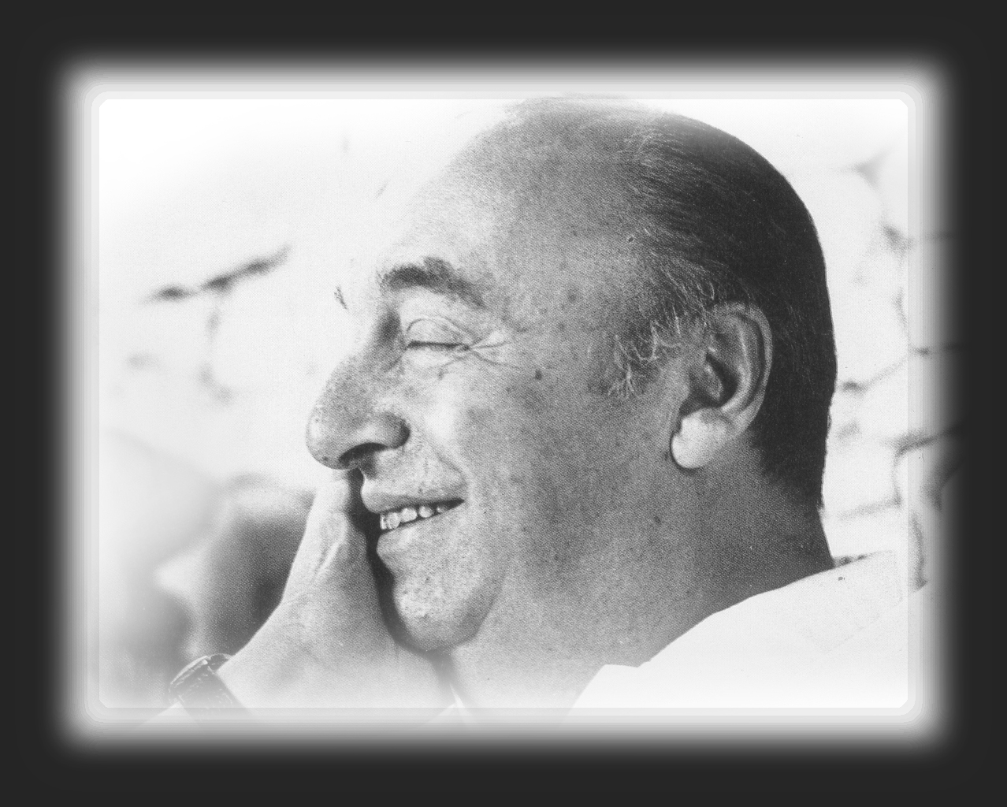
1951
His works are translated to Yiddish, Hebrew, Korean, Vietnamese, Japanese, Arabic, Turkish, Ukranian, Portuguese, Czech, Georgian, and Armenian.
1952
The order of arrest that forces Neruda to live in exile is revoked.
He returns to Chile and is greeted everywhere by joyous celebrations.
1953
Neruda is awarded the Stalin Peace Prize.

Slide 23
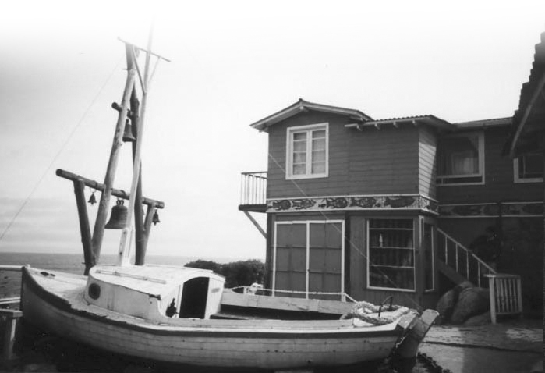
1955
He moves to Isla Negra on the coast south of Santiago, living with Matilde Urrutia in a house he calls La Chascona.

Slide 24
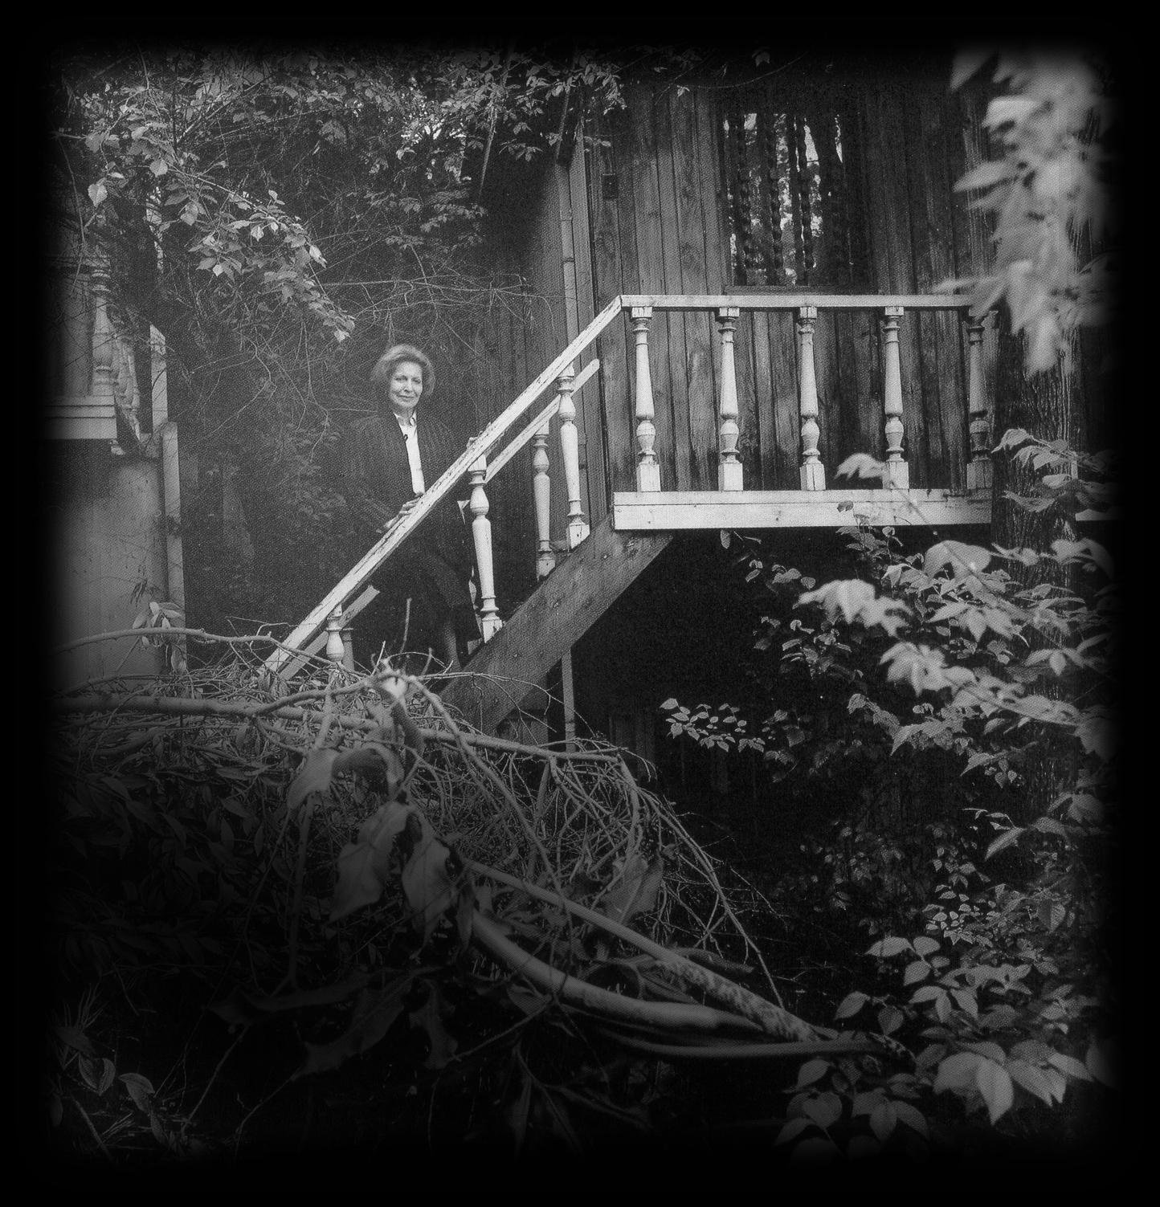
SONNET LXV
Matilde, where are you?
I needed the light of your energy
And I looked everywhere, till hope was gone,
I looked at this empty house where you were absent,
Where nothing was left but tragic windows.
And I waited for you like an empty house
For you to see me and live in me.
So that my windows would cease aching.
translated by Stephen Tapscott

Slide 25
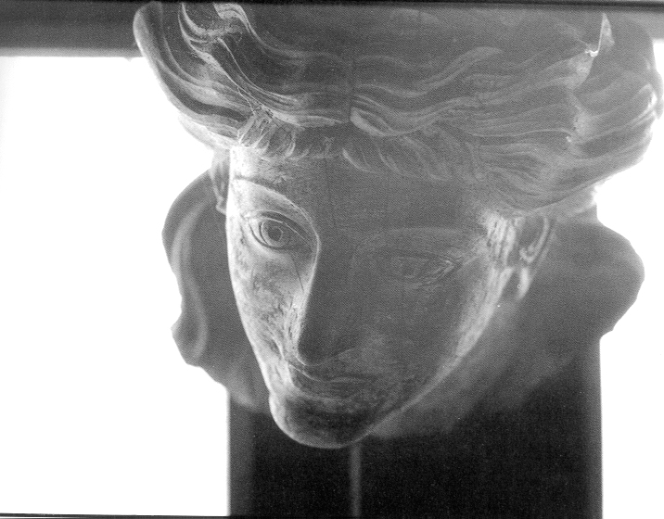
Lovely one, my lovely one,
your voice, your skin,
your fingernails,
lovely one, my lovely one
When you walk or when you rest,
When you suffer or when you dream
Always
You are mine,
My lovely one,
Always.

Slide 26
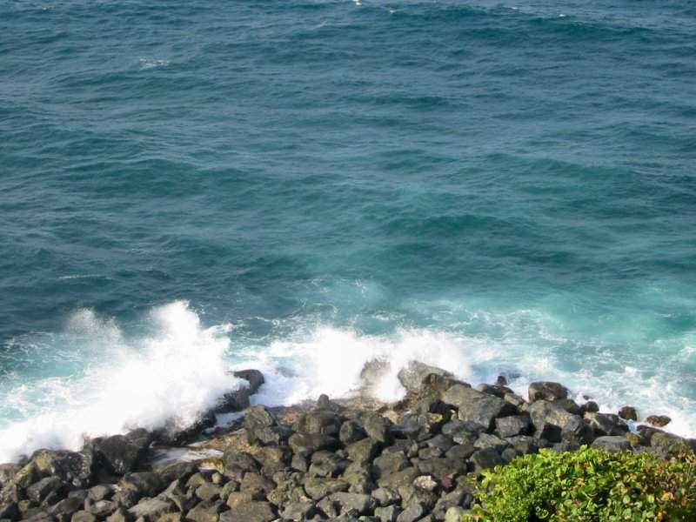
Ahhh….. vastness of pines, echo of waves breaking,
slow play of lights, solitary bell,
twilight falling on your eyes, my love,
Land-shell, in you the earth sings!

Slide 27
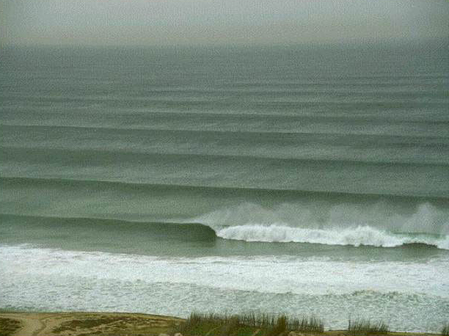
Some other time, man or woman, traveler,
later, when I am not alive,
look here, look for me
between stone and ocean,
in the light storming through the foam.

Slide 28
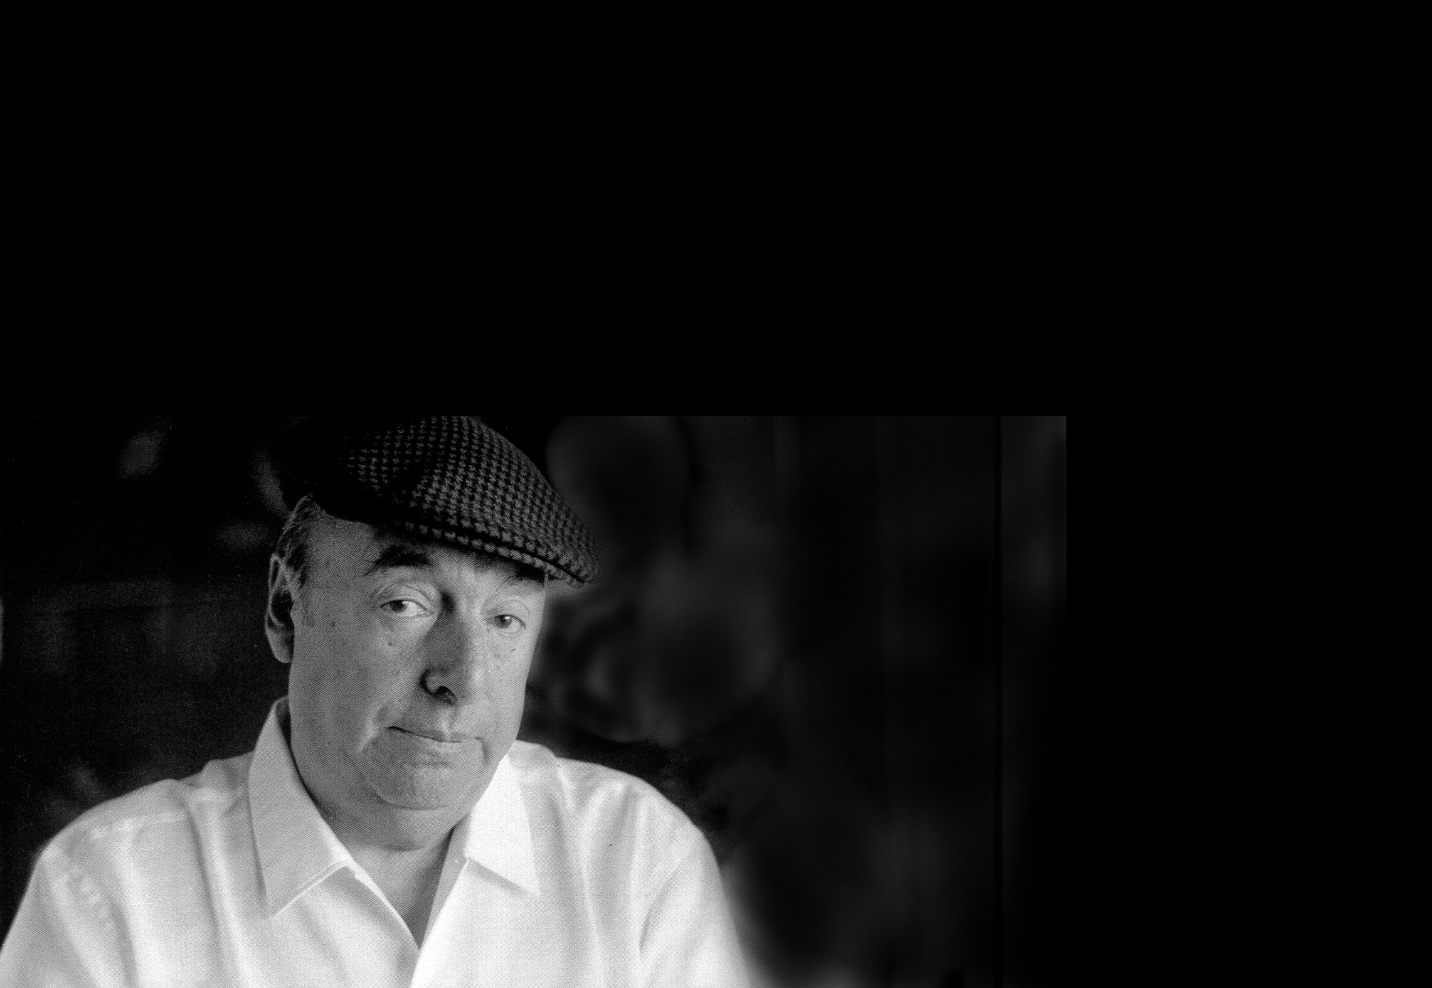
1969
Neruda is chosen as a candidate for presidency of Chile in the primary elections.
I don’t want my country divided.
nor bleeding from seven knife wounds.
I want the light to be hoisted over new homes.
We all can fit in this land of mine.
I don’t want my country divided.

Slide 29
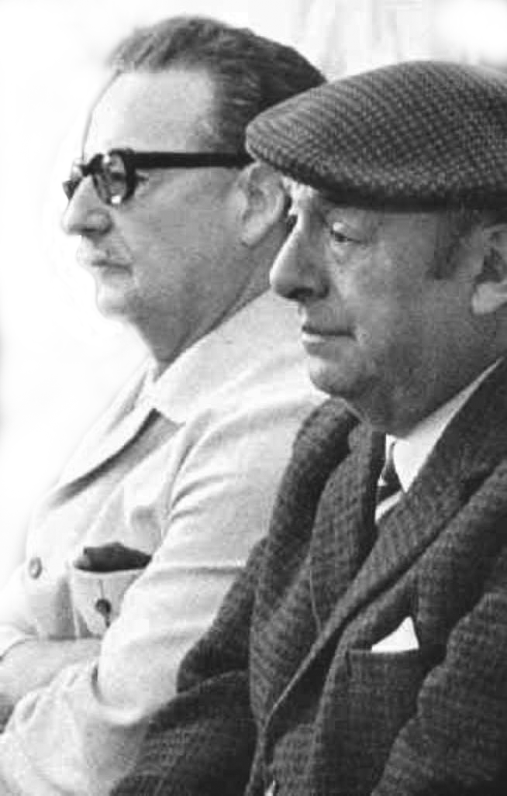
1970
When the political parties of the left unify behind the socialist candidate and personal friend Dr. Salvador Allende, Neruda withdraws from the presidential race.
1971
President Salvador Allende selects Neruda to be Chile’s Ambassador to France.

Slide 30
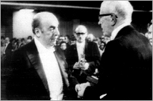

1971
On October 21, he is awarded the Nobel Prize for Literature in Norway.
“Lastly, I wish to say to the people of good will, to the workers, to the poets, that the whole future has been expressed in this line by Rimbaud: only with a burning patience can we conquer the splendid City which will give light, justice and dignity to all mankind.
Thus, poetry shall not have
sung in vain. ’’

Slide 31


1973
1973
1973
On Sept. 11, 1973,
President Salvador Allende
dies in a military coup directed by General Augusto Pinochet and supported by the United States.
On Sept. 23, 1973,
Pablo Neruda dies in
Santiago de Chile,
10 days after the military coup.

Slide 32

Because where a man has no voice,
there, my voice.
Where blacks are beaten,
I can not be dead.
When my brothers go to jail
I shall go with them.
When victory,
not my victory
but the great victory
arrives,
even though I am mute I must speak:
I shall see it come even though I am blind.
I shall go on living.
translated by Donald D. Walsh

Slide 33


There is no such thing as solitary hope or lone struggle.
It is the voices of the people who bestow on me the strength and innocence that must animate all poetry. It is through them that I touch its nobility, its surface of leather, of green leaves, of joy. It is they, the people’s poets, who show me the light.
*
I understood that my human mission was none other than to add my talents to the swelling force of unified peoples, to join them in blood and spirit, with passion and hope, because only from that swelling torrent can be born the progress necessary for writers and for peoples.

Slide 34
Vocabulary
Connotation: An idea or a feeling that a word evokes in addition to its literal or primary meaning.
Denotation: The literal or primary meaning of a word in contrast to the feelings or ideas that the word suggests.
Ode: a lyric poem in the form of an address to a particular subject.

Slide 35
What kinds of poetry did Neruda write?
He wrote about many different subjects:
…Politics, love, day-to-day life, sorrow, Odes, surrealist poems, communist poems, struggle, freedom.
He describes objects, animals and plants, his love of things made or grown by human hands.

