Slide 1
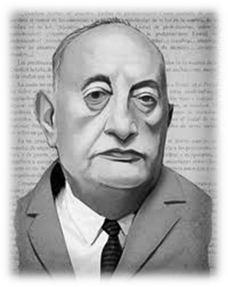
Miguel Angel Asturias

Slide 2
Life
Born October 19 1899 Guatemala City, Guatemala
Lived in Paris from 1923-33
Won the Nobel Peace Prize in 1967
Was one of the most famous surrealist and magical realism writers during his time
Died at 74 on 9 June 1974, Madrid, Spain

Slide 3
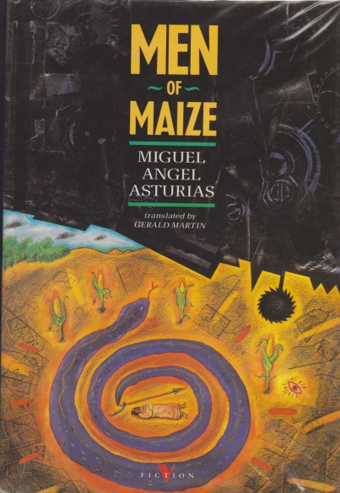
Literacy Works
Austirus helped establish Latin America literacy in Western World
Helped spread knowledge of indigenous people and their cultures
Most famous work include; Leyendas de Guatemala, El Señor Presidente, and Men of Maize
Most famous for his surrealism and
magical realism work

Slide 4
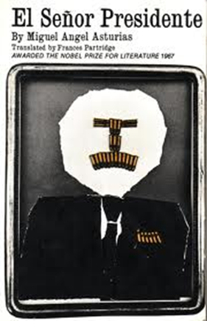
Controversy
One of Asturias' most famous novels, El Señor Presidente, describes life under a ruthless dictator.
He spent many years exiled in Europe and South America because of his controversial works

Slide 5
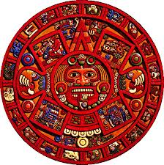
Mayan Influence
Many texts involved Mayan people and life
Did not speak or know Mayan language but wrote what he thought they said and felt
Famous for bringing Mayan culture into light

Slide 6
Made By
Shareef Holley
Lucas Harari
Dylan Bowman

