Slide 1
Mario Vargas Llosa
Politician, writer, journalist, essayist.

Slide 2
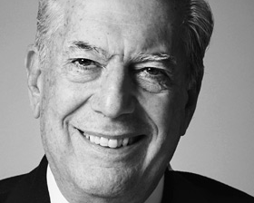

Slide 3
Biographical information
Mario Vargas Llosa was born in a middle-class family on March 28, 1936.
He won his Nobel Prize in 2010 for his “Cartography of structures of power and his trenchant images of the individuals resistance, revolt, and defeat”.
He was one of the leading writers of his generation.
Some critics consider him to have a larger international impact and world wide audience than any other writer of the Latin American Boom.

Slide 4
Mario Vargas Llosa’s Nobel Prize speech
“At times I wondered whether writing was a solipsistic luxury in countries like mine.”
“Since every period has its horrors, ours is the age of fanatics, of suicide terrorists, an ancient species convinced that by killing they earn heaven, that the blood of innocents washes away collective affronts, corrects injustices, and imposes truth on false beliefs.”

Slide 5
Five Novels of Literary Contributions from Llosa
The Time of the Hero (1963)
Aunt Julia and the Scriptwriter (1977)
The War of the End of the World (1981)
The Feast of the Goat (2000)
The Bad Girl (2006)

