Slide 1
Essay on Maus/Night/Oral History
You will write a 3-5 paragraph essay on Maus/Night/Oral History with a focus on the following:
MLA format
In-text citations/Bibliography
Topic sentences/Supporting sentences/Concluding sentences/Transitional devices.
Thesis – What is the importance of oral history?

Slide 2
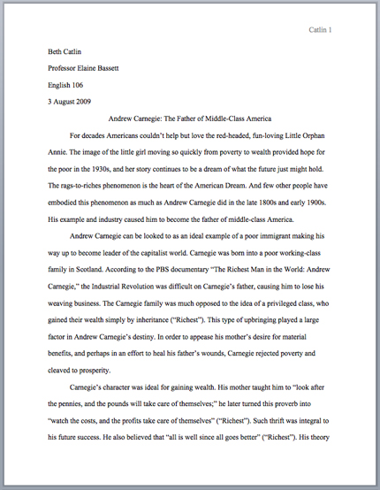

Slide 3
MLA Format
In the upper left-hand corner of the first page, list your name, your instructor's name, the course, and the date. Again, be sure to use double-spaced text.
Double space again and center the title. Do not underline, italicize, or place your title in quotation marks; write the title in Title Case (standard capitalization), not in all capital letters.
Use quotation marks and/or italics when referring to other works in your title, just as you would in your text: Fear and Loathing in Las Vegas as Morality Play; Human Weariness in "After Apple Picking"
Double space between the title and the first line of the text.

Slide 4
Topic Sentence
During the 1990s, I really enjoyed watching Friends on television every Thursday night. I really wanted Rachel’s haircut—I think every girl wanted Rachel’s haircut back then! Rachel’s haircut went really well with the Guess Jeans that were so popular in the 1990s. I remember all the advertisements for Guess and Calvin Klein Jeans that were in each month’s Sassymagazine. I don’t think Sassy magazine exists anymore, but it was one of the most popular magazines for young women in the 1990s.
Every paragraph should include a topic sentence that identifies the main idea of the paragraph.
What do you think the topic sentence of this paragraph should be?

Slide 5
Thinking about the 1990s brings back a lot of memories for me about fashion and popular culture. During the 1990s, I really enjoyed watching Friends on television every Thursday night. I really wanted Rachel’s haircut—I think every girl wanted Rachel’s haircut back then! Rachel’s haircut went really well with the Guess Jeans that were so popular in the 1990s. I remember all the advertisements for Guess and Calvin Klein Jeans that were in each month’s Sassy magazine. I don’t think Sassy magazine exists anymore, but it was one of the most popular magazines for young women in the 1990s.

Slide 6
In-text citations
In-text citations: Author-page style
[example] In Night, Elie Wiesel, shows that leaving the objects on the train showed they had also left their “illusions” (Wiesel 3).
In Maus, Vladek shows Artie how to be tough with his friends when he says, “If you lock them together in a room with no food…then you could see what it is, friends” (Spiegelman 6).

Slide 7
Works Cited Page
MLA Citation –
Lastname, Firstname. Title of Book. City of Publication: Publisher, Year of Publication. Medium of Publication.
Wiesel, Elie,Wiesel, Marion.Night. New York : Hill And Wang, 2006. Print.
Spiegelman, Art. Maus: A Survivor's Tale. New York: Pantheon Books, 1986. Print.
Smith, Jane. Personal interview. 19 May 2014.

Slide 8
Comic book Presentations
Your presentations will include a visual of what you created [I have the pdf file].
An example of how you used your oral history interview in your comic book presentation.
An explanation of why you personally found the oral interview to important to preserve.
Grades will be based on student feedback, your comic book and overall presentation.

