Slide 1

GRAPHIC NOVELS
Cutting edge stories from around the world

Slide 2
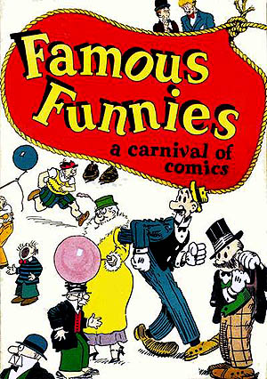
GRAPHIC NOVELS: ORIGINS
Graphic novels grew out of comic books.
  First comic book: 1933
  Famous Funnies
  Superman emerged in 1938, after two sixteen year old boys from Ohio wrote the first Superman story with illustrations.

Slide 3
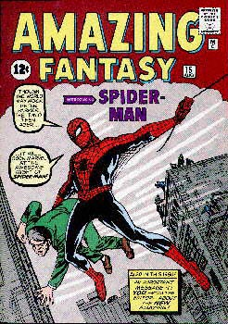
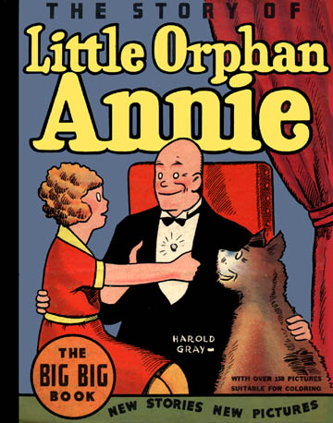
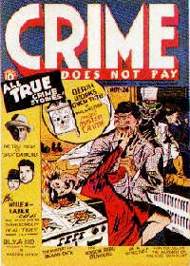
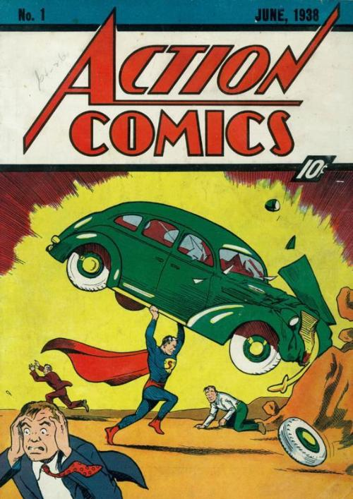
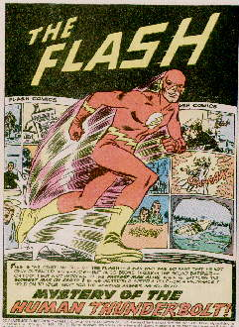
Other Early Comics

Slide 4

First Graphic Novel?
  Under debate, but most people consider Will Eisner’s A Contract with God (1978) to be the first GN in the form we recognize today.
  Told the story of families growing up in poverty in New York City in the 1930’s.

Slide 5

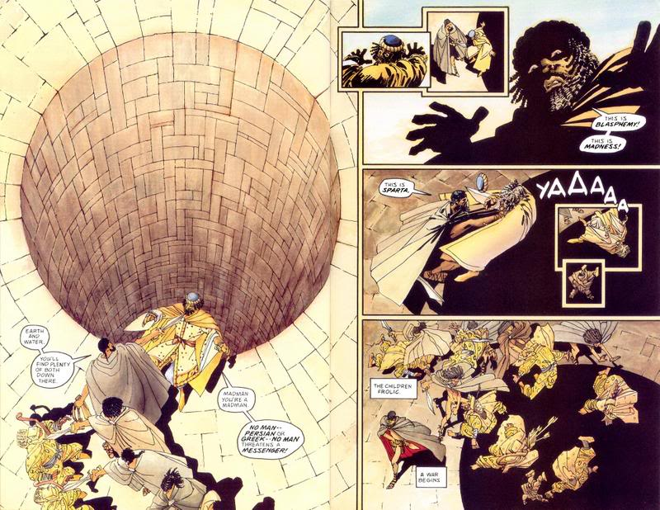
KEY CHARACTERISTICS
Telling a story through images
Use of PANELS
WORD BALLOONS
THOUGHT BALLOONS
American GN are read left to right, top to bottom.

Slide 6
COMPARE/CONTRAST
GRAPHIC NOVELS
MANGA
Graphic novel is the English phrase for sequential art in book form
GNs often targeted at adults
American GNs borrow heavily from manga, including stories and artwork.
Manga is Japanese for “whimsical picture,” and refers to sequential art narratives of any genre
In the US, most manga is read by teens and young adults
Arranged top to bottom then, right to left (opposite of American/Western GN)

Slide 7

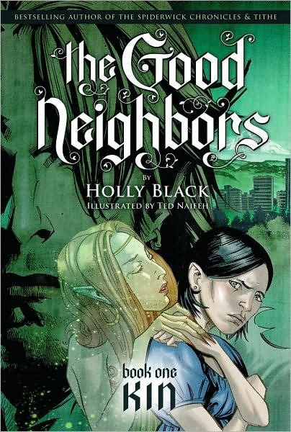
WHICH IS WHAT?
US GN OR MANGA?
GN OR MANGA?

Slide 8
GRAPHIC NOVEL AND FILM
Why do you think GN and film go so well together?
Graphic Novels have been adapted into several films, including:
Men in Black
Batman Begins
V for Vendetta
Hellboy
Art School Confidential
Ghost World
Avatar
The Spiderwick Chronicles
And several books and movies have become graphic novels, including:
Twilight
Fahrenheit 451
The Scarlet Letter
Artemis Fowl
  GN is a very visual, cinematic representation of a story
  Strong, dramatic plot
  Many films use storyboards to develop the look and progression of the movie, like a GN summary of the film
GN use a lot of dialogue, just like a movie

Slide 9
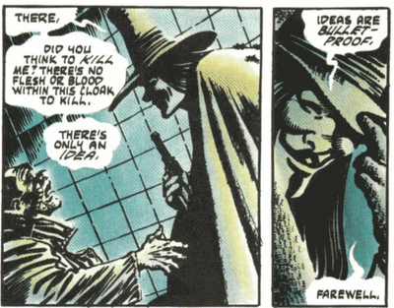
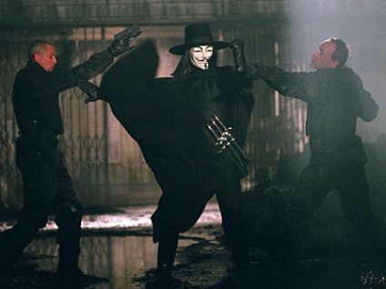
What do you think?
V for Vendetta.
Graphic novel written from 1982-1989,
film produced 2005.

Slide 10
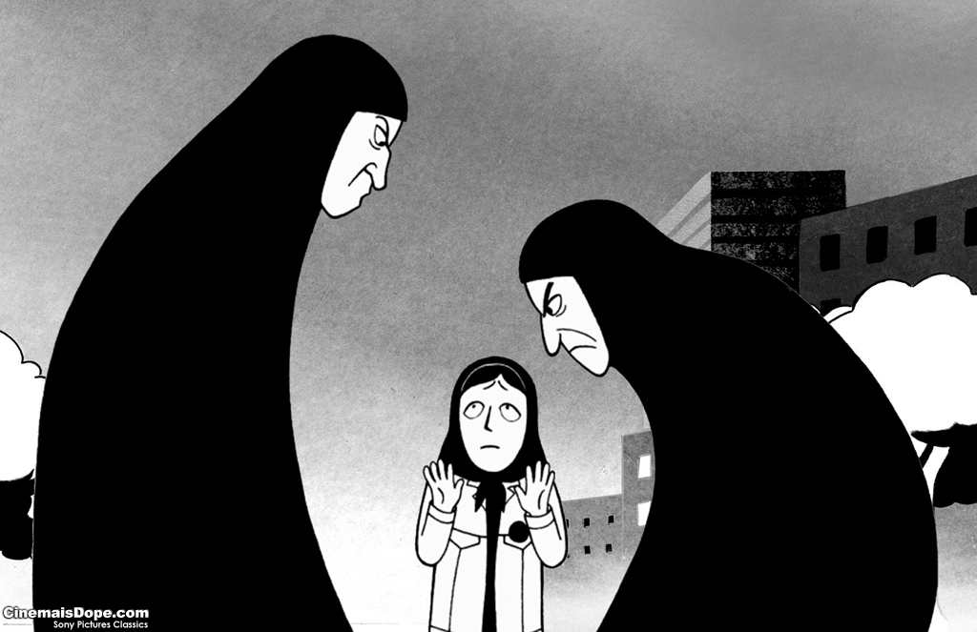
Persepolis and the Graphic Novel Form
As you read the rest of the book, remember the rich tradition that Satrapic is drawing from, and consider why she chose to tell her story as a graphic novel.

Slide 11
resources
Abel, Jessica. “What is a Graphic Novel?” ArtGeek.com. Accessed 9 November 2009.
http://www.artbomb.net/comics/introgn.jsp
Arnold, Andrew D. “The Graphic Novel Silver Anniversary.” TIME. Accessed 9 November 2009. http://www.time.com/time/columnist/arnold/article/0,9565,542579,00.html
Eisner, Will. 1978. A Contract with God. Accessed 9 November 2009. http://www.willeisner.com/books/contract_god.html
“The History of Comics.” Accessed 9 November 2009. http://www.comic-art.com/history/history1.htm
Little, Drego. “In A Single Bound: A Short Primer on Comics for Educators.” Accessed 9 November 2009. http://www.newhorizons.org/strategies/literacy/little.htm

