Slide 1
Gabriel Garcia Marquez
&
Magical Realism
“Realismo mágico”

Slide 2
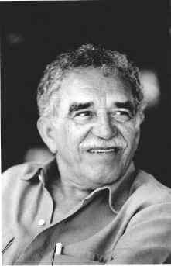

Slide 3
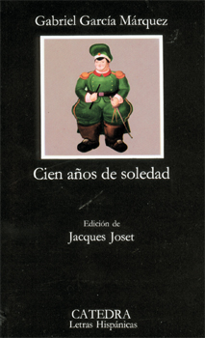
Cien años de soledad
One Hundred Years of
Solitude (1967)

Slide 4
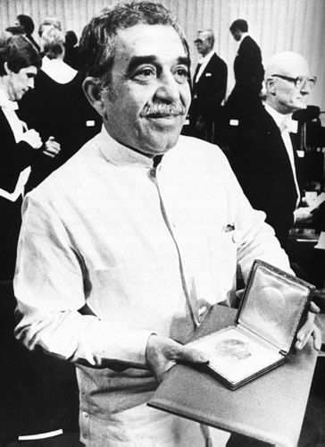
Nobel Prize-Literature
1982

Slide 5
Garcia Marquez
Latin-American journalist
Novelist & short story writer
Central figure in the so-called Magic Realism movement in Latin American literature
Gabriel was born in Aracataca, Colombia in 1928
He died April 17, 2014 in Mexico City.
Aracataca is in the “banana zone” of Colombia

Slide 6
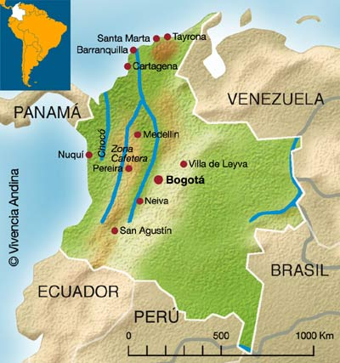
Aracataca

Slide 7
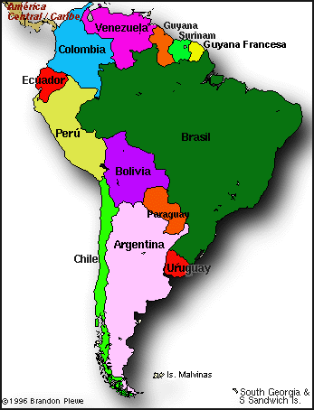

Slide 8
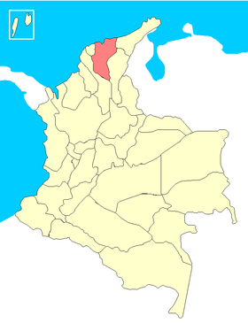
Departamento del Magdalena
Aracataca-(zona bananera)
Colombia is divided in
32 “departamentos”

Slide 9
He was raised by his grandparents
Garcia Marquez studied law and journalism at the National University of Bogota and at the University of Cartagena
In 1948 he started his career as a journalist
He worked all over Europe and in Latin America
In 1955 he was the European correspond in Rome and Paris for the newspaper, El Espectador.

Slide 10
He was founder of Prensa Latina, a Cuban press agency and worked in Prensa Latina offices of Havana and New York
In 1955 appeared his “novella” La Hojarasca (Leaf Storm) which introduced to the public the fictional Colombian village of Macondo
Macondo is the equivalent of William Faulkner’s Yoknapatawpha.

Slide 11
Among other important writers, who have influenced Garcia are Kafka, Virgina Woolf, Juan Rulfo and James Joyce.
In 1982 Garcia Marquez was awarded the Nobel Prize for Literature.
His best known book is One Hundred Years of Solitude (1967) was published by Editorial Sudamericana in Buenos Aires, Argentina.

Slide 12
Garcia Marquez has said that he just tried to tap
“the magic in commonplace events”
As fantastic as the events seem in the novel, they
have much real basis, among them the massacre of
hundreds of workers, which occurred after the banana
workers struck against the United Fruit Company in 1928.
The lost historical consciousness of the villagers is
symbolized by the “insomnia epidemic threatens to wipe
out all layers of identity and culture”.

Slide 13
Magical realism (Realismo Mágico)
Is a artistic genre in which magical elements appear in an otherwise realistic setting.
The term was initially used by German art critic Franz Roh to describe painting which demonstrated another possibility of reality, an altered reality
The term has been attributed to the Cuban writer Alejo Carpentier who first applied it to Latin American fiction in 1949

Slide 14
In the prologue of his novel “The Kingdom of this World (1949);(El Reino de este mundo) Carpentier refers to –”lo real maravilloso”-(roughly “marvelous reality”)
Carpentier’s conception was of a kind of heightened reality in which elements of the miraculous could appear without seeming forced or unnatural.

Slide 15
Magical realism has been popularized by Latin American authors as a literary form, and it has come to be a global phenomenon in world literature
Works of magical realism mingle realistic portrayals of ordinary events and characters with elements of fantasy and myth, creating a rich world that is at once familiar and dreamlike.

Slide 16
More than anything else, magical realism is an attitude toward reality that can be expressed in popular or cultured forms, in elaborated or rustic styles, in closed or open structures
The magical realist doesn’t create imaginary worlds in which we can hide from everyday reality
Is the normal and logical incorporation of supernatural or magical events in our daily reality.

Slide 17
Interview/Garcia Marquez comments
“The tone that I eventually used in One Hundred Years of
Solitude was based on the way my grandmother used to tell
stories. She told things that sounded supernatural and fantastic,
but she told them with complete naturalness….
What was most important was the expression she had on her face.
She did not change her expression at all when telling her stories
and everyone was surprised. In previous attempts to write, I
tried to tell the story without believing in it. I discovered that
what I had to do was believe in them myself and write them with
the same expression with which my grandmother told them: with
a brick face”.

Slide 18
Elements of magical realism
Contains fantastical elements
The fantastic elements may be intuitively “logical” but they are never explained
Characters accept rather than question the logic of the magical element
Exhibits a richness of sensory details
Uses symbols and imagery extensively
Emotions and the sexuality of the human as a social construct are often developed upon in great detail

Slide 19
Distorts time so that it is cyclical or so that it appears absent
Another technique is to collapse time in order to create a setting in which the present repeats or resembles the past
Inverts cause and effect (the character may suffer before the tragedy occurs)
Elements of legend and folklore are incorporated
Uses a mirroring of either past and present, astral and physical planes, or the characters
Presents events from multiple perspectives

Slide 20
Things to consider:
Magical realism challenges our traditional notion of time as a linear process
For magical realists time can move in a circular pattern or even fold in on itself so that earlier events collide with later ones
The point of magical realism may not be plot or character but getting the reader to think in another way about things
The greatest accomplishment of this writing is the use of the metaphors
The author looks to bridge the duality of concepts, like life and death and succeeds by writing metaphorically.
Metaphor in this sense is not a mere literary technique but the essence of expression for new concepts
Metaphorical language both describes new and special and influences the way the mind apprehends reality.

Slide 21
Vocabulary
Garners: To gather or deposit.
Scapular: Christian garment or clothes
Flotsam: Floating wreckage of a ship
Virile: Characterized by energy
Frivolity: Not serious
Nostalgia: Longing for the past.
Promontory: Natural elevation.

Slide 22
In few sentences, describe what you can remember about Magical Realism, Gabriel Garcia Marquez, where he was born, etc.
Speculate why Marquez would be known as a writer of magical realism. Consider how and where he was raised.

Slide 23
After reading the story
After reading “The Most Handsomest Drowned Man in the World”, prepare a short explanation why it is a good example of magical realism.
Begin your explanation by writing the following:
In Gabriel Garcia Marquez’s short story, “The Most Handsomest Drowned Man in the World the author writes about an event that can be considered magical realism, a story containing fantastical elements. [noun phrase]
Type your reaction (approx one page) for the next class.

