Slide 1

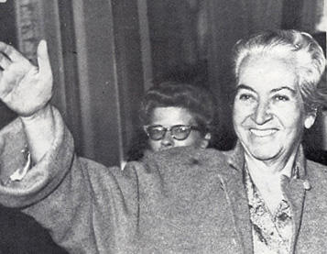
Gabriela Mistral
First Latin American who won the Nobel Prize in Literature

Slide 2
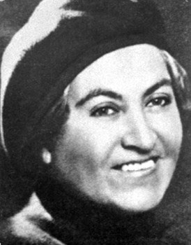
Life
1889-1957
Born in Vicuna Chile
Daughter of a dilettante poet
Really began to write poetry as a village school teacher after her boyfriend committed suicide.
She received the Nobel Prize in Literate in 1945

Slide 3
Gabriela’s Position and Contribution to Chile
Gabriela had an important role in the education systems of Mexico and Chile.
She was an active member in cultural committees of the League of Nations.
Gabriela was in the Chilean council in Naples, Madrid and Lisbon.

Slide 4
Gabriela’s Key Idea’s
Thanking Sweden and Alfred Nobel. She said that she was moved to be honored, to be the voice of Spanish and Portuguese.
She was the first L.A winner of a Nobel Prize.
Quote:
“I am the direct voice of the poets of my race and the indirect voice for all the Spanish and Portuguese tongues.”

Slide 5
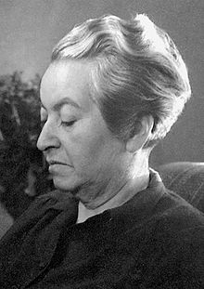
Popular Works
Anniversary
Death Sonnet 1
Dust
Pine Forest
The Alpaca
The Rose
The Shinning Host
The Sad Mother
I Am Not Alone
Song of Death
The Lark
Creed
Decalogue of the Artist
The Stranger- La Extranjera

Slide 6
Analysis of Gabriela’s Text
“Let wind and salt and sand drive you crazy, mix you up so you can’t tell East from West”
Gabriela’s words seem to describe life in a way. She has had so many hardships that spin around her life and completely distorts it. When she comes back to reality her life is nothing like she left it and everything has changed.

Slide 7
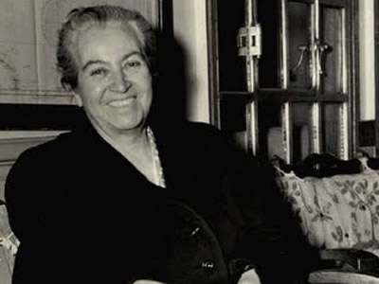
Conclusion
Gabriela Mistral was the first Latin American to win a Nobel Prize in Literature. She was one of the few women to get get the prize. Her work represents nature, betrayal, passion, a mother’s love, sorrow, loss, the struggle of recovery, and Latin American Identity.

Slide 8
By
Devon
Corrina

