Slide 1
Gabriela Mistral
Won the Nobel Peace Prize in 1945, for her poetry.
By: Joy Hardy & Ivanna Hernandez

Slide 2
Biographical Info
Born in Vicuna, Chile in 1889 originally known as Lucila Godoy y Alcayaga
Daughter of a poet, began to write poetry as a village school teacher after romance with railway employee, who committed suicide.
Taught elementary and secondary school until poetry made her famous.
“Sonetos de la Muerte” is a love poem in memory of the dead that made her famous.

Slide 3
Contribution
She played an important role in the educational system of Mexico and Chile.
She was an honorary of different cultural societies in Chile, the US, Spain, and Cuba.
Taught Spanish literature in the US at Columbia University, Middlebury College, Vassar college, and the University of Pueto Rico.

Slide 4
Key ideas
In her acceptance speech, she acknowledges the people of Sweden, Europe, and the American continent.
She’s the voice of woman in Poetry and Latin American poets. “I am the direct voice of the poets of my race and the indirect voice for the noble Spanish and Portuguese tongues.”

Slide 5
Author’s Work
She was recognized as a person as much as her work.
Through her work cultural values and traditions were recognized.
Her work defended the rights of woman, children, the poor, freedom of democracy, and the need of peace.
Her poems were extremely emotional and they kindled the fire in people’s hearts.
Over the years her poems have contributed to Latin Americas culture.

Slide 6
Sonetos de la Muerte
In the poem, she talks in detail how it may feel after death.
The poems purpose has to do with recognizing the dead, and comforting the living.
“….Del nicho helado en que los hombres te pusieron,
te bajaré a la tierra humilde y soleada.
Que he de dormirme en ella los hombres no supieron,
y que hemos de soñar sobre la misma almohada…”

Slide 7
Conclusion
Her poetry has reflected in culture and traditions especially in Latin America. She moved people with her words and gave a voice to all different people. She combined her educational knowledge with her poetic talent to influence those she visited.
"En la tierra seremos reinas,
y de verídico reinar, y siendo grandes nuestros
reinos, llegaremeos todas al mar."

Slide 8
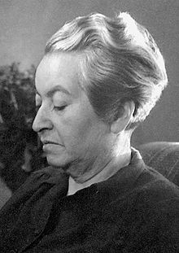
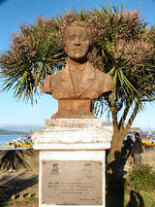
Monument of gabriela

Slide 9
Anniversary
And we go on and on,
Neither sleeping nor awake,
Towards the meeting, unaware
That we are already there.
That the silence is perfect,
And that the flesh is gone.
The call still is not heard
Nor does the Caller reveal his face.
But perhaps this might be
Oh, my love, the gift
Of the eternal Face without gestures
And of the kingdom without form!

Slide 10
Thank
You
☺

