Slide 1
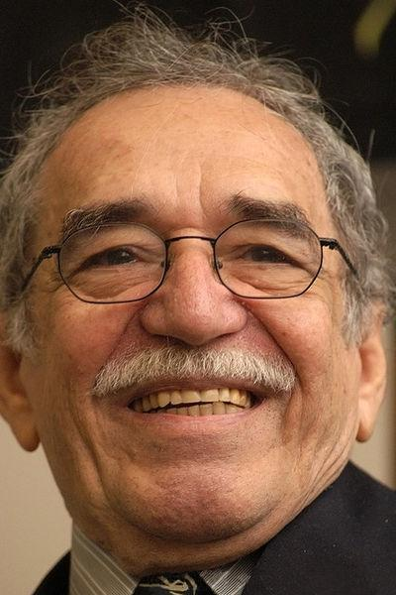
Gabriel Garcia Marquez
Born on March, 6, 1928 in Columbia
Became to be known worldwide for his book "Cien aos de soledad" translated to "One Hundred Years Of Solitude"
Became a Journalist after college
By creating the Book "One Hundred Years Of Solitude" Gabriel is considered to contributed to the creation "Magical Realism"

Slide 2
Contribution To His Home Country
After Writing One Hundred Years of Solitude he went back to see his family in Barcelona, Spain, Catalonia. He stayed away for seven years, during this time he worked with the Colombian government against the guerrillas, including in the 19th of April movement or (M-19). Also known to have relationships with powerful leaders like Fidel Castro.

Slide 3
Nobel Prize Acceptance Speech
Awarded the Nobel prize for literature in 1982
Awarded for his novels and stories involving fantastic and wonderful thing mixing into the real world creating something called magical realism.
In Marquez speech he talks about European Colonialism, and the removal of terrorism in Latin American Culture. He also calls out some specific Latin American countries that have been affected by foreign policies.

Slide 4
Contributions to literature
Gabriel Garcia Marquez i considered to be one of the people who created a style of writing called "Magical Realism"

Slide 5
Conclusion
Gabriel Garcia Marquez was a large contribution to because he was the first to mix magic with realisliteraturem creating a new genre.

