Slide 1
Frida Kahlo
Frida Kahlo de Rivera was a Mexican painter, born in Coyoacán, who is best known for her self-portraits. Kahlo's life began and ended in Mexico City, in her home known as the Blue House. Wikipedia

Slide 2
Mexican culture and Amerindian cultural tradition figure prominently in her work, which has sometimes been characterized as Naïve art or folk art. Her work has also been described as "surrealist", and in 1938 one surrealist [Andre Breton] described Kahlo herself as a "ribbon around a bomb".

Slide 3
Frida was one of four daughters born to a Hungarian-Jewish father and a mother of Spanish and Mexican Indian descent.
At the age of 18, she was seriously injured in a bus accident. She spent over a year in bed recovering from fractures to her spine, collarbone and ribs, a shattered pelvis, and shoulder and foot injuries. She endured more than 30 operations in her lifetime and during her convalescence she began to paint.

Slide 4
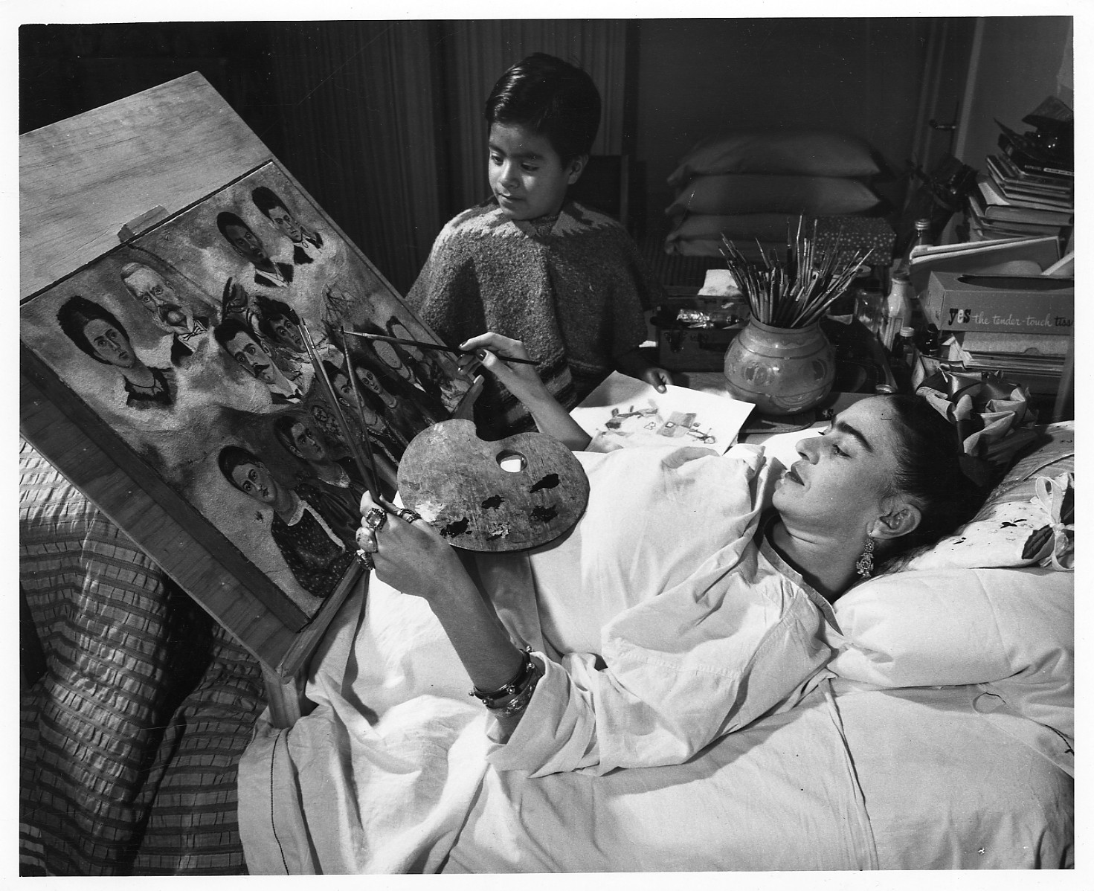

Slide 5
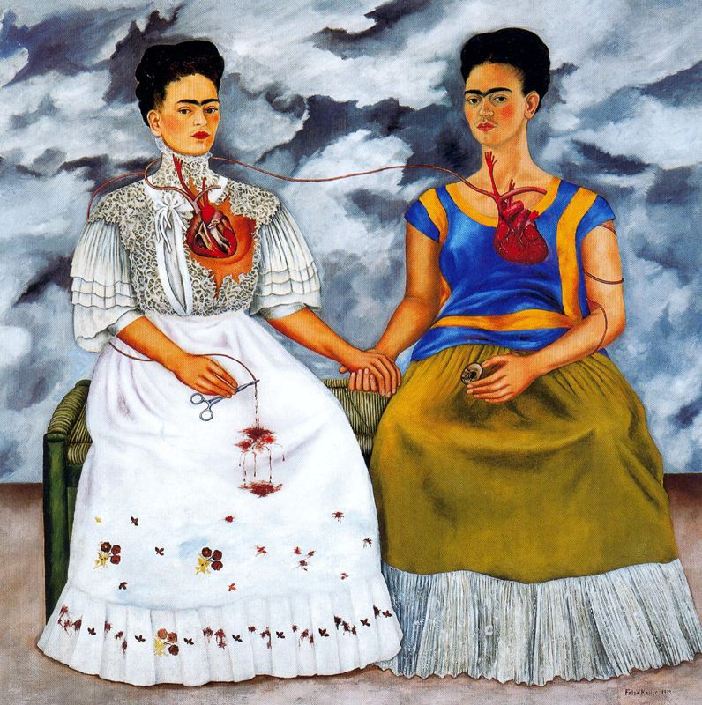
The Two Fridas

Slide 6
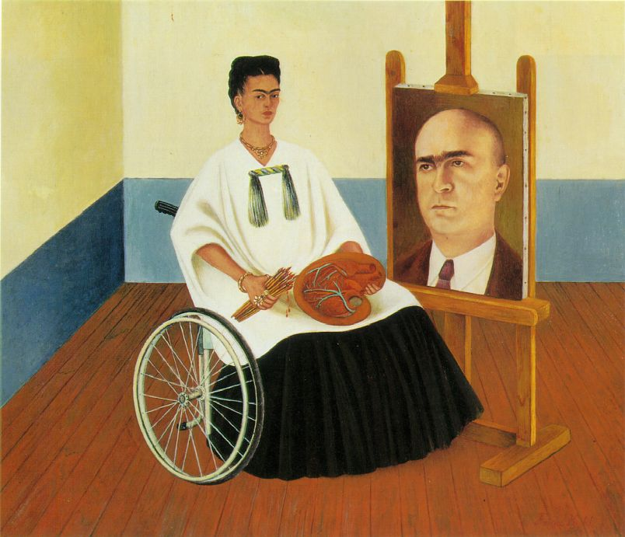
Self-Portrait with the Portrait of Doctor Farill 1951

Slide 7
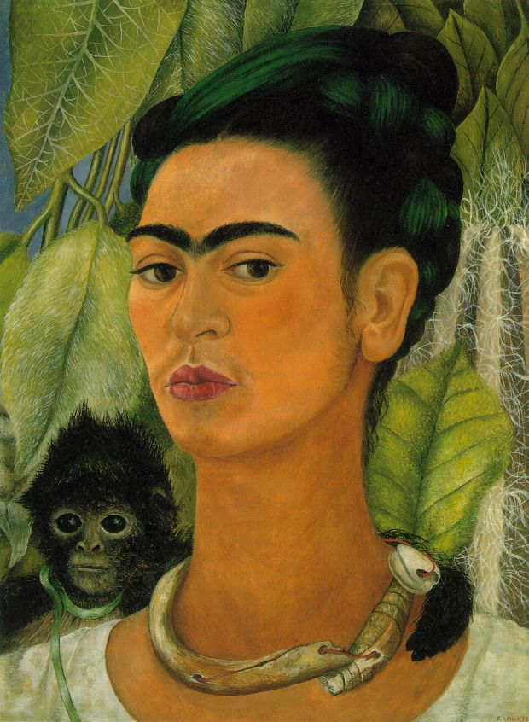
Self-portrait with monkey

Slide 8
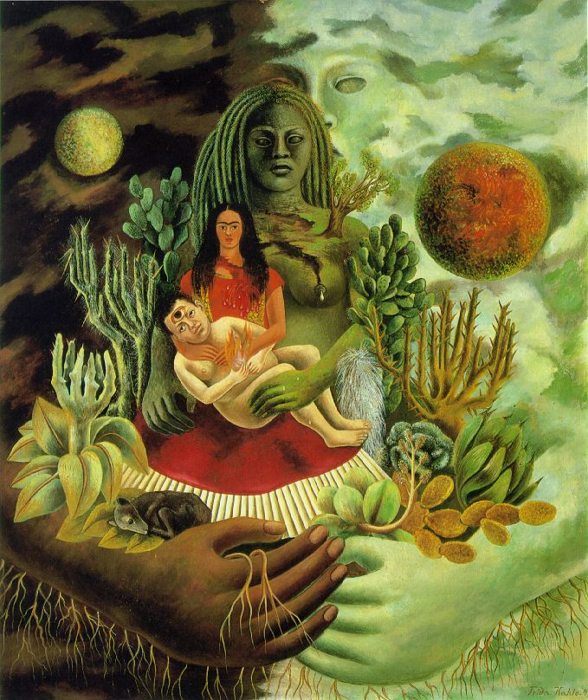
The Love Embrace of the Universe, the Earth (Mexico), Me, and Senor Xolotl
1949

Slide 9
Theme, culture and personal identity
The subject of a talk, a piece of writing, a person's thoughts, or an exhibition; a topic.
Answer the following questions:
What is the ‘theme’ of some of these works by Frida Kahlo?
What is the artist saying about the subject she has painted?
Explain how Frida’s paintings exhibit a sense of cultural and personal identity?

