Slide 1
Objective
How society and culture is constructed.

Slide 2
Essential Questions
Persepolis

Slide 3
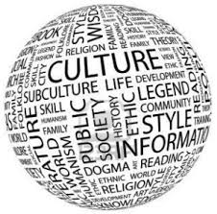
What are the benefits and boundaries of a culture?

Slide 4
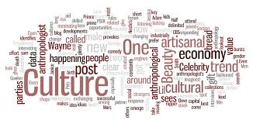
How is our understanding of society and culture constructed?

Slide 5
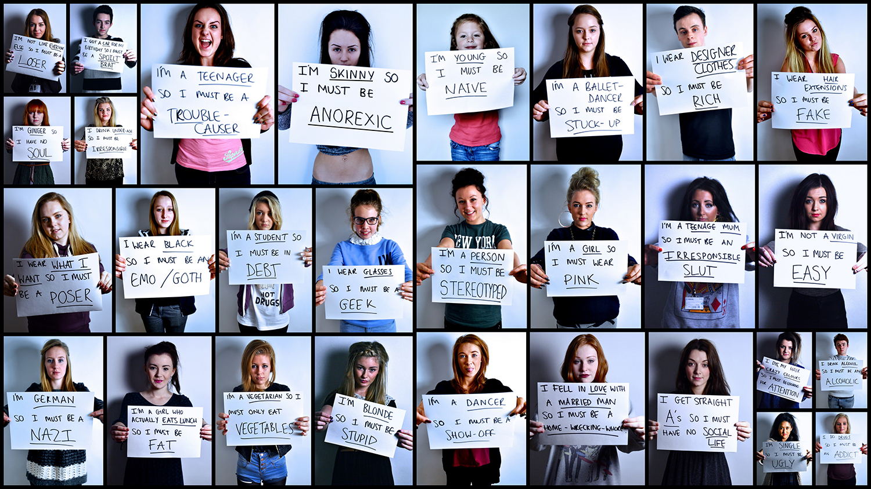
How are stereotypes constructed and deconstructed?
stereotype: a widely held but fixed and oversimplified
image or idea of a particular type of person or thing.

Slide 6
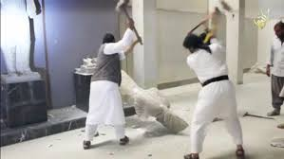
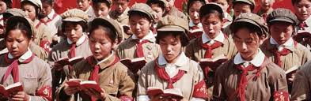
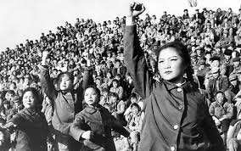
How are children and young adults affected by a cultural revolution?

Slide 7
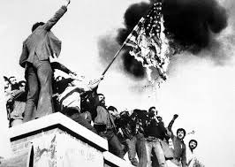
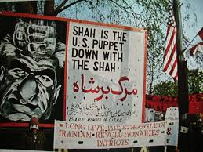
How do cultures radicalize people?

Slide 8
Vocabulary from The Secret Garden
Dissimulation
Vigilante
Reconcile
Potentate
Iconoclast

Slide 9
dis·sim·u·la·tion
dəˌsimyəˈlāSH(ə)n/
noun
concealment of one's thoughts, feelings, or character; pretense.

Slide 10
vig·i·lan·te
ˌvijəˈlan(t)ē/
noun
plural noun: vigilantes
a member of a self-appointed group of citizens who undertake law enforcement in their community without legal authority, typically because the legal agencies are thought to be inadequate.

Slide 11
rec·on·cile
ˈrekənˌsīl/
verb
restore friendly relations between.

Slide 12
po·ten·tate
ˈpōtnˌtāt/
noun
a monarch or ruler, especially an autocratic one.

Slide 13
i·con·o·clast
īˈkänəˌklast/
noun
1.
a person who attacks cherished beliefs or institutions.

