Slide 1
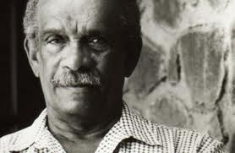
Derek Walcott
A Latin American Nobel Prize Winner

Slide 2
Biographical Info.
Derek Walcott was born in Castries on the island of Saint Lucia, North of Venezuela, in 1930
He was a poet and a playwright.
He was raised in a catholic family under French colonial rule.
His father died when he was about 2 years old

Slide 3
Early Adulthood
After studying in a local college, he moved to Trinidad in 1953.
At age 18, he made a debut with 25 Poems but his breakthrough was with the Green Night a collection of poems published.
He was mostly into writing books of poetry and writing plays.
He would the classic, folklore, and history in with the vernacular language.

Slide 4
Career
In 1981, he was hired as a professor at Boston University.
He wrote books of poetry and plays on a regular basis for about two decades.
His poem Omeros, which references characters of The Iliad and The Odyssey, was praised as his major achievements.
He won the Nobel Prize for Literature in 1992, the first Caribbean writer to be awarded.

Slide 5
Acceptance Speech
He mentions the broken language of the Caribbean and the struggle of other Caribbean writers.
He dedicated the award to them and wants to support them with their struggles of coming through.
Since he was the first Caribbean writer to be awarded he doesn’t want to be the last.

Slide 6
After the Nobel Prize
He kept on writing books throughout 1992 to 2010
In 2009 he started a three year scholar in residence position in the University of Alberta
In 2010 he became a proffesor of the University of Essex

