Slide 1
Dante’s Inferno
Images by William Blake, Gustave Dore, Sony PSP, and others.

Slide 2
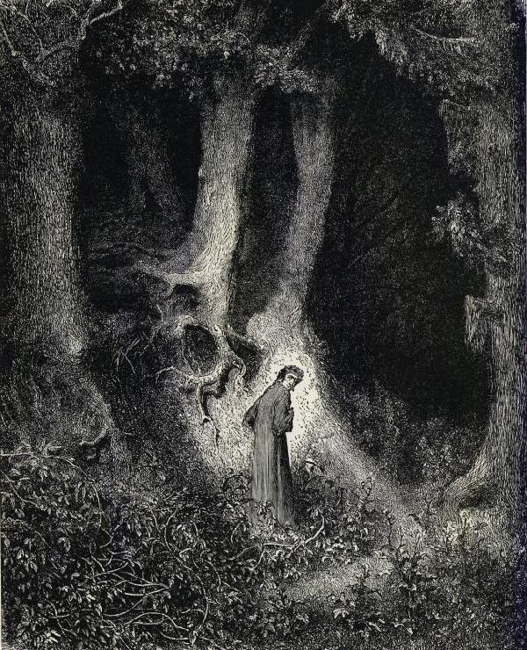
Dante goes astray in the Dark Wood

Slide 3
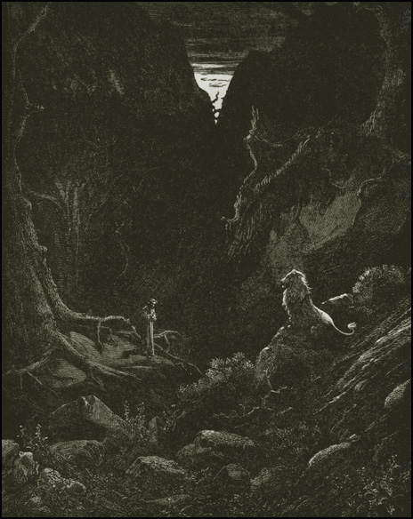
The Lion suddenly confronts Dante

Slide 4
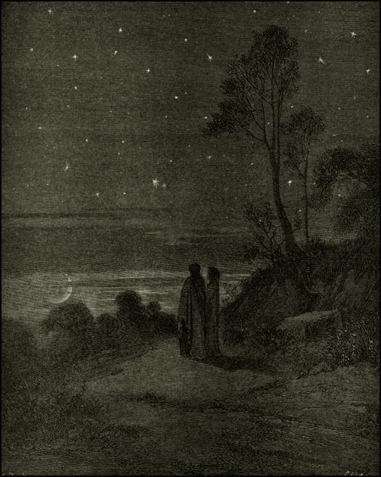
The Darkening Sky of the First Night

Slide 5
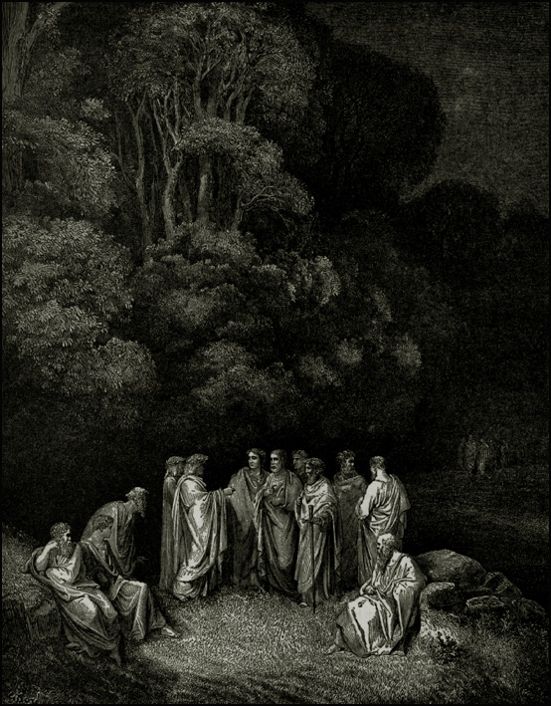
Homer and the other Classical Poets by Gustave Dore

Slide 6
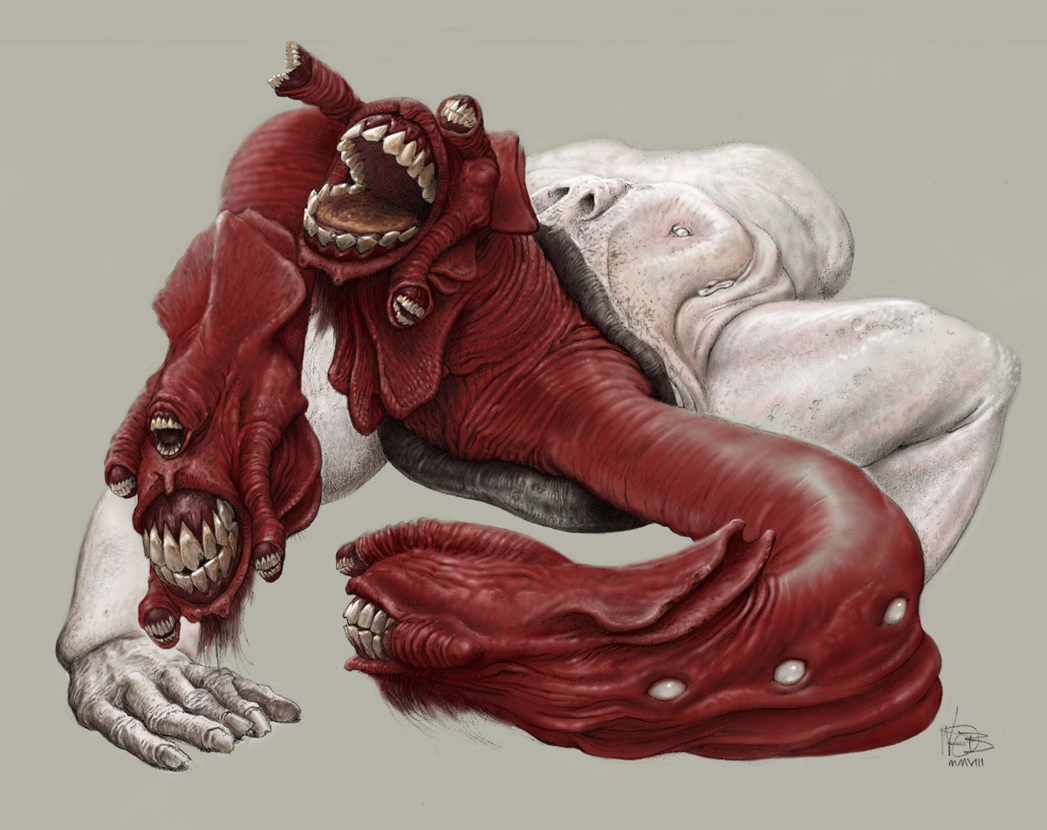
Cerebrus

Slide 7
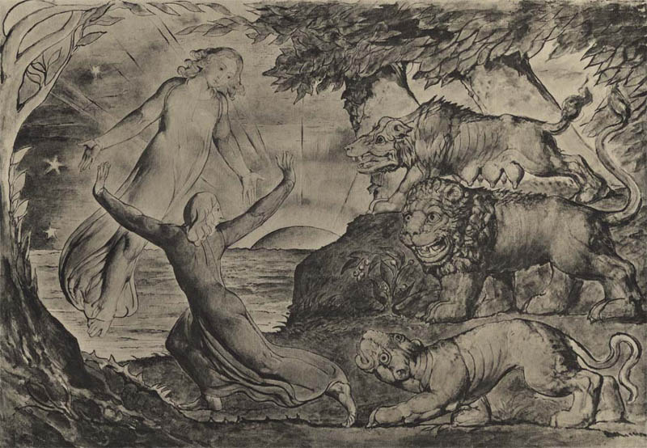
The Three Beasts by William Blake

Slide 8
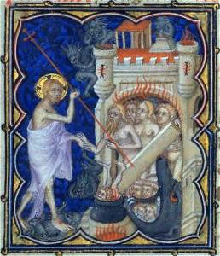
The Harrowing of Hell

Slide 9
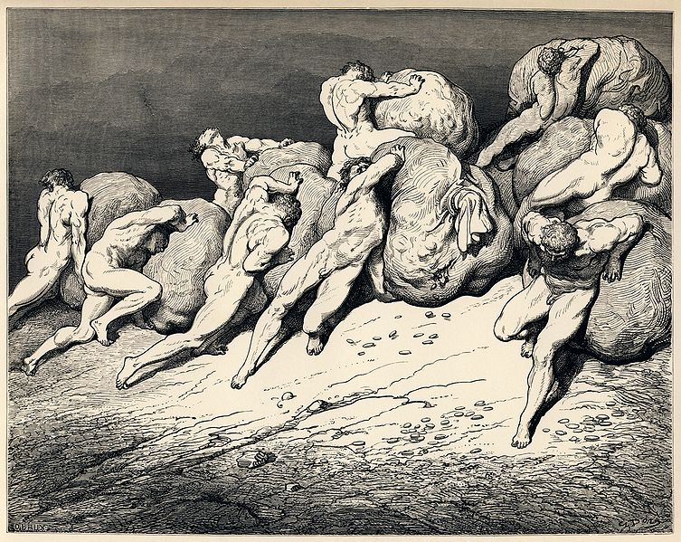
Fourth Circle - Greed

Slide 10
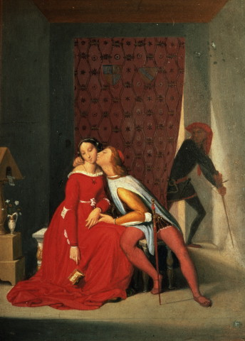
Gianciotto Discovers Paolo and Francesca

Slide 11
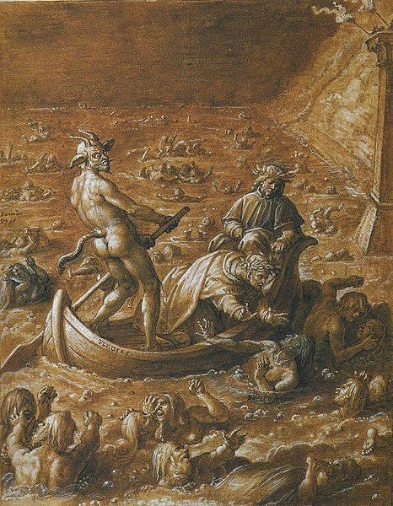
The Fifth Circle

Slide 12
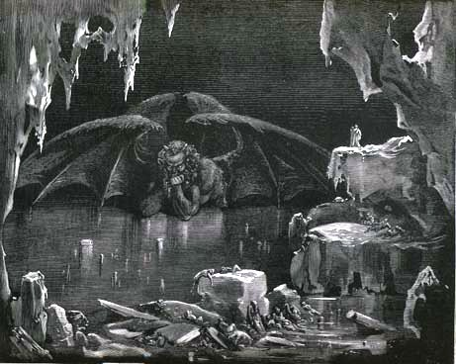
Satan is trapped in the Ninth Circle

