Slide 1
Civil War in New Mexico

Slide 2
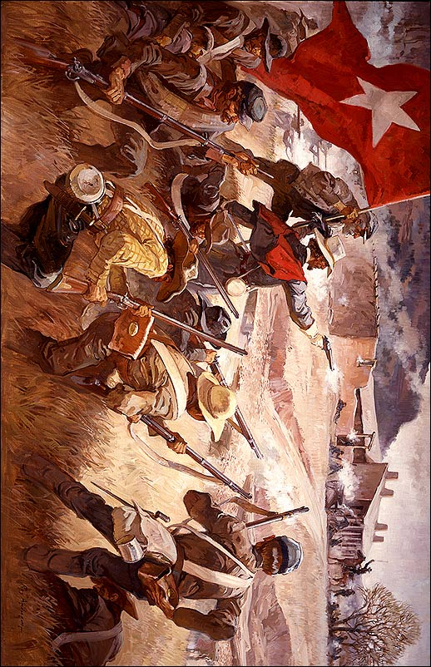

Slide 3
When and in what region of the country might the battle represented here have taken place?
Why is New Mexico, or the Battle of Glorieta Pass so important to our history and the history of the Civil War?

Slide 4
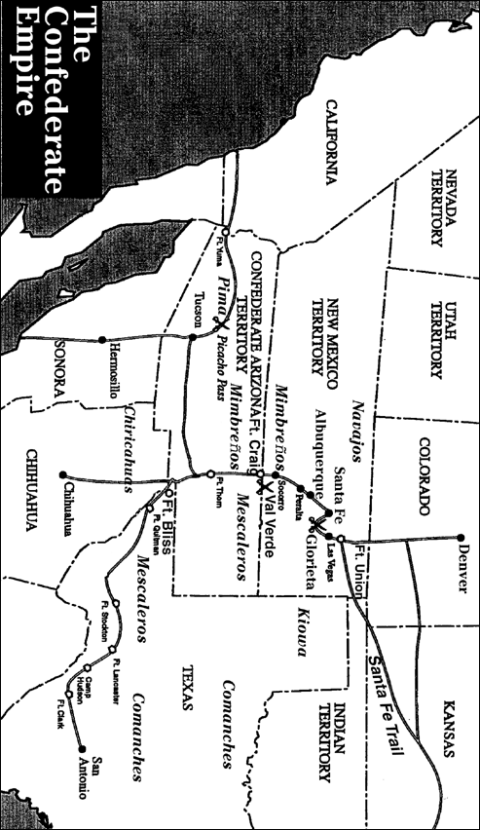
Map of New Mexico Territory

Slide 5
Questions for Map 1
1. Study the territories and states as they existed in 1862. How does this map differ from a modern map of the United States?
2. Locate the Santa Fe Trail. Name the states or territories shown on this map through which the trail passed on the way to Santa Fe.
3. Why did the Confederacy want to win control of New Mexico Territory?
4. What Indian tribes may have had an interest in the outcome of the war between the Union and the Confederacy in this region?

Slide 6
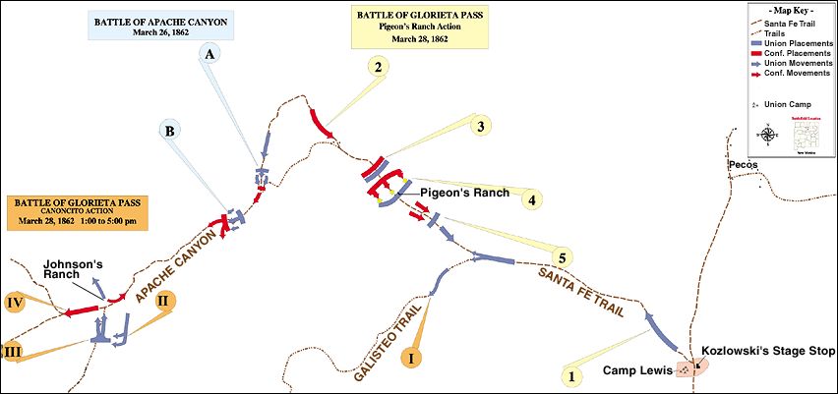
Map of Battle of Glorieta Pass

Slide 7
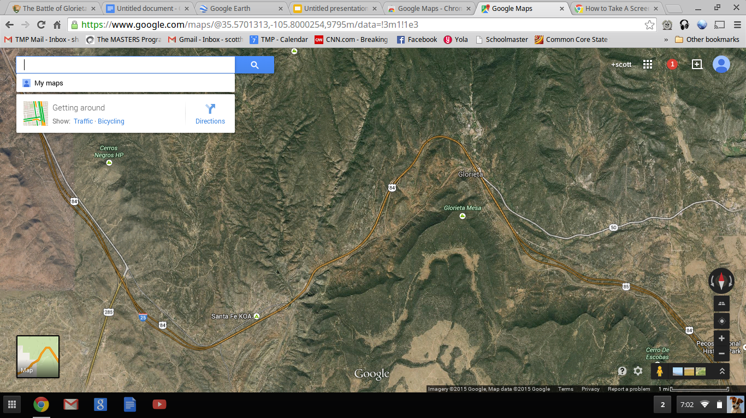

Slide 8
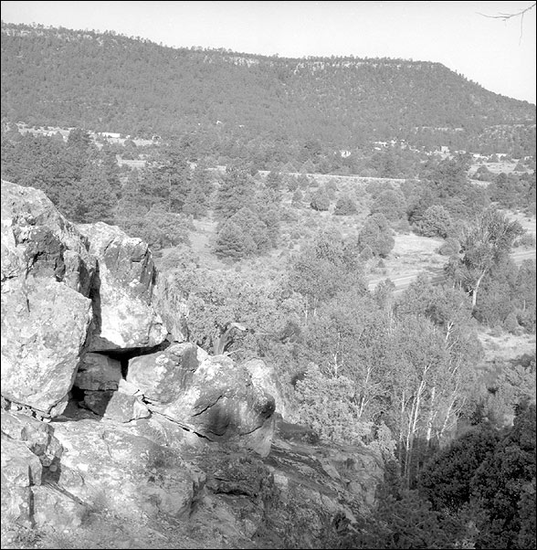
Sharpshooter Ridge
This photograph was taken in 1990 from Sharpshooter's Ridge, just north of Pigeon's Ranch. It was the location of the Union right flank during the last day's battle. Much of the land in and around the battlefield remains intact because of its isolation from cities and the nature of the terrain.
Questions for Photo 2
1. Why was Sharpshooter's Ridge a strategic position for the Colorado Volunteers serving in the Union army?
2. Do you think it is important to preserve the battlefield from any future development and change? Why or why not?

Slide 9
Impact of the Confederate Invasion
Activity 2: Impact of the Confederate Invasion
Have the class examine Peticolas' diary entry in Reading 2 and discuss the following questions:
1. What evidence does he include about a local residence?
2. Why do you think there were no people at the house?
3. When the people who lived at the house returned to their home after the battle how do you think they might have felt when they discovered that soldiers had broken into their home and slept there using the woman's clothes like a blanket?
4. How do you think the residents might have felt if they returned to their ranch to find bodies of dead or wounded soldiers or fresh graves?
5. Do you think that individuals holding either strong Union or Confederate views would react differently than those who held to the frontier tradition of helping out those in need? Why or why not?

Slide 10
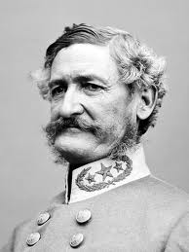
CSA Brigadier General Henry Hopkins Sibley

Slide 11
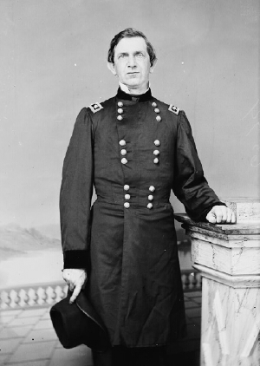
Union General Edward Canby

