Slide 1
William Blake -
Songs of Innocence and of Experience

Slide 2
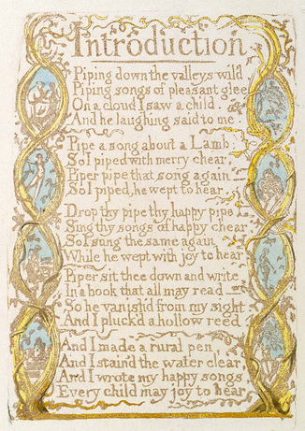
Introduction
INTRODUCTION
Piping down the valleys wild,
Piping songs of pleasant glee,
On a cloud I saw a child,
And he laughing said to me:
‘Pipe a song about a Lamb!’
So I piped with merry cheer.
‘Piper, pipe that song again.’
So I piped: he wept to hear.
‘Drop thy pipe, thy happy pipe;
Sing thy songs of happy cheer!’
So I sung the same again,
While he wept with joy to hear.

Slide 3
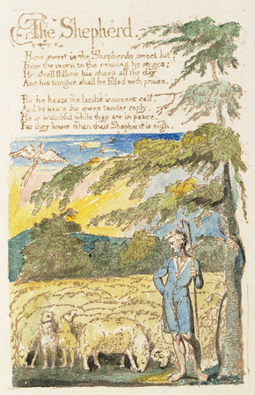
The Shepherd
How sweet is the shepherd’s sweet lot!
From the morn to the evening he strays;
He shall follow his sheep all the day,
And his tongue shall be fillèd with praise.
For he hears the lambs’ innocent call,
And he hears the ewes’ tender reply;
He is watchful while they are in peace,
For they know when their shepherd is nigh.

Slide 4
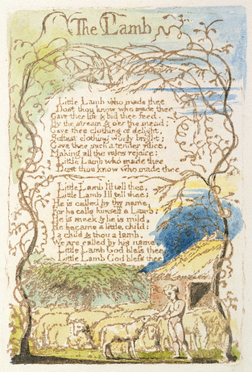
THE LAMB
Little lamb, who made thee?
Does thou know who made thee,
Gave thee life, and bid thee feed
By the stream and o’er the mead;
Gave thee clothing of delight,
Softest clothing, woolly, bright;
Gave thee such a tender voice,
Making all the vales rejoice?
Little lamb, who made thee?
Does thou know who made thee?
Little lamb, I’ll tell thee;
Little lamb, I’ll tell thee:
He is callèd by thy name,
For He calls Himself a Lamb.
He is meek, and He is mild,
He became a little child.
I a child, and thou a lamb,
We are callèd by His name.
Little lamb, God bless thee!
Little lamb, God bless thee!

Slide 5
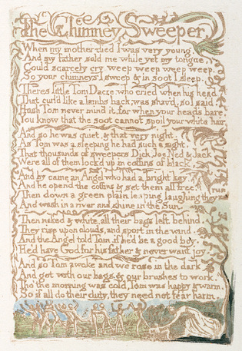
The Chimney Sweeper
When my mother died I was very young,
And my father sold me while yet my tongue
Could scarcely cry ‘Weep! weep! weep! weep!’
So your chimneys I sweep, and in soot I sleep.
There’s little Tom Dacre, who cried when his head,
That curled like a lamb’s back, was shaved; so I said,
‘Hush, Tom! never mind it, for, when your head’s bare,
You know that the soot cannot spoil your white hair.’

Slide 6
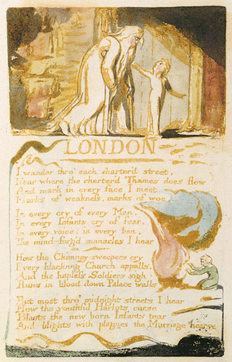
London
I wander through each chartered street,
Near where the chartered Thames does flow,
A mark in every face I meet,
Marks of weakness, marks of woe.
In every cry of every man,
In every infant’s cry of fear,
In every voice, in every ban,
The mind-forged manacles I hear:
How the chimney-sweeper’s cry
Every blackening church appals,
And the hapless soldier’s sigh

Slide 7
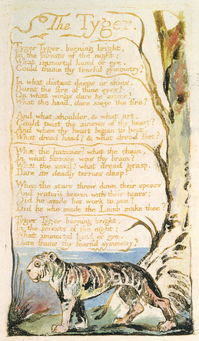
The Tyger
Tiger, tiger, burning bright
In the forests of the night,
What immortal hand or eye
Could frame thy fearful symmetry?
In what distant deeps or skies
Burnt the fire of thine eyes?
On what wings dare he aspire?
What the hand dare seize the fire?
And what shoulder and what art
Could twist the sinews of thy heart?
And, when thy heart began to beat,
What dread hand and what dread feet?

